Slide 1
“Keep Learning On Track for Success”
2018 Washington Fire Administrative Support Conference
May 7-8, 2018
Harold D. Scoggins, Fire Chief
Seattle Fire Department

Slide 2
Thank You’s
Washington Fire Administrative Support Board
Ashley-Chair, Louise-Vice Chair, Cindy-Sec./Tres., Cathy & Lisette-Western Reps., Mykel-Eastern Reps. and Jamie-Communications
Each of the Presenter’s
John Norlin, Pat Ellis, Catherine Cadoo, Andrew Healy and Jordan Peabody
The many sponsors it takes to make this event happen
Bias, Browne Family Vinyards, Enduris, Hot Mama‘s Espresso, Interstate All Battery Center, Kellogg’s Cellars, LN Curtis, McLendon Hardware, Northwest Admins, Northwest Safety Clean, Olive Catering, Tumwater FF L-2409, Visit Walla Walla and WSFF Trn & Ed Fund
Most of all, Thank You to each of You!

Slide 3
A bit about me…
I am a Proud Product of the LA Unified Public School System
I figured it out when I went into the USFA 1984-1989
Glendale Fire Department from 1989 – 2015, FF to FC
Education: AS, BS, MS, Cert Chief Officer….
In Service to others…
SFD 2015 to the Present…

Slide 4
“Keep Learning On Track for Success”

Slide 5
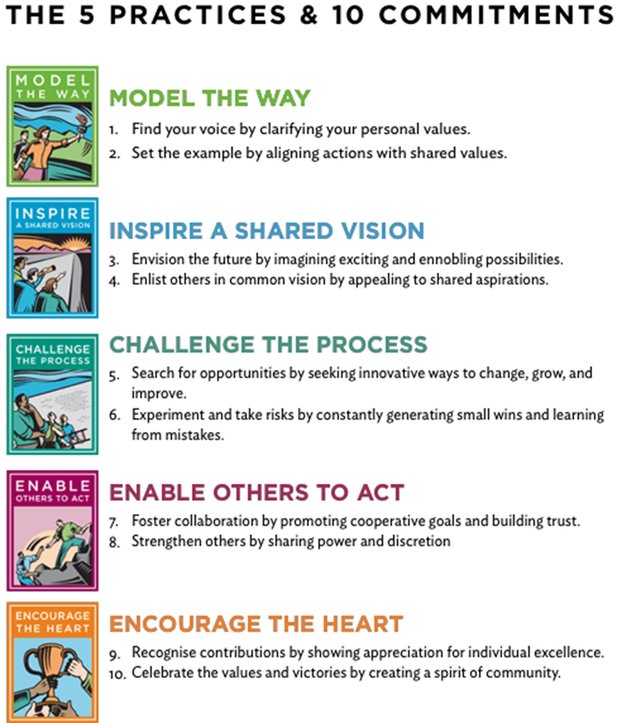
Understand what it takes
Commit the time to growth
Challenge the Status Quo
Reflect on where you are and where you want to be
Don’t be defensive with thought
The Leadership Challenge, Kouzes & Posner

Slide 6
Belief in Mission
Mission (MVVP) sets your compass & Purpose is your Why
Easy to buy in to something bigger than self
Connects you to a community
Helps you understand what you are reaching
for or contributing too

Slide 7
Start with Why, Simon Sinek

Slide 8
Lead Yourself 1st
Be disciplined
Know where you are going
There is nothing like a solid foundation
Put practical steps in place for growth

Slide 9
Don’t Fear Failure
Take the Challenge, do things that others said you couldn’t
Don’t get caught up in complaining, blaming or making excuses
Take intentional steps toward growth WHEN Failure happens, because it will
Build on your strengths, pour into weaknesses
Get out of your comfort zone

Slide 10
“Keep Learning On Track for Success”

Slide 11
See your future
Don’t be afraid to see your path
(Drive to Long Beach)
Understand what it takes to achieve
your goals
You have to see it first

Slide 12
Know Who’s in your circle?
Are you Building Relationships?
Being Mentored or Mentoring?
Are you building trust?
Are they/you Positive or Cynical?
What are you pouring into you?

Slide 13
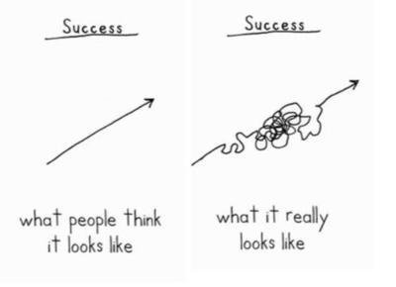
understand it’s a messy process!
It takes many tries to get it right
Its may not look like to thought when you started
It will be frustrating getting there
Sometimes, it will challenge everything you
thought it was supposed to be
You have to believe every effort was worth it.

Slide 14
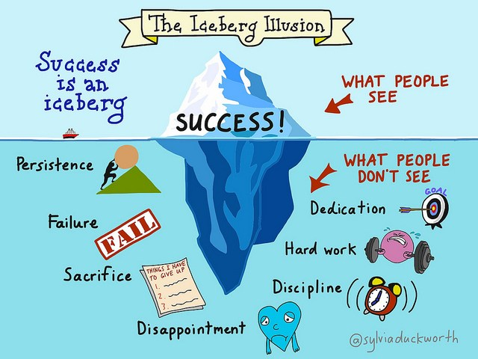
“Keep Learning On Track for Success”
Understand what it takes
Belief in Mission
Lead yourself 1st
Don’t Fear Failure
See your future
Know who’s in your circle
Understand, It’s a Messy Process
Enjoy, the moment!

Slide 15
Questions???
Patience and perseverance have a magical effect before which difficulties disappear and obstacles vanish.
John Quincy Adams

