Slide 1


Date
Location

Slide 2
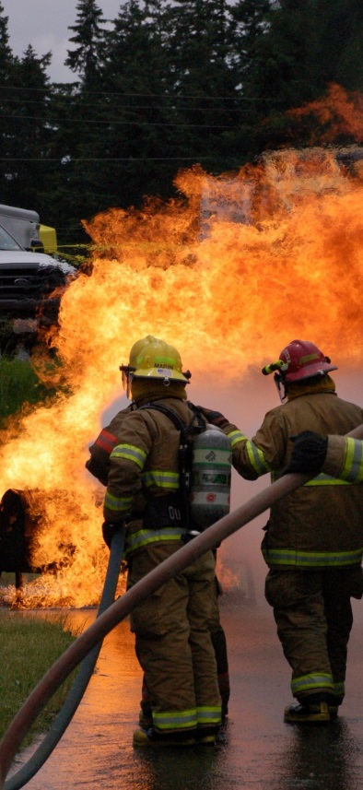
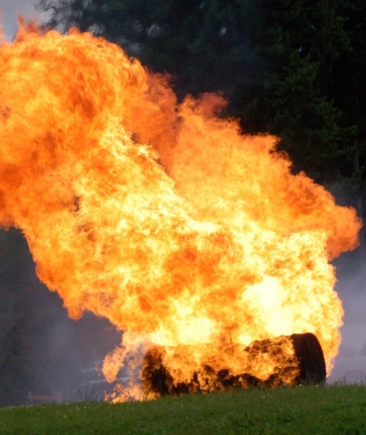
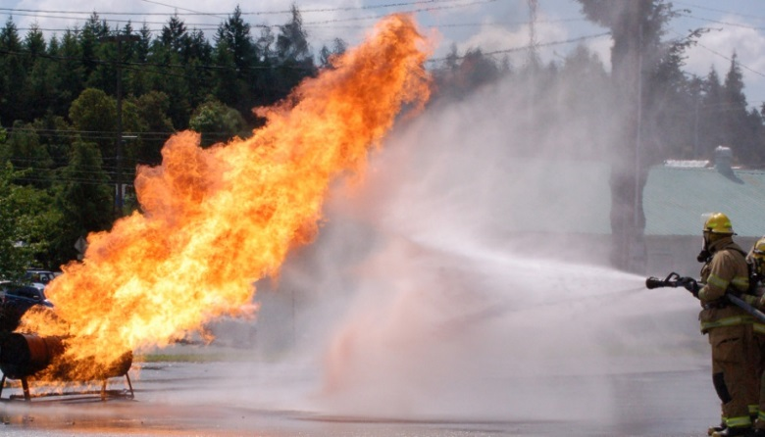
WAC 296.305 application to:
LIVE FIRE TRAINING

Slide 3
Objectives:
Who influences fire service regulation
What is live fire training
What are the mandatory training subjects relating to Live Fire Training
Have access to check lists for safe operations at live fire training

Slide 4

WA
State
Who Influences Our Training
NFPA
TRNG
Private
Interest
Public
Interests

Slide 5
Who Influences Regulation
WA
State
A collection of Session Laws (enacted by the Legislature, and signed by the Governor, or enacted via the initiative process), arranged by topic, with amendments added and repealed or laws removed

Slide 6
Who Influences Regulation
NFPA
Its more than 200 technical code- and standard- development committees have over 6,000 volunteer seats. Members are from private and public interests.
This WAC is effected by NFPA standards.

Slide 7
Who Influences Regulation
Public
Interests
Citizens, informal groups and Fire Department members that lobby for change.

Slide 8
Who Influences Regulation
Private
Interest
Private interests include:
IAFF, IAFC, Association of Washington Cities, WSCFF, Etc.

Slide 9
What are the two resources
WA
State
NFPA
TRNG

Slide 10
What do the NFPA influences effect
NFPA
NFPA Section 1410 – Live Fire Training
WA
State
TRNG
In conjunction with General Safety and Health Standards of
L & I.
Mandatory
WAC 296-305

Slide 11
What is Live fire training: Any fire set within a structure, tank, pipe, pan, etc., under controlled conditions to facilitate the training of firefighters under actual fire conditions.

Slide 12
Why would there be a problem with live fire training?
Career Lieutenant and Fire Fighter Die in a Flashover During a Live-Fire Training Evolution – Florida
On July 30, 2002, a 32-year-old male career Lieutenant (Victim #1) and a 20-year-old male career fire fighter (Victim #2) died while participating in a live-fire training evolution. A flashover occurred several minutes after the fire had been lit in the acquired vacant structure
U.S. Fire Administration/Technical Report Series
Three Firefighter Fatalities in Training Exercise
Milford, Michigan
USFA-TR-015/October 1987
An unusual training exercise involving simulated arson sets and live firefighting evolutions in an abandoned farmhouse resulted in the deaths of three volunteer firefighters and injuries to three others.
Third Baltimore Fire Official Suspended Following Recruit's Death
BALTIMORE-- Another Baltimore city fire official has been suspended after the death of a recruit during a live fire training exercise last week.

Slide 13
The following slides are a brief review of the NFPA 1403 standard that WAC 296-305 refers to.
Consult the entire NFPA and WAC standards before conducting a live fire training.
This class is considered an orientation to live fire burn best practices.
Common sense must be utilized in conjunction with all applicable rules and regulations during any training.
Remember, 10% of Line of Duty Deaths occur during training.
Control as many aspects of live fire as you can but immediately stop any and all unsafe acts before an injury occurs.

Slide 14
4.3 Student Prerequisites.
Prior to being permitted to participate in live fire training evolutions, (all) student shall have received training to meet the minimum job performance requirements for Fire Fighter I

Slide 15
WAC Mandated Training
That must be completed before live fire
Basic Fire Training
  Hose Evolutions
  Nozzles
  Fire Streams
  Tools and Equipment
  SCBA Care/Use
  Search & Rescue
  Ventilation
  ICS
Safety
Respiratory Protection
Passport Accountability
Asbestos training
TRNG

Slide 16
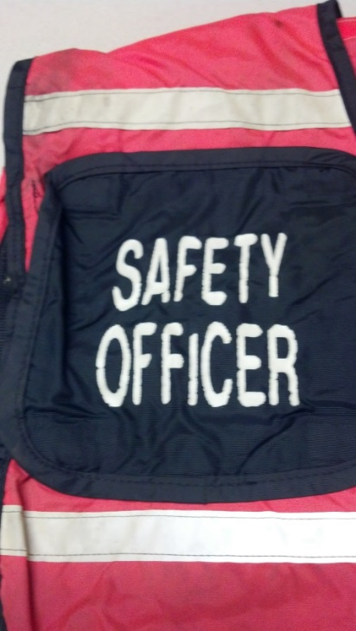
4.4 Safety Officer.
4.4.1 A safety officer shall be appointed for all
live fire training evolutions.
4.4.2 All live fire training instructors and safety
officers shall be trained on the application of
the requirements contained in this standard.
4.4.4 The responsibilities of the safety officer
shall include, but not be limited to, the following:
(1) Prevention of unsafe acts
(2) Elimination of unsafe conditions
4.4.6 The safety officer shall not be assigned other duties that
interfere with safety responsibilities.

Slide 17
4.6 Instructor in Charge and Instructors
4.6.1 The instructor-in-charge shall have received training to meet the minimum job performance requirements for Fire Instructor I
4.6.2 The instructor-in-charge shall be responsible for full compliance with this standard.
4.6.4 The instructor-in-charge shall assign the following personnel:
(1) One instructor to each functional crew, each of which shall not exceed five students
(2) One instructor to each backup line
(3) One additional instructor for each additional functional assignment

Slide 18
4.6.7 Additional instructors shall be designated when factors such as extreme temperatures or large groups are present, and classes of long duration are planned.
4.6.9 Instructors shall take a personal accountability report (PAR) when entering and exiting the structure or prop during an actual attack evolution conducted in accordance with this standard.
4.6.11 Awareness of weather conditions, wind velocity, and wind direction shall be maintained, including a final check for possible changes in weather conditions immediately before actual ignition.

Slide 19
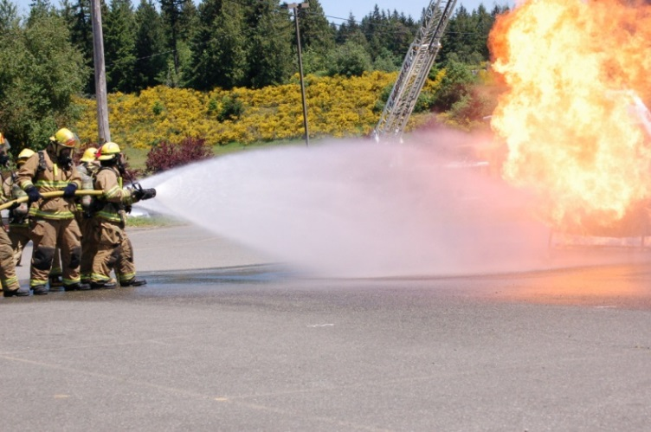
4.6.12 Training Instructors on How to Use Specialty Props.
4.6.12.1 The instructors and the safety officer responsible for
conducting live fire training evolutions with a gas-fueled training system or with other specialty props (such as flashover simulator) shall be trained in the complete operation of the system and the props.

Slide 20
4.6.12.2 The training of instructors and the safety officer shall be performed by an individual authorized by the gas fueled training system and specialty prop manufacturer or by others qualified to perform this type of training.

Slide 21
4.7 Fire Control Team
4.7.1 A fire control team shall consist of a minimum of two
personnel.
4.7.1.1 One person who is not a student or safety officer shall
be designated as the “ignition officer” to ignite, maintain, and
control the materials being burned.
4.7.2 The decision to ignite the training fire shall be made by
the instructor-in-charge in coordination with the safety officer.

Slide 22
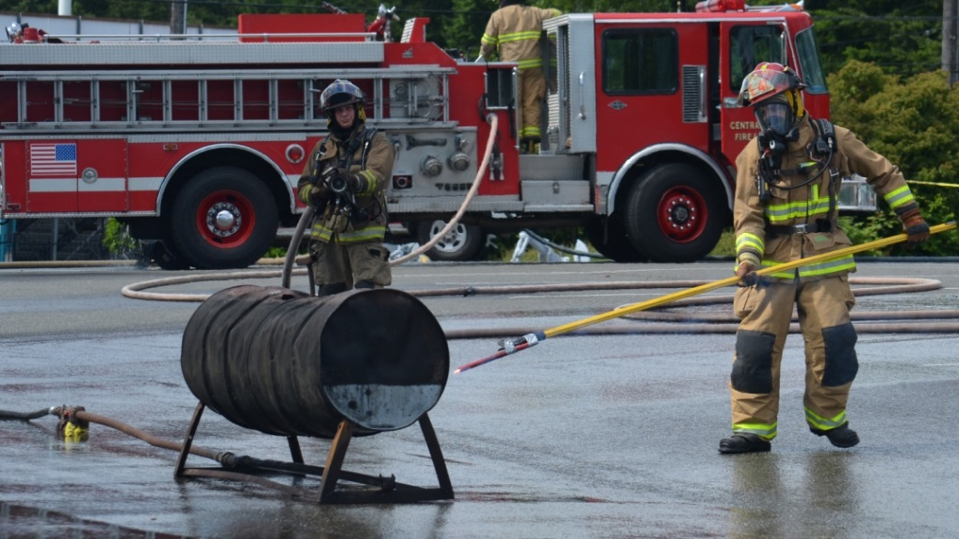
4.7.3 The fire shall be ignited by the ignition officer.
4.7.4 The fire control team shall wear full personal protective clothing, including SCBA, when performing this control function.
4.7.5 A charged hose
line shall be available
when the fire control
team is igniting or
tending to any fire.

Slide 23
4.8.1 All students, instructors, safety personnel, and other
personnel shall wear all protective clothing and equipment
specified in this chapter according to manufacturer’s instructions
whenever they are involved in any evolution or fire suppression
operation during the live fire training evolution.
4.8.2 All participants shall be inspected by the safety officer
4.8.3 All PPE shall have been manufactured to meet the requirements of NFPA 1971
4.8.4 SCBA shall have been manufactured to meet the requirements
of NFPA1981
4.8.6 Personal alarm devices shall have been manufactured
to meet the requirements of NFPA 1982

Slide 24
4.8 Personal Protective Clothing Cont.
4.8.7 All students, instructors, safety personnel, and other personnel participating in any evolution or operation of fire suppression during the live fire training evolution shall breathe from an SCBA air supply whenever they operate under one or more of the following conditions:
(1) In an atmosphere that is oxygen deficient or contaminated
by products of combustion, or both
(2) In an atmosphere that is suspected of being oxygen deficient
or contaminated by products of combustion, or both
(3) In any atmosphere that can become oxygen deficient,
contaminated, or both
(4) Below ground level

Slide 25
Additional Subjects that require more in-depth review
4.11 Water Supply.
4.11.1 The instructor-in-charge and the safety officer shall
determine the rate and duration of water flow necessary for
each individual live fire training evolution
delivering a minimum of 95 gpm (360 L/min).
4.11.3 Backup line(s) shall be provided to ensure protection
for personnel on training attack lines.

Slide 26
4.11.6 Except under the conditions of 4.11.6.1, separate water sources shall be utilized for the supply of attack lines and backup lines in order to preclude the loss of both water supply sources at the same time.
4.11.7 There shall be room provided around all props so that
there is space for all attack line(s) as well as backup line(s) to
operate freely.

Slide 27
4.12 Fuel Materials.
4.12.1 The fuels that are utilized in live fire training evolutions shall only be wood products.
Video details NLV fire training exercise gone wrong
http://www.youtube.com/watch?v=sNVcflxemQk
There are special rules for structures specifically built for training fires.
Chapter 6 Gas-Fired Live Fire Training Structures covers Training Structures

Slide 28
4.12.2 Pressure-treated wood, rubber, plastic, polyurethane foam, upholstered furniture, and chemically treated or pesticide-treated straw or hay shall not be used.
4.12.3 Flammable or combustible liquids, as defined in
NFPA 30, Flammable and Combustible Liquids Code, shall not be used in live fire training evolutions.
4.12.6 Fuel materials shall be used only in the amounts necessary to create the desired fire size.

Slide 29
4.12.8 The instructor-in-charge and the safety officer shall
assess the selected fire room environment for factors that can affect the growth, development, and spread of fire.
4.12.9 The instructor-in-charge and the safety officer shall
document fuel loading, including all of the following:
(1) Fuel material
(2) Wall and floor coverings and ceiling materials
(3) Type of construction of the structure, including type of
roof and combustible void spaces
(4) Dimensions of the room

Slide 30
4.12.10 The training exercise shall be stopped immediately when the instructor-in-charge or the safety officer determines through ongoing assessment that the combustible nature of the environment represents a potential hazard.
Live fire house explosion
http://www.youtube.com/watch?v=0dSpoUUFBBM

Slide 31
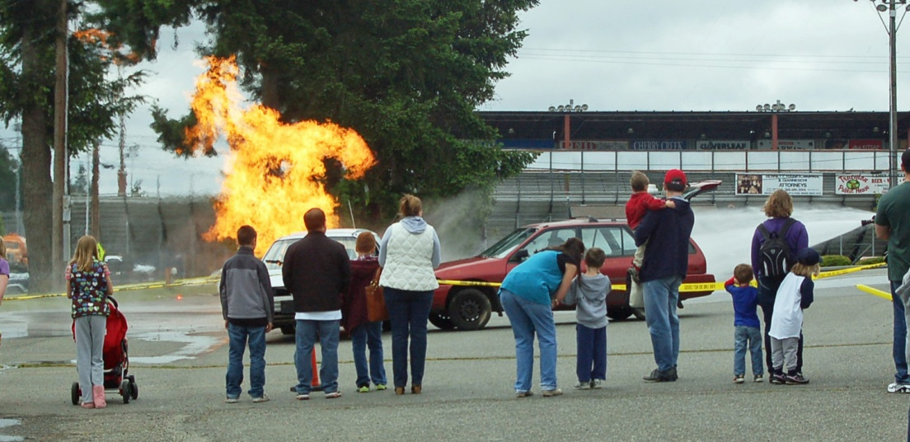
4.14 Visitors and Spectators.
4.14.1 All spectators shall be restricted to an area outside the operations area perimeter established by the safety officer.

Slide 32
4.15 Pre-burn Plan/Briefing.
4.15.1 A pre-burn plan shall be prepared and shall be utilized during the pre-burn briefing sessions.
4.15.6 Prior to conducting any live fire training, all participants shall have a knowledge of and familiarity with the prop or props being used for the evolution.
4.15.7 Prior to conducting any live fire training, all participants shall be required to conduct a walk-through of the acquired structure, burn building, or prop in order to have a knowledge of and familiarity with the layout of the acquired structure, building, or prop and to facilitate any necessary evacuation.

Slide 33
5.1 Structures and Facilities.
5.1.1 Any acquired structure that is considered for a structural fire training exercise shall be prepared for the live fire training evolution.
5.1.3 Preparation shall include application for and receipt of required permits and permissions.

Slide 34
5.2 Hazards.
5.2.1 In preparation for live fire training, an inspection of the structure shall be made to determine that the floors, walls, stairs, and other structural components are capable of withstanding the weight of contents, participants, and accumulated water.
5.2.2 All hazardous storage conditions shall be removed from the structure or neutralized in such a manner as to not present a safety problem during use of the structure for live fire training evolutions.

Slide 35
ASBESTOS
All structures used for training must be surveyed for potential hazardous substances, such as asbestos, prior to the initiation of any training activities.
The survey must comply with chapter 296-62 WAC http://apps.leg.wa.gov/WAC/default.aspx?cite=296-62

Slide 36
If the hazardous substances or asbestos containing materials of ˃ 1% asbestos are to be disturbed during any training activity they must be removed prior to beginning that activity.
In live fire training structures where < or = 1% asbestos has been disturbed, the fire department will provide written notice to the owner/agent that asbestos has been disrupted and remains on-site.
Removal of asbestos < or =1% is not required prior to live fire training.

Slide 37
Lead Paint
For structures built before 1978, you must assume that painted surfaces are likely to contain lead and inform workers of this presumption.
Surveys for lead containing paints are not required.
Lead containing paints are not required to be removed prior to training activities.

Slide 38
5.3 Utilities.
5.3.1 Utilities shall be disconnected.
5.3.2 Utility services adjacent to the live burn site shall be
removed or protected.
5.5 Rapid Intervention Crew (RIC). A RIC trained in accordance with NFPA 1407, Standard for Training Fire Service Rapid Intervention Crews, shall be provided during a live fire training evolution.

Slide 39
Chapter 8 Exterior Live Fire Training Props
8.1.2 Props used for outside live fire training shall be designed specifically for the evolution to be performed.
8.2 Inspection and Maintenance.
8.2.1 Exterior props shall be inspected visually for damage
prior to live fire training evolutions.
8.2.1.1 Damage to exterior props shall be documented and
the owner or AHJ shall be notified.

Slide 40
8.2.2 All safety devices and emergency shutdown switches, plus
doors, shutters, vents, and other operable devices, shall be
checked prior to any live fire training evolutions to ensure they
operate correctly.
8.2.3 The structural integrity of the props shall be evaluated
and documented annually.

Slide 41
Chapter 9 Reports and Records
9.1 General.
9.1.1 The following records and reports shall be maintained on all live fire training evolutions in accordance with the requirements of this standard:
(1) An accounting of the activities conducted
(2) A listing of instructors present and their assignments
(3) A listing of all other participants
(4) Documentation of unusual conditions encountered

Slide 42
Chapter 9 Reports and Records
9.1 General. continued
(5) Any injuries incurred and treatment rendered
(6) Any changes or deterioration of the structure
(7) Documentation of the condition of the premises and adjacent area at the conclusion of the training exercise
9.1.4 A post-training critique session, complete with documentation, shall be conducted to evaluate student performance and to reinforce the training that was covered.

Slide 43
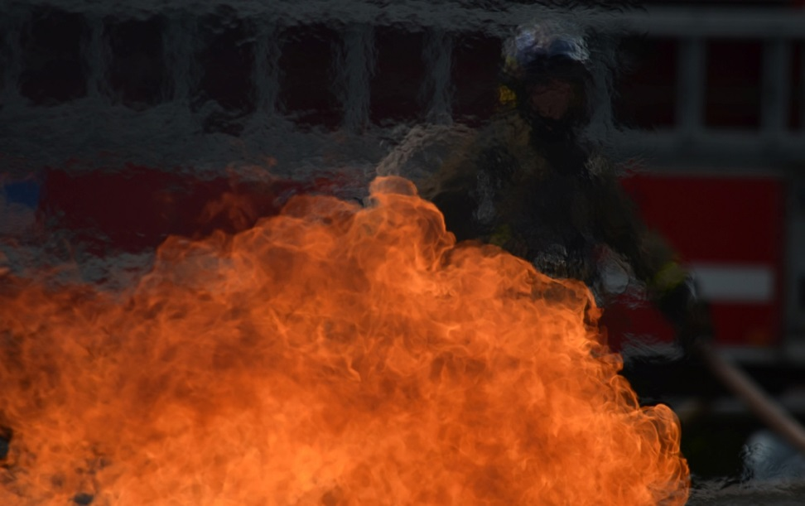
A.1.1 Live fire training of entry level and experienced fire
suppression personnel are high-risk activities.
This risk can be
effectively managed
through compliance
with this standard.

Slide 44
These Lists and rules are in place because firefighters have been seriously injured or have died because the rules were not adhered to.
Follow the rules just as we expect others to do.
Failing to follow these rules can leave officers culpable for injuries.

Slide 45

So, have you met the standard for…
WAC Mandated Training
That must be completed before live fire
The instructor-in-charge shall be responsible for full compliance with this standard.
A safety officer shall be appointed for all
live fire training evolutions.
A fire control team shall consist of a minimum of two personnel.
All participants shall be inspected by the safety officer and Maintain SCBA use as directed by WAC 296
TRNG
Backup line(s) shall be provided to ensure protection for personnel on training attack lines.
Separate water sources
The training exercise shall be stopped immediately when the instructor-in-charge or the safety officer determines … a potential hazard.
Formulate and share the pre-burn plan

Slide 46
So, have you met the standard for…
A trained RIC … shall be provided during a live fire training evolution.
All of the applicable Reports and Records are completed according to Chapter 9
Remember it is not just light them and fight them; everyone goes home safe.
TRNG

Slide 47
Here are more resources for training…
OSHA website Asbestos information
eHow resources for Asbestos
TRNG
NFPA.org
Sample live fire check sheets

Slide 48
Objectives:
Who influences fire service regulation
What is live fire training
What are the mandatory training subjects relating to Live Fire Training
Have access to check lists for safe operations at live fire training

