Slide 1
Active Shooter Preparedness for Administrative Professionals
Presented by
Sergeant Paul Fairbanks and lieutenant Justin Walker

Slide 2
Mental Preparation
WHAT IF?
-What will you do?
-Do you feel like you are prepared?

Slide 3
Preparedness Videos
LA County Sheriffs Office
Texas State Office of Risk Management
Houston
DHS

Slide 4
Resources (Department of Homeland Security)
DOH Preparedness Workbook
DOH Active Shooter Quick Reference Guide
DOH Resources & Fact Sheet

Slide 5
“Admins as “First Responders”
As Police response tactics and training evolve with the changing threat, so too does the response by civilians or eye witnesses
For the first few minutes until Emergency Services arrive, you, as witnesses are the “first responders”

Slide 6
OBJECTIVE:
CHANGE MINDSET TO BE MORE MENTALLY PREPARED
for an ACTIVE SHOOTER.

Slide 7
Why Prepare?
During an active shooter incident, fight or flight or freeze response kicks in.
  Body physically prepares for physical exertion (increased heart rate, increased blood flow to muscles, adrenaline dump, decreased blood flow to less vital areas)
  Lowered cognitive thinking/reasoning ability
If you have not prepared mentally, you risk freeze, no action (black mode-mental indecision) during a time when immediate action is crucial to your survival and the survival of your kids!!!
Example of School Preparation…Fire Drills, Lock Down

Slide 8
Active Shooter Incidents:
DYNAMIC INCIDENTS
Requires: Dynamic Thought that changes with the situation.
…and if need be: Dynamic Action to adjust to the situation.

Slide 9
Active Shooter
Know Your Situation
Do what is reasonable to survive
Remember Your Responsibilities
  Yourself/Staff SAFE?
  How Do We Prepare to Do These Things?

Slide 10
Visualization Exercise: “What if..” questions
What if I hear shooting and screaming down the hallway?
What if I’m running away from the shooting and I see bodies on the ground?
What do I do if the shooter is in front of me shooting at people, but they haven’t seen me yet?
Can I help everyone? Should I help everyone?

Slide 11
Make up your own What IF questions. Be specific or broad as you want. The more answered questions you generate, the more you are preparing yourself for if the incident happens.
**Practice asking What If questions frequently.
**Make it your own simulation. When you see a random person, pretend they are shooter. What would you do?

Slide 12
“An individual must use his/her own discretion during an active shooter event as to whether he/she chooses to run to safety or remain in place…but, do SOMETHING.”
MAKE A DECISION!
  Run
  Hide (ie. Lock Down Protocol, if Safe)
  Fight
Notes:
Each of these will be discussed later. Just introduce and move on.

Slide 13
Run
If you can and you deem it safe, get out and get to a safe place. (Consider having a planned off-campus run to location that administration knows about).
You will have to rely partially on instinct.
Leave belongings behind, but take your cell phone if it is handy. (Remember to silence your cell phones).

Slide 14
Hide
Find a hidden, safe location (10 to 12 minutes of hiding)
  Remember if the shooter is an employee, they will be aware of LOCK DOWN Procedures and the facility layout.
Find protection behind furniture if possible.
  Know difference between concealment and cover.
Blockade the door with furniture or other heavy objects.
Be prepared to transition to Run or Fight as the situation changes.

Slide 15
FIGHT
This is a very personal decision…. What do you have worth living for and what will you do to live?
IF SUSPECT IS IN CLOSE PROXIMITY
  An individual must use his/her own discretion about when he or she must engage a shooter for survival.
  Make a plan as to how you will survive the situation.
  Make a total commitment to action and act as a team with others if possible.
  What do you have around you to use as a weapon?
  Do WHATEVER is necessary to survive the situation.

Slide 16
What to Expect from Police:
They are there to find and stop the threat.
Officers are in a heightened sense of awareness to threats.
Do not run at them, make sudden movements, yell, scream at Officers
Show them your hands, tell them what you know, comply with their directions

Slide 17
Calling 911
Only call when you're safe
Know where you're calling from
Who, what, where, when?

Slide 18
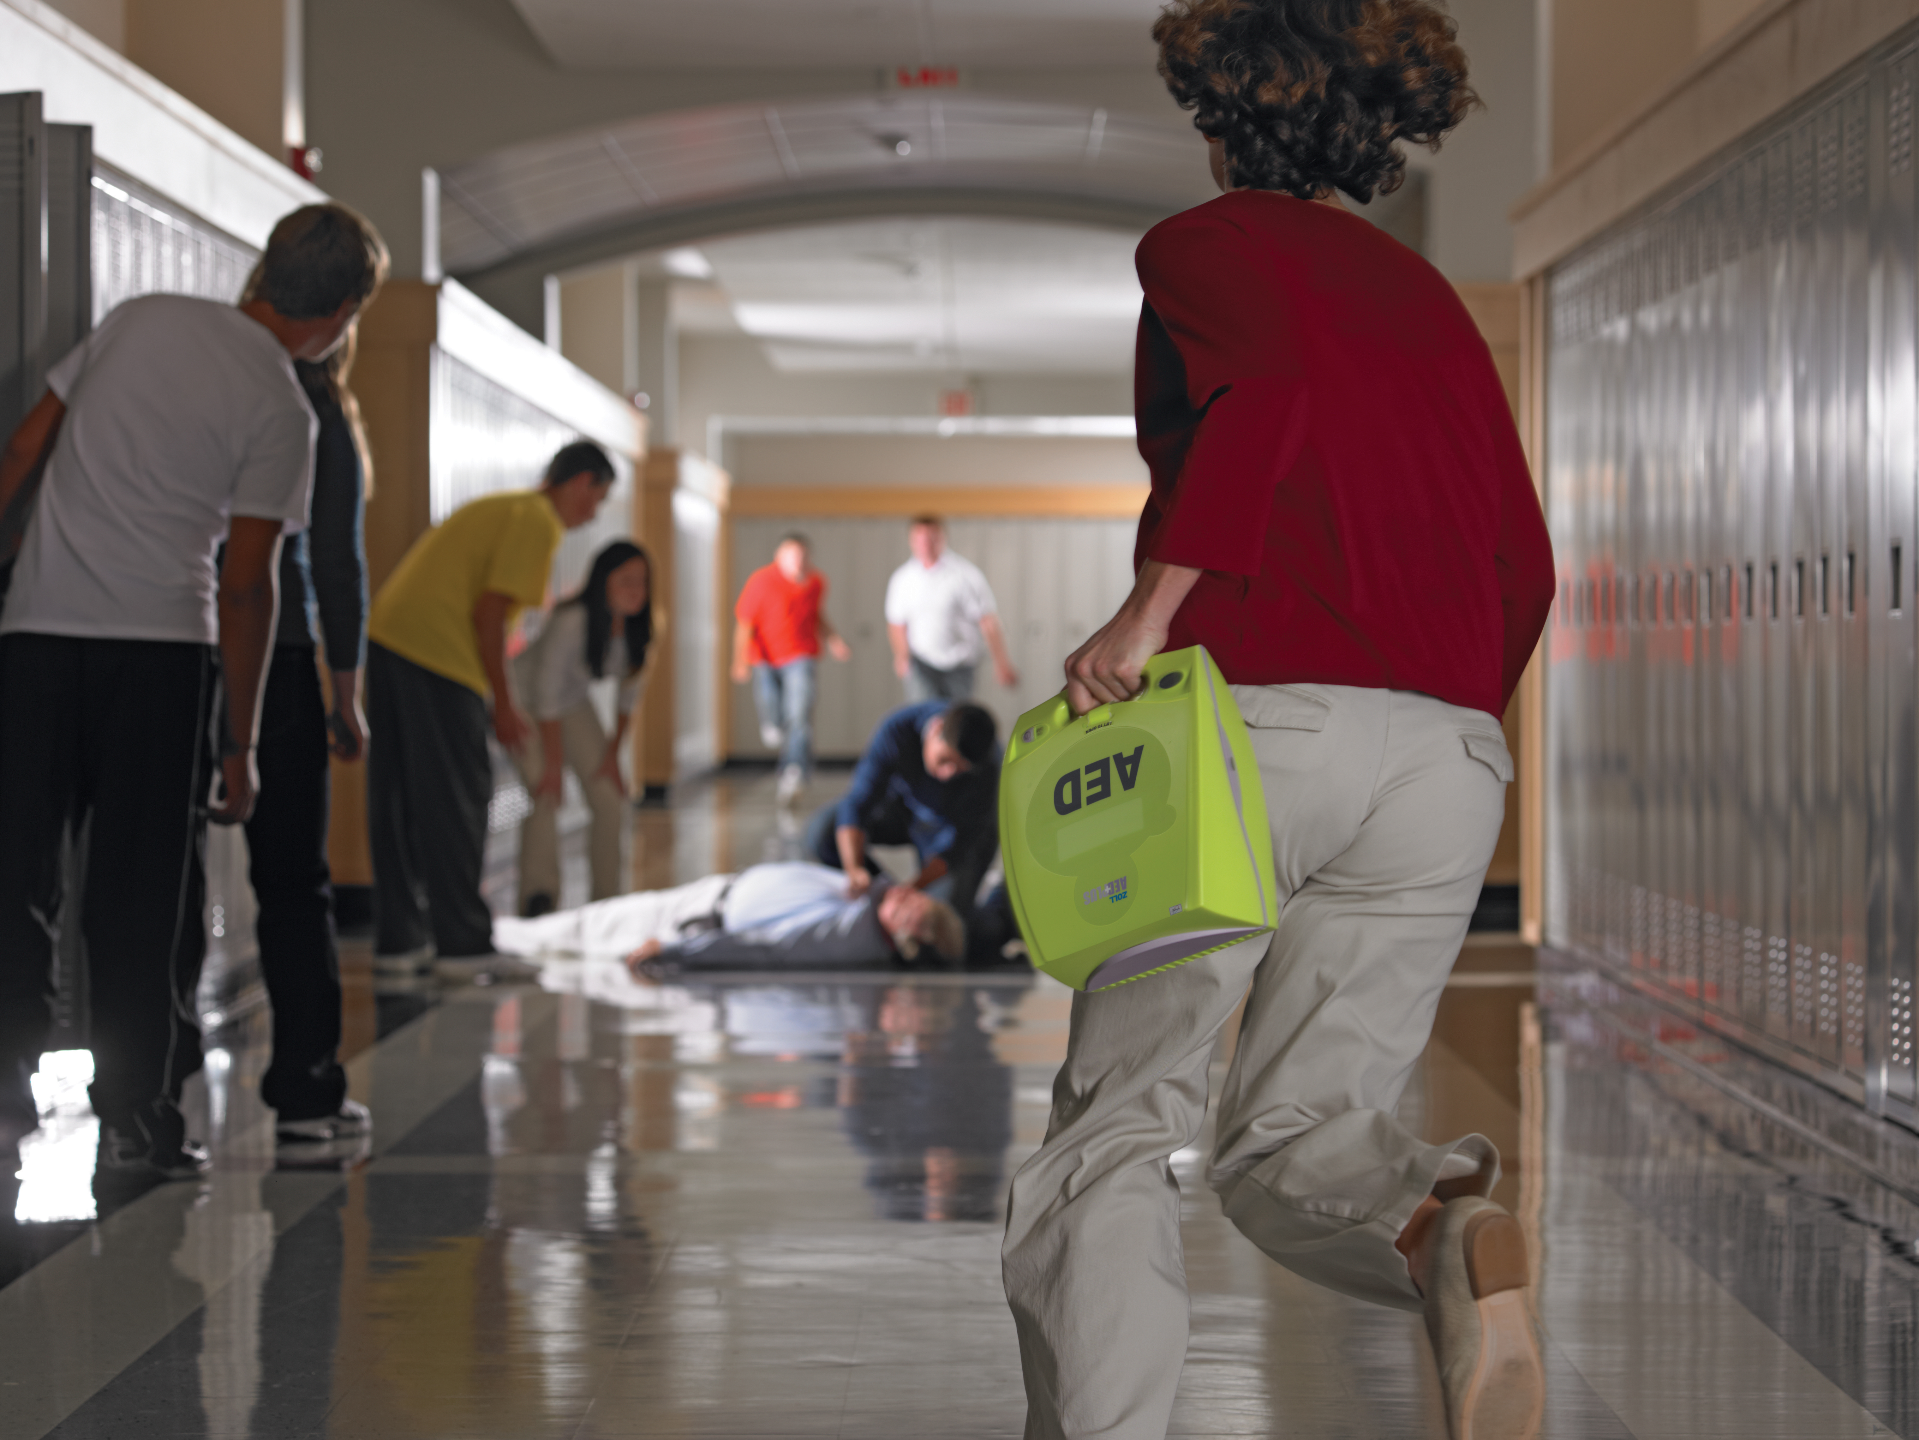
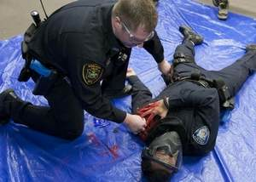
First Care Providers and Non-Medical First Responders
Law Enforcement Officers
Eye witnesses
Notes:
Basic Trauma Care for Educators program – KC Medic One
Care Under Fire training – various police agencies

Slide 19

Trauma Chain of Survival
First Care Providers
(community members, teachers, security)
Fire/EMS
(BLS/ALS)
Emergency Medicine
(ER)
Non medical
First Responders (LEO)
Trauma Surgeons
(OR)
Notes:
Right intervention at the right time and place

Slide 20
What to do while waiting for Police and Fire, when in a safe location or after the threat is neutralized?
How to care for the injured?
Do you have public access trauma kits?
Do you know how to control bleeding?
Do you know how to protect an airway?

Slide 21
MARCH-E Priorities
Massive hemorrhage
Airway
Respirations
Circulation
Hypothermia / Head & spine injury / Handling
- Everything else…

Slide 22
Hemorrhage Control Concepts
Bleeding is bad
Massive bleeding is massively bad
Requires RAPID and AGGRESSIVE interventions

Slide 23
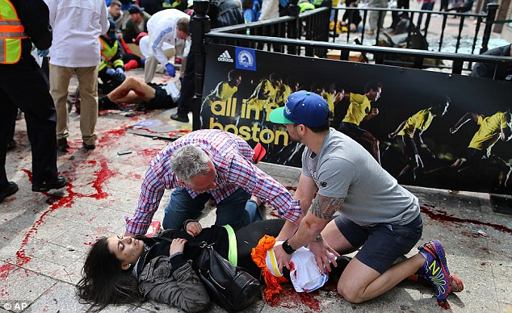
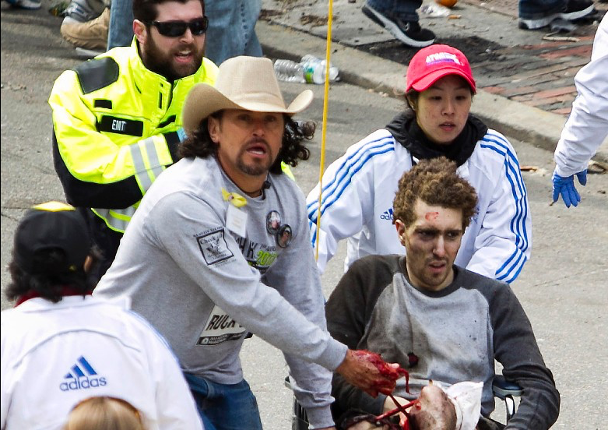
Massive Hemorrhage
Need for a rational approach to hemorrhage control
Immediate, very aggressive direct pressure to the ground!
Think tourniquet early!
Elevation? – no evidence it works
Pressure points?
Are the damaged blood vessels compressible or not?

Slide 24
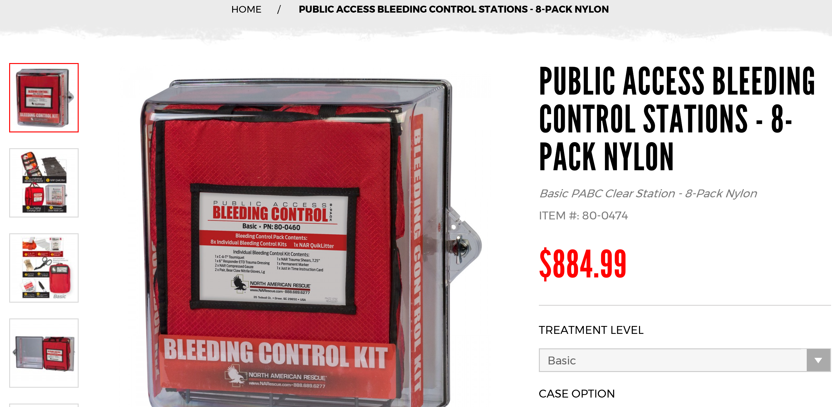

Slide 25
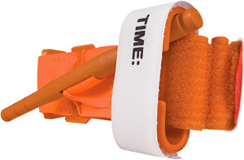
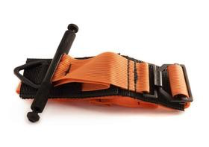
Limb Tourniquets
Combat Application Tourniquet (CAT) – Generation 6 or 7
  Eastside F&R, Bellevue FD, Seattle FD
  Most LE agencies in King County
Special Operations Forces Tactical Tourniquet – Wide (SOFTT-W)
  Various KC fire/EMS agencies
  Public access trauma kits
Notes:
Why CAT over SOFTT?
Both are good tourniquets, but the CAT has MUCH more data showing it’s efficacy and safety
~80% of military usage has been with the CAT
The 6th Generation of the CAT has proven very reliable
The 7th Generation of the CAT is new, and has various changes, including a single-route buckle
The current generation (3rd Gen) of the SOFTT looks like it ought to be very good, but hasn’t yet been proven with many field applications

Slide 26
How to apply
Take up all slack possible before cranking windlass
Tighten until bleeding stops
Secure and reassess frequently
Note application time
Notes:
Tourniquets hurt. Within about 20-30 minutes, the pain will be severe.
Improvised tourniquets hurt worse than the commercial varieties.
Don’t let the patients complaint about the pain keep you from tightening the tourniquet adequately to stop the bleeding!
The solution to the pain is pain management drugs!

Slide 27
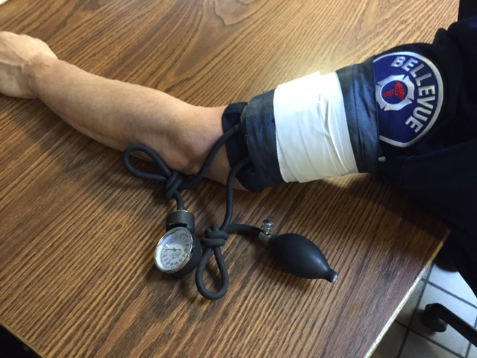
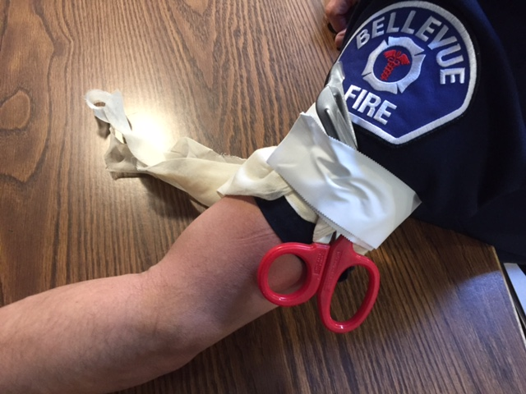
Improvised Tourniquets
BP cuff
Triangular bandage & windlass
Suit tie and scissors
Notes:
BP cuffs should be taped to prevent velcro slippage, or accidental removal
BP cuffs aren’t designed to hold pressure for long periods. They will need to be checked very frequently or the tubing must be clamped or knotted
Triangular bandages come out of the package ready to be used as a tourniquet (about 3 in band)
Windlass must be sturdy – consider using a pair of trauma shears

Slide 28
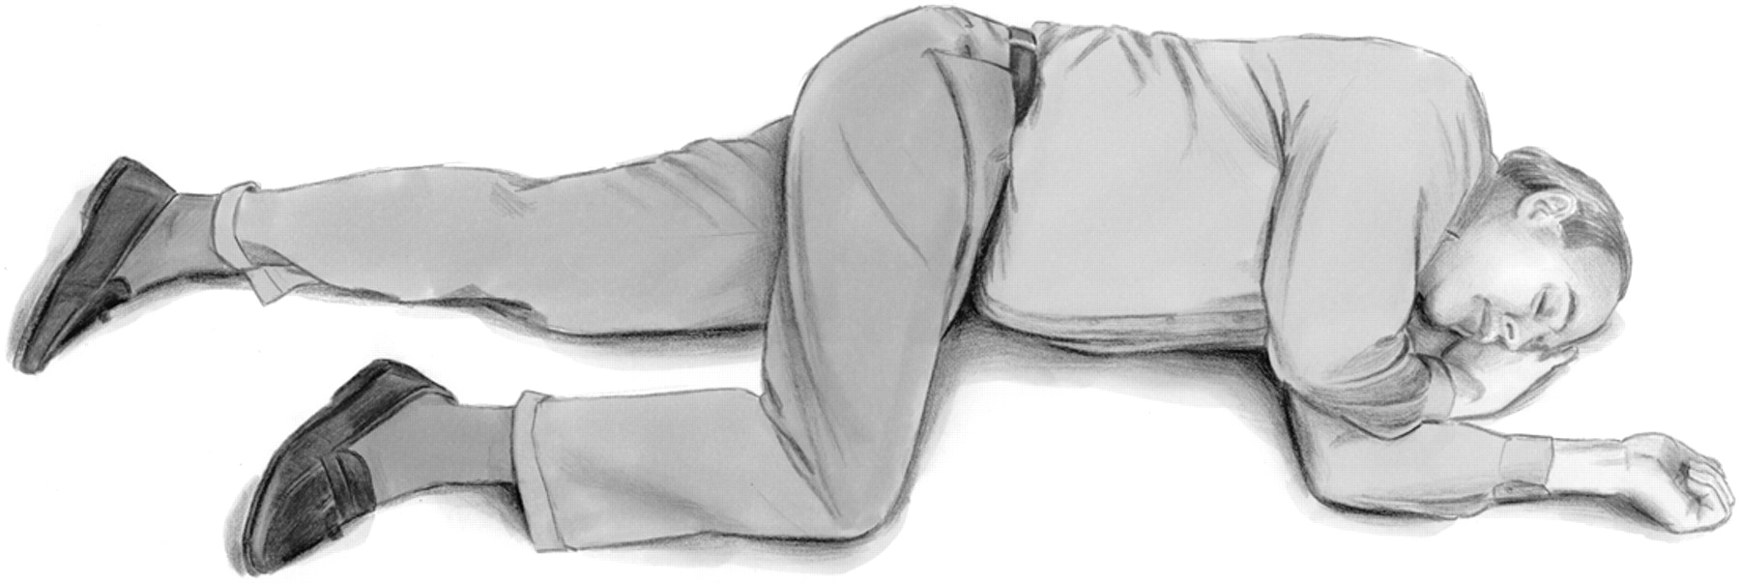
Airway
If conscious, allow upright positioning
If unconscious, put in recovery position
Notes:
Jerry Stromyer, age 24 from Kincaid, WV - 1986
Bit down on blasting cap at party
“Hold my beer and watch this…”

Slide 29
Wound Packing
Find
  Find the source of the bleeding, and put your finger on it
Fill
  Fill the entire wound bowl with gauze, maintaining constant pressure, against bone if possible
Press
  Press hard while packing, and maintain direct pressure for 3-5 minutes after wound bowl filled to allow clot to develop
Protect
  Protect the clot with gentle handling and movement – the first clot is the most stable clot…

Slide 30
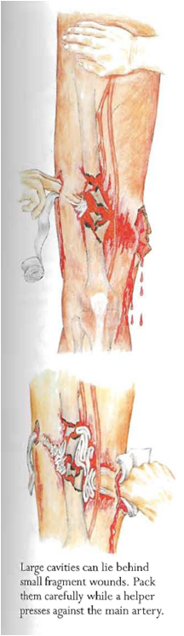





Wound Packing
Prehosp Emerg Care, 2014 Apr-Jun
Keys to wound packing
Identify the bleeder
Pack to the source
Pack against bone
Maintain pressure
Gentle handling

Slide 31
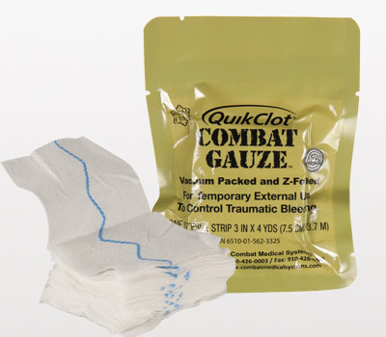
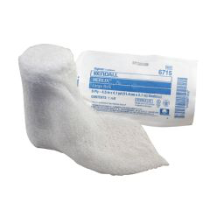
Hemostatic Gauze?

Slide 32
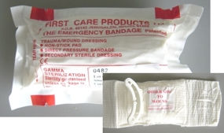
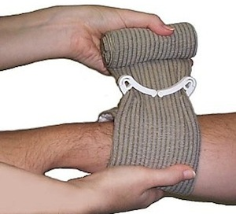
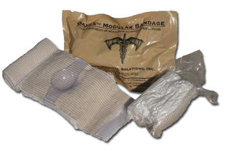
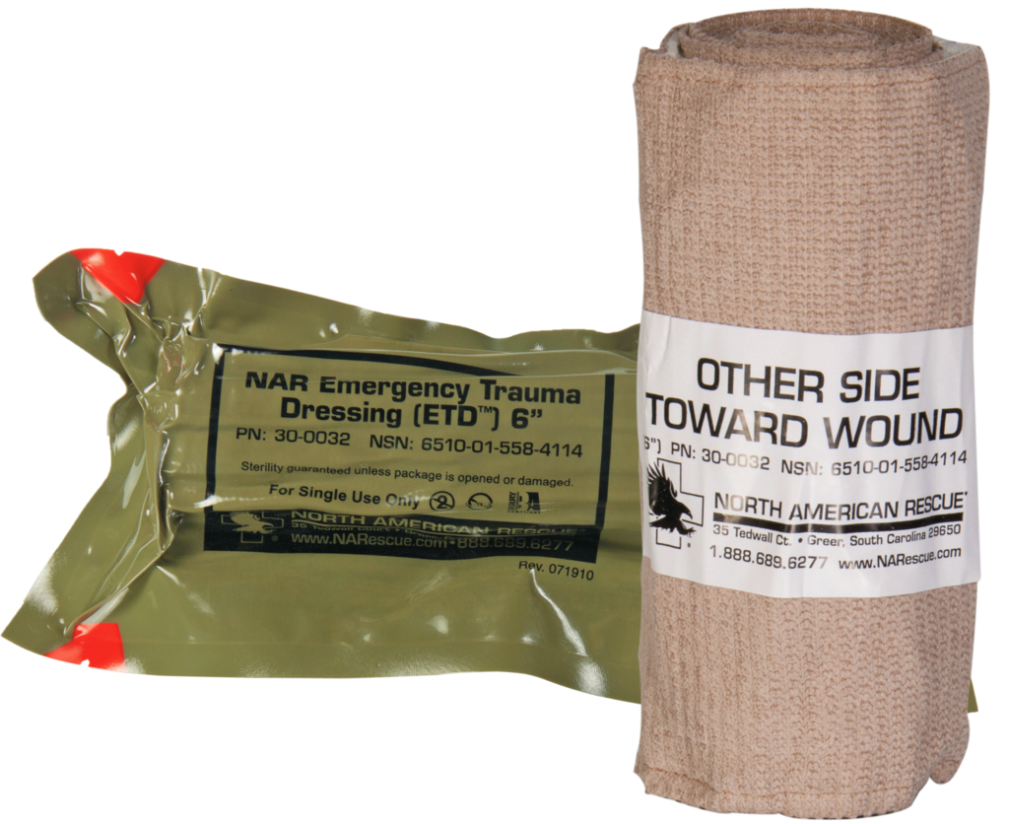
Pressure Bandages

Slide 33
What If…(again)-group activity.
What if I hear shooting and screaming down the hallway?
What if I’ve locked down my area and I hear shooting coming down the hallway towards ME or my office?!
What if I’m running away from the shooting and I see bodies on the ground?
What do I do if the shooter is in front of me shooting at people, but they haven’t seen me yet?
What if I hear gunshots and screaming coming from other parts of the building?
Can I help everyone? Should I help everyone?
Can you start to answer a few more of these questions?

Slide 34
(Review)
DEVELOP A SURVIVAL MINDSET
Awareness and Preparation:
Take time to understand your surroundings and environment BEFORE an emergency occurs.
Ask yourself: “What if …?” questions and develop a plan.
During Incident, DECIDE:
RUN, HIDE, and FIGHT.
Notes:
Awareness and Prep – Use airplane safety checks as example

Slide 35
Remember:
Be Dynamic and “think on your feet” during the incident.

Slide 36
Questions?

