Slide 1
Office Ergonomics

Slide 2
Course Objectives
Look at ways to reduce risk of injuries on the job
Evaluate and control ergonomic hazards
Recognize early warning signs
Discuss: posture, monitors, keyboards, desks, chairs, phones

Slide 3
What is ergonomics
Ergonomics is the study of the kind of work you do, the environment you work in and the tools you use to do your job.
When your workstation is set up correctly, you may:
  Be less likely to have problems such as headaches or eyestrain
  Reduce neck and back pain
  Prevent tendon problems that are linked to doing the same task over and over

Slide 4
Ergonomics Problem
Many potential work related risks in an office environment
Some work can cause fatigue, discomfort and musculoskeletal disorders (MSD)
My examples
  Years on days
  Good office, bad posture and use of the computer and phone
  Standing vs. sitting and movement
  Stress

Slide 5
Principles of Ergonomics
Look for ways to adapt the workplace to fit the worker
Tasks that can lead to injuries
  Awkward Posture – poorly designed workstation and poor practices
  Repetitive Motions – Can cause injury due to continual strains to same part of the body
  Pressure Points – direct pressure against a hard surface
Notes:
Awkward posture – me standing but still slumping and shoulders in bad location.
Repetitive Motions – my example of constantly looking left, using the phone, etc.
Pressure points – edge of desk, impact to nerves and tendons

Slide 6
Principles of Ergonomics
To minimize the risk of injury
  Do not do tasks that exceed your physical ability
  Make your workspace designed around you!
  Use appropriate equipment to help you do your job
  Set up your work environment to help you
  Your Desk is all about YOU!

Slide 7
Musculoskeletal Disorders
Small problems or movements that produce a small amount of discomfort can become an MSD issue
Computer desk signs and symptoms
  Numbness and burning sensation to hands
  Reduced grip strength
  Swelling or stiffness in joints
  Pain in wrists, forearms, elbows, neck and back
  Reduced range of motion
  Dry, itchy, sore eyes and blurred vision
  Aching or tingling, cramping and weakness

Slide 8

Proper Positioning

Slide 9
Proper Positioning
Best to maintain a neutral body position – joints are naturally aligned
Regardless of your position, in the same position for a long time can be an issue – adjust your chair, take small breaks to stretch and walk around

Slide 10
Evaluate Your Workstation
Ensure your space is set up in the safest and most comfortable way
All things within easy reach and aligned properly
Your workstation is all about YOU!

Slide 11
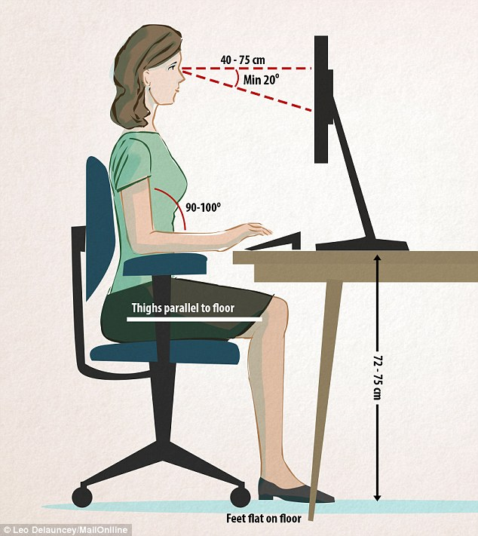
Computer Monitors
Monitors
  20 – 40 inches away and directly in front of you
  Not more than 35 degrees to the left or right
  Top of screen at or near eye level
  Prevent glare from window, etc.
  Feet flat on the floor
  Thighs parallel to floor

Slide 12
Computer Monitors
Monitor to close or to far away can lead to awkward posture and eye strain
Eye fatigue – can cause dryness if you look at the monitor for a long time
Take viewing breaks – look away from the monitor, blink to exercise the eyes
Do some non-computer duties/work

Slide 13
Computer Monitors
Using printed material – don’t put it off to the side when reading and typing, have it directly in front of the monitor
Two monitors – keep them close together and your chair right in the middle of them
Adjustable monitor – good to have but if not, adjust your chair. Be careful as a higher chair can cause other posture issues with legs not properly aligned and feet not flat on the floor

Slide 14
Keyboards
Typing is a very common task we all do
Keyboard arrangement
  Directly in front of you
  Not to high or to low, this can lead to carpal tunnel syndrome
  Not to close or to far away from you, elbows should remain close to your body and forearms parallel to the floor

Slide 15
Keyboards
Body Position
  Relax your shoulders and keep elbows close to your body
  Keep wrists straight and in line with your forearms
  Maintain a neutral wrist position, not bending your wrists up or down
Bad Practices
  Bending your wrists sideways to reach keys
  Wrists bent upward
  Allowing contact stress to wrists, arms

Slide 16
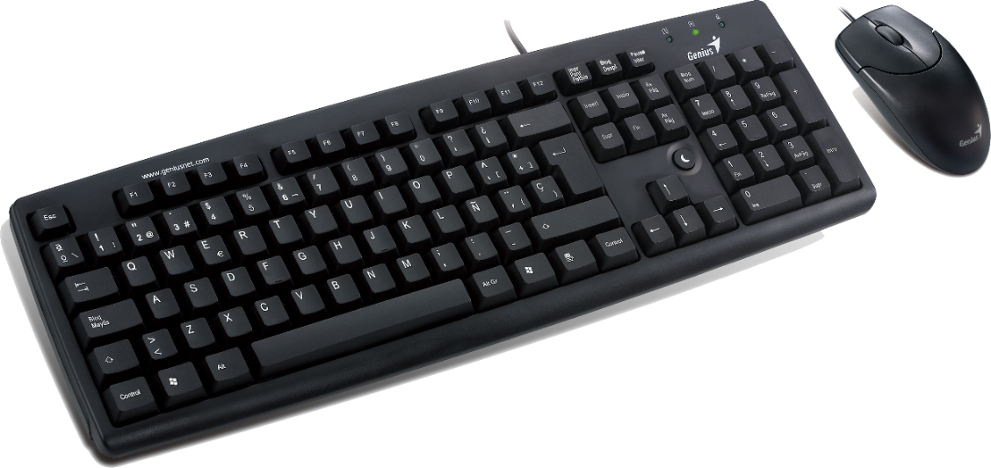
Keyboards and the mouse
Keep the mouse close to the keyboard
Try switching hands once in a while

Slide 17
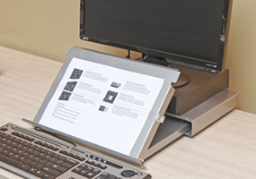
Document Holders
Keep them close to the monitor
Appropriate placement reduces
  Bad head/neck posture
  Headaches
  Eyestrain
  My example – always a document to the left – an issue for me

Slide 18
Desks
Assessment
  Clearance for your legs
  Things placed so that you have awkward posture
  Most used items within close reach?
  Monitor at the right height and distance?

Slide 19
Desks
Your primary work zone is the area from your elbow to your hand
Items used frequently should be in this zone
Examples – keyboard, mouse, phone. Able to reach/use them while sitting properly
Contact stress – if your wrists contact the edge of the desk, consider padding the edge, use a wrist rest

Slide 20
Desks
Proper space is provided – clearance under the desk and good space for your feet
Keep it free of clutter to keep movement and adjustments in place

Slide 21
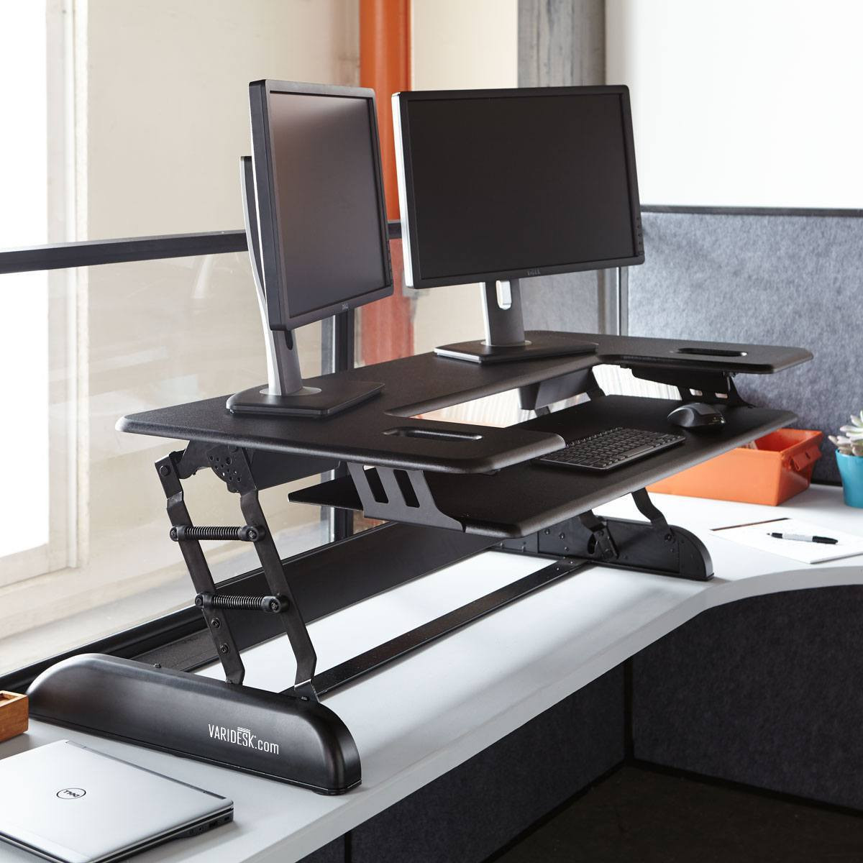
Desks
Recommendation
  Consider a standup desk
  Don’t sit all day – get up every hour and walk around for a few minutes
  Sitting all day is like smoking

Slide 22
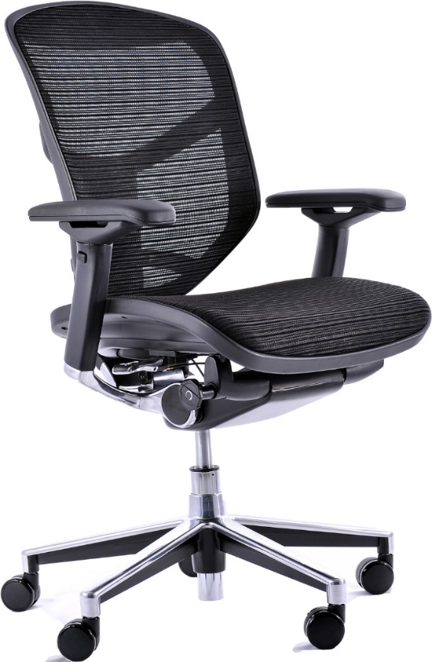
Office Chairs
Good chairs
  Support for the legs, buttock, back and arms
  Reduces awkward posture
  Fully adjustable
  Feet flat on the floor, knee slightly lower than the hips
Notes:
Backrests – very important for support
Seat – adjustable and at the right height, accommodate different hip sizes
Armrests – adjustable, not to hard, rounded/padded edges, correct height
Base – at least five legs,

Slide 23
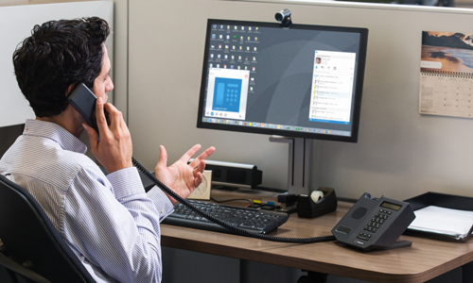
Your Desk Phone
The phone is a key component of your workstation
Keep the cord from getting tangled up
Phone within reach
Don’t pinch the phone between shoulder and neck
Use a headset

Slide 24
Questions?
Keith Wright
Central Pierce Fire and Rescue
kwright@centralpiercefire.org

