Slide 1
Washington State Archives
Electronic Records Management :
Put Out The Fire!
Presented by:
Leslie Koziara, CRM, ERMP
Electronic Records Management Consultant
leslie.koziara@sos.wa.gov 360-586-4893

Slide 2
Overview
Requirements for Public Records
Requirements and Guidelines (by format)
  Scanned Documents
  Email
  Websites and Databases
  Texts, Social Media and more!
The Digital Archives

Slide 3
RCW 40.14 Preservation and Destruction of Public Records
“Public records include any paper, correspondence, completed form, bound record book, photograph, film, sound recording, map, drawing, machine-readable material, compact disc meeting current industry ISO specifications, or other document, regardless of physical form or characteristics, and including such copies thereof, that have been made by or received by any agency of the state of Washington in connection with the transaction of public business”

Slide 4
Protect your public records
RCW 42.56.100
Protection of Public Records
…” to protect public records from damage or disorganization, ………. Such rules and regulations shall provide for the fullest assistance to inquirers and the most timely possible action on requests for information.……”

Slide 5
WHAT IS A RECORD? QUIZ # 1
Fire Station #4 is called to the scene of an accident. A firefighter take a digital photo of the incident. Is this photo a public record?
□ Yes □ No
Notes:
When test is completed by participants – review answers.

Slide 6
WHAT IS A RECORD? QUIZ # 2
In your desk drawer, you have a copy of the contents of your personnel file. It contains duplicates of your application, training taken, awards received, etc. Is this a public record?
□ Yes □ No
Notes:
When test is completed by participants – review answers.

Slide 7
WHAT IS A RECORD? QUIZ # 3
You come back to your desk following lunch and your computer indicates that you have two email messages waiting for you.
A.) One message is from the assistant fire chief requesting shared leave for a colleague on extended sick leave.
B.) The other message is from your boss, giving you the agreed-upon timelines and goals for an upcoming project.
Which message is a public record?
□ A only □ B only □ Both A and B □ Neither A nor B

Slide 8
WHAT IS A RECORD? Quiz # 4
Fire District #9 has Facebook and has invited public comment on a proposal for a new fire station.
Is this a public record?
□ Yes □ No

Slide 9
Preservation of Electronic Records
WAC 434-662-040
Electronic records must be retained in electronic format and remain usable, searchable, retrievable and authentic for the length of the designated retention period.

Slide 10
Designated retention period? Huh?
If you are new to RM, there is a document for managing public records for retention and disposition is called a “retention schedule”
Each agency will use two schedules:
  CORE (Common Records)
  Fire and Emergency Sector Schedule (under development)

Slide 11
Regardless of format – use for both paper and electronic records
Retention schedules tell you:
  What types of records (grouped by record series) you are required to keep
  How long you are required to keep them
  What to do with the records once retention has been met:
    Destroy (roughly 95% of the time)
    Transfer to Archives (roughly 5% of what’s left)

Slide 12
“Defensible Disposition”
Retention schedules are legal documents and provide agencies with the authority to get rid of records once retention has been met

Slide 13
Approved schedules available online
www.sos.wa.gov/archives
Click on: Local Government Services
Then: Retention Schedules

Slide 14
Can I Print and Then Delete Electronic Records?
NO - Printing and retaining a hard copy is not a substitute for the electronic version unless approved by the appropriate records committee.

Slide 15
Why Printing Doesn’t Work
Metadata associated with “born digital” records establishes and preserves the authenticity of the record which is the evidence of the transaction it documents.
Printing electronic records (e.g. emails) preserves the informational content but not the authenticity of the record.

Slide 16
What is a “Born Digital” Record?
Regardless of how it was created:
  If the transaction or evidence of public business occurs in paper then the paper record needs to be retained.
  If the transaction or evidence of public business occurs electronically then the electronic record needs to be retained.
Washington State Archives Documenting Democracy

Slide 17
What is “Born Digital”? #1
  Minutes are drafted using Microsoft Word and then printed.
  Chair signs the printed minutes at the next meeting.
  Transaction of public business occurs in paper so the signed paper minutes need to be retained.
Washington State Archives Documenting Democracy

Slide 18
What is “Born Digital”? #2
  Agendas are drafted using Microsoft Word.
  Agendas are distributed to Committee members via email with the Word attachment.
  Transaction of public business occurs electronically so the email and attachments need to be retained.
Washington State Archives Documenting Democracy

Slide 19
Digitized Records
Can I Scan and Toss?
“Conversion to an imaging system does not automatically authorize the destruction of the source documents for which images have been created.”
  WAC 434-663-600
Washington State Archives Documenting Democracy

Slide 20
“Scanning and Tossing” Requirements
Requirements document just released March 9, 2012.
No longer have to seek approval from Washington State Archives - nothing needs to be submitted
If agency determines that its procedures for scanning and managing the records meet or exceed the requirements in the standard, the agency may destroy Non-Archival source records after they have been scanned and verified.
Washington State Archives Documenting Democracy

Slide 21
“Scanning and Tossing”:
Primary Concerns
Are the records designated Non-Archival?
Are the records being scanned in a way that ensures a complete, accurate, and durable copy?
Will the images be accessible and protected from unauthorized deletion/alteration for the entire required retention period?
Washington State Archives Documenting Democracy

Slide 22

Managing Electronic Records

Slide 23
Why not just keep it all?
Consider this:
    Think needle in a haystack.. less hay, easier to find the needle - less costs for discovery and disclosure
    Yeah, storage is cheap, litigation is NOT
    Other associated costs:
      Additional space needed (equipment and facility)
      Additional maintenance and staffing needed
      Additional upgrades, increased migration & recopying, disaster planning
      Additional long-term sustainability issues

Slide 24
So where do you start?
    First responders need to establish agency records management policies & procedures
      Requires executive buy-in and input from legal
      Identifies roles and responsibilities
      Should address appropriate use
      Include records management fundamentals
    Need user and IT support
    Training and education are essential
    Periodic compliance checks are crucial
      Automatic deletion is not recommended!

Slide 25
Put out the fire
Successful organization and control is a
win–win situation
  Agency benefits in lower costs and more efficient operations
  Employees benefit with better access and increased productivity
  Public benefits with transparency and prompt responses to any requests

Slide 26
A winning strategy for electronic records
Identify
Organize
Disposition (take action)

Slide 27
Identify
Using approved records retention schedules will help you:
  Identify records you need to keep
  Identify records you can get rid of
  Identify records needing additional attention:
  Essential
  Archival

Slide 28
Use RM to identify improvements to process
Do an analysis on what processes may be eligible for consolidation and streamlining
Another way to save money
  Look at ways to go “paperless”
  Look for ways to improve a process
    Just because that’s the way it’s always been doesn’t make it better
    How much duplication is there?
    How much time and energy does something take?

Slide 29
Organize
Using what you have
Agencies already have established files for their paper records, use what has already been developed and adapt to “electronic” filing systems
Retention schedules already exist
Also serves as excellent preparation prior to implementing any automated processes

Slide 30
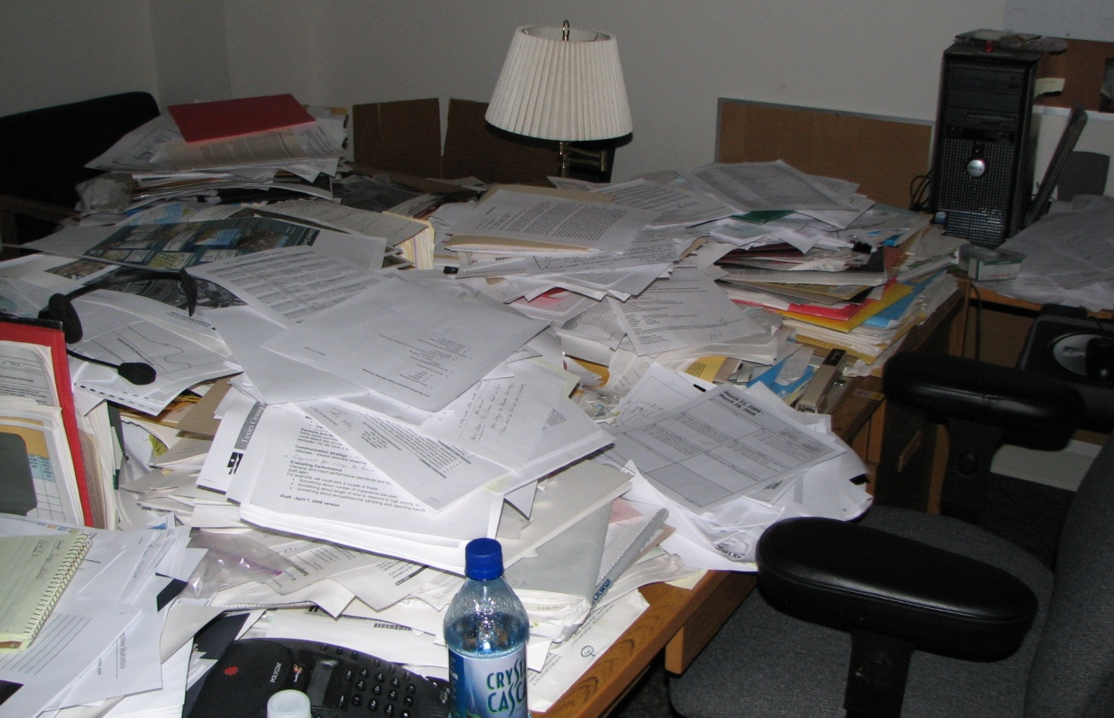
File it – it’s not just for paper

Slide 31
Create a plan
Create a “file plan” or “file structure”
Link to retention schedules
Pre-determined file folders provide consistency, centralization and organization
Mirror the plan throughout – use same structure for paper, email, desktop, network drives and servers
Develop desk guides and cheat sheets

Slide 32
Disposition- Do it!
Organize to destroy
Apply same retention and disposition practices to electronic records as you would paper based records
Regularly schedule disposition to clear out those items having met retention and get rid of them!
Sweep out the garage!

Slide 33
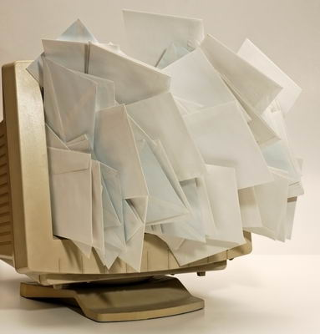

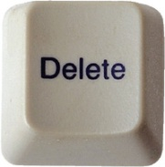

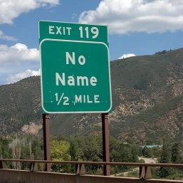
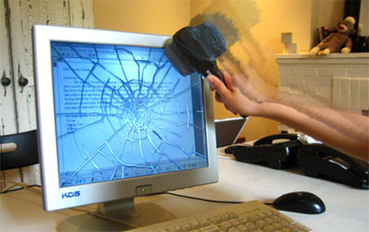




Electronic Record Life Cycle
CONSIDER CONTENT
If NO retention value Delete
Create or Receive Record
Record / Save
Properly ID
DESTROY and document destruction
When retention is met, ID records for destruction
Non-Archival
Keep until retention met
If Archival
Transfer
Approve for destruction

Slide 34
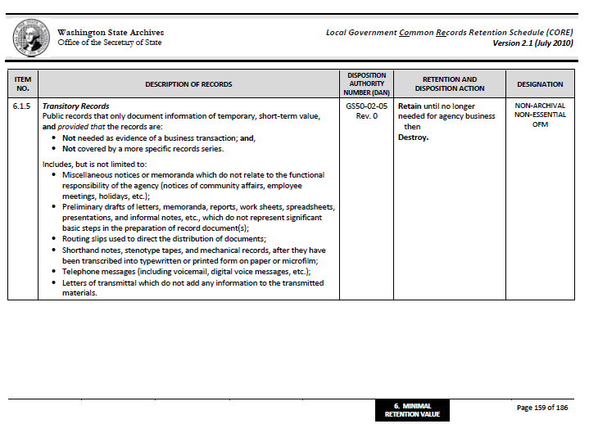
Little or no retention
Local Government Agencies

Slide 35
Organizing Emails – Option 1
Within email application
Individual users move e-mails into pre-determined folders that match those on server or shared drive
Good to set up as “working files”, or for records with minimal retention value
Recommend records with significant retention value be retained on drives or servers

Slide 36
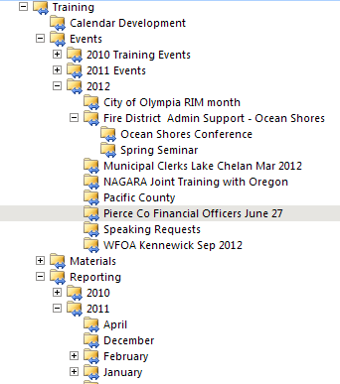
For example
Additional folders can be set up to further define the content – easy to locate and search, under DAN # GS 22005
Mirror this structure on shared drive or server for records with retention value

Slide 37
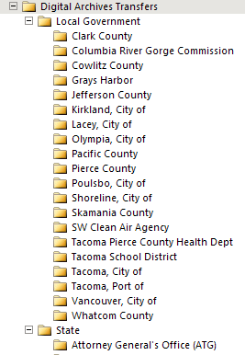
Another example
Outlook file structure

Slide 38
Organizing E-mails – Option 2
Using shared drive or network server
Designated shared drive or server is used as centralized “file cabinet” or repository
Users save their emails into pre-determined folders in specific “drawers”
Users can access in a centralized location
Generally no active retention or disposition applied, but can set up system administrators to track and disposition

Slide 39
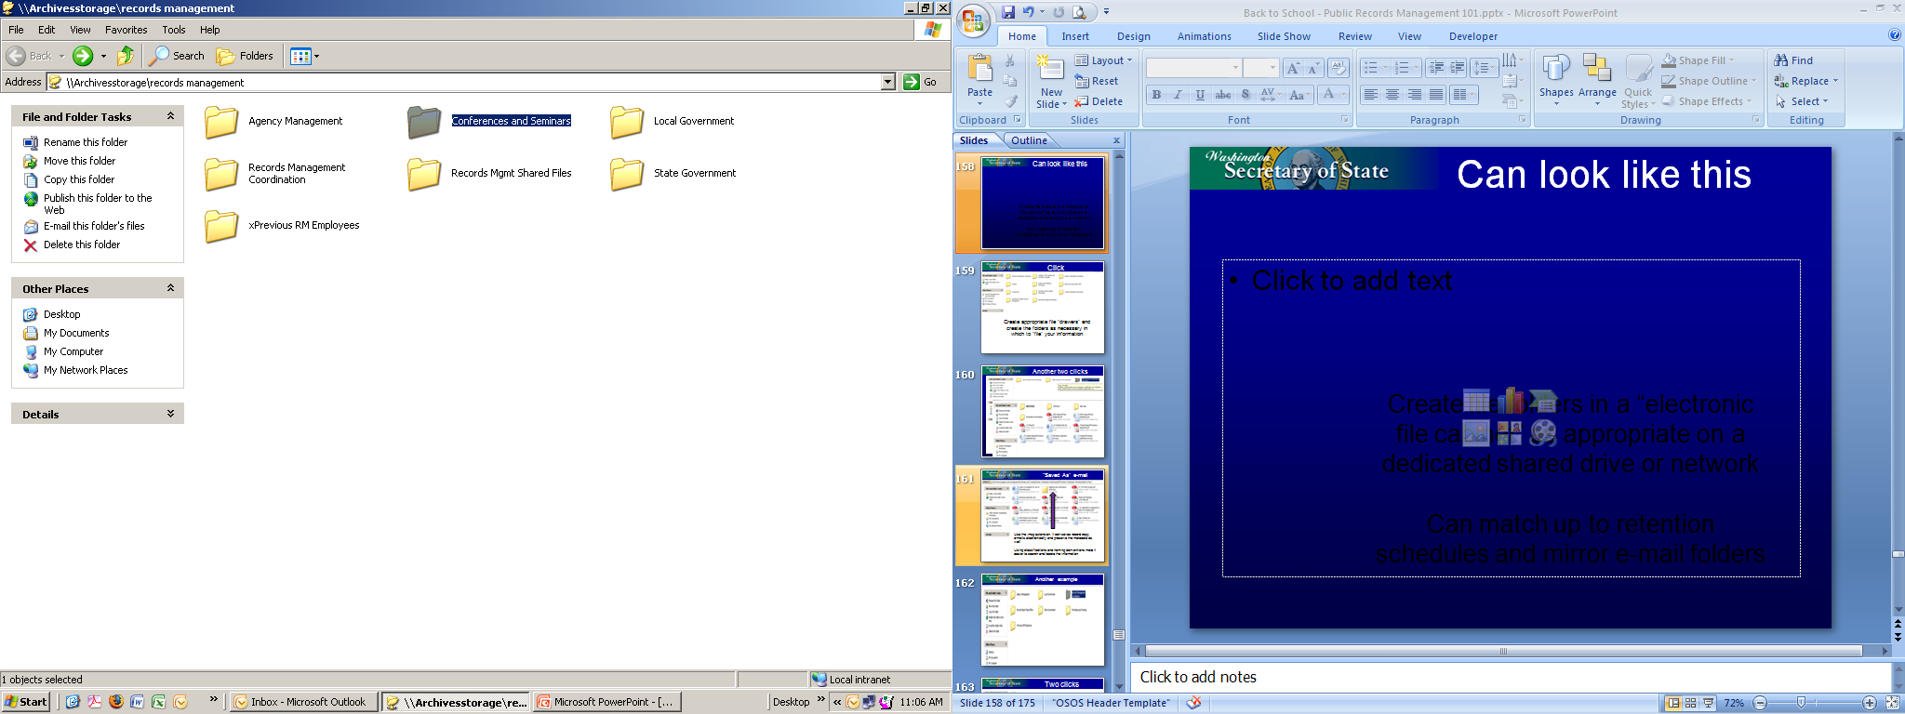
Can look like this
Training (Conferences & Seminars
GS22005
Create file “drawers” and create appropriate folders in a server or shared drive “electronic file cabinet”
Marry up with appropriate retention schedules and mirror pre-set email folders

Slide 40
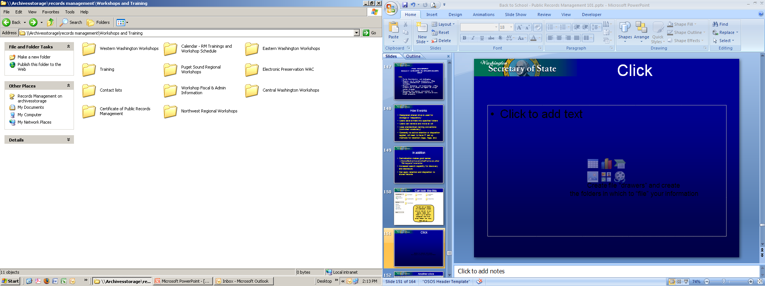
Next click
Create appropriate file “drawers” and create the folders as necessary in which to “file” your information – all of these are still GS 22005

Slide 41
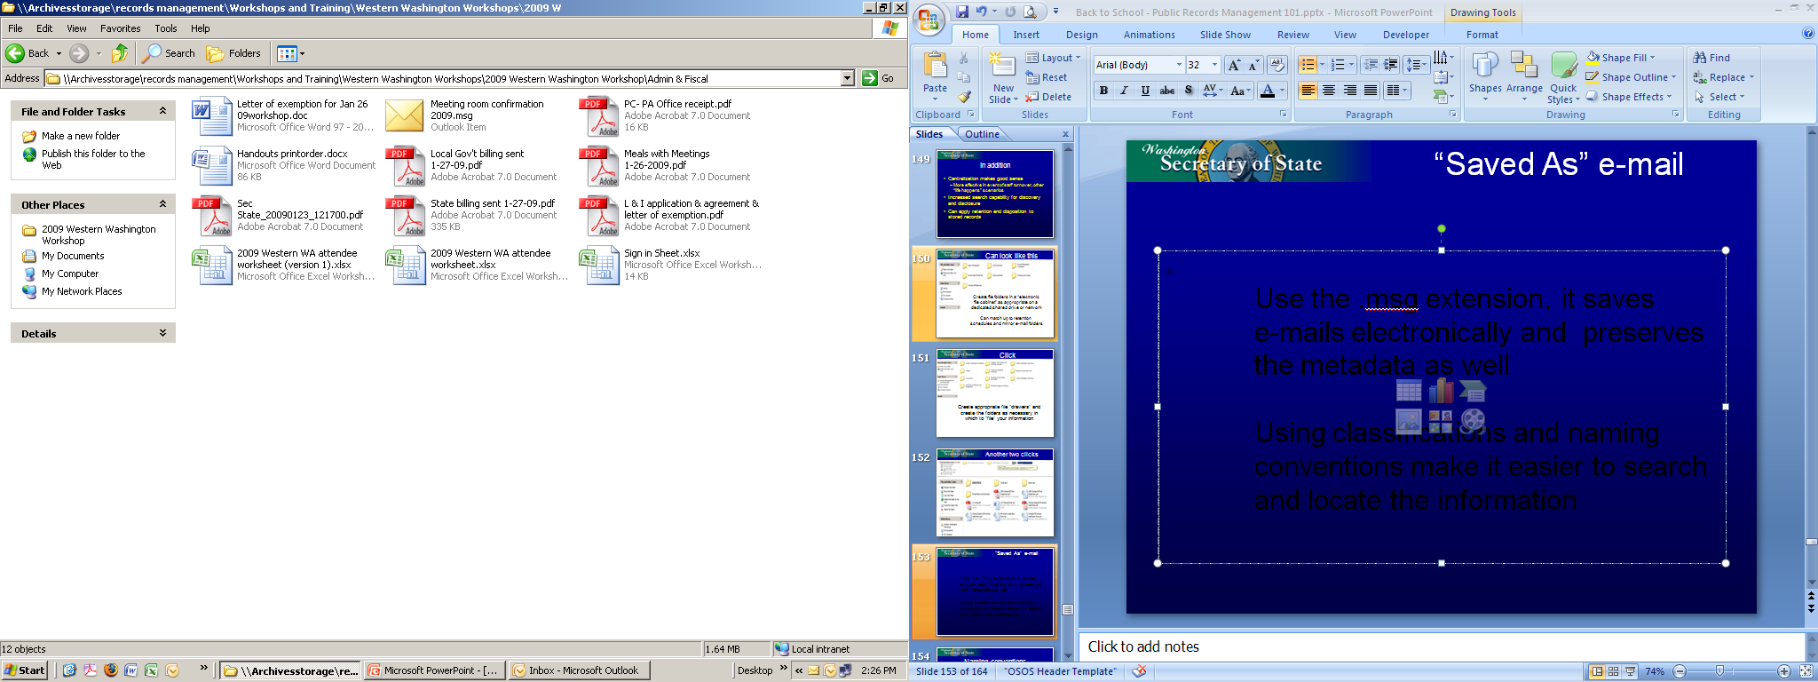
Email regarding meeting room contract
By using the .msg extension, it can saves record copy
emails electronically and preserve the metadata as well – also will save attachments
Using classifications and naming conventions make it easier to search and locate the information

Slide 42
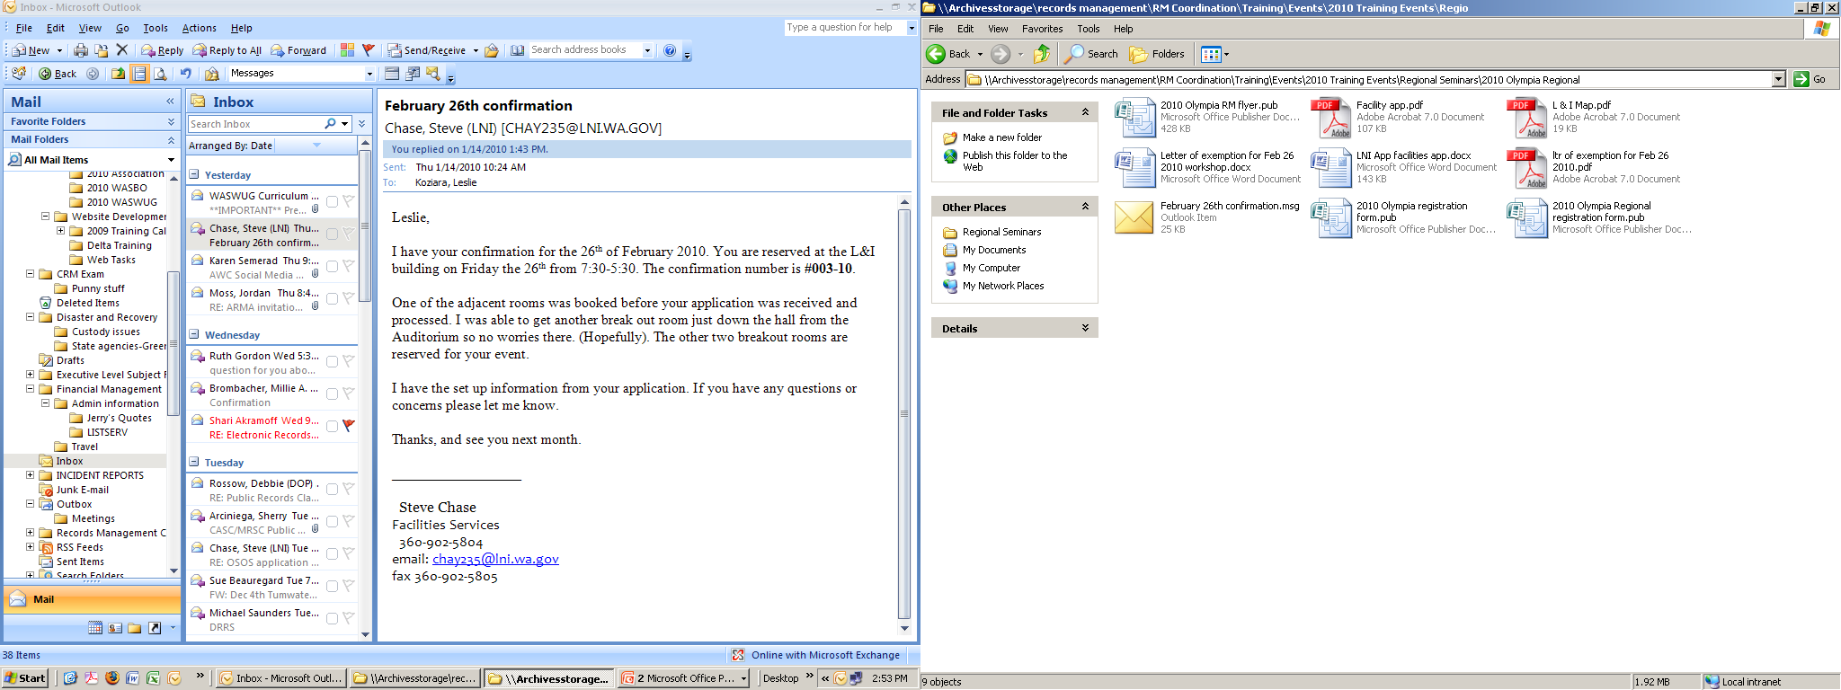
Email saved using .msg extention in server along with other formats
Drag and drop

Slide 43
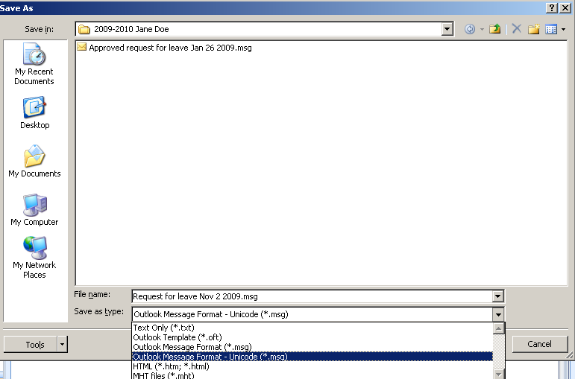
BBy using the .msg extention, you are able to save emails along with all the other formats together in one place under one record series, all under the same retention and manage it as a whole instead of bits and bytes
One place, one folder, one retention

Slide 44
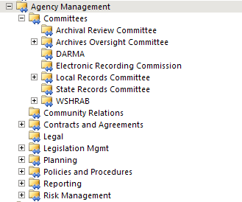
Another example

Slide 45
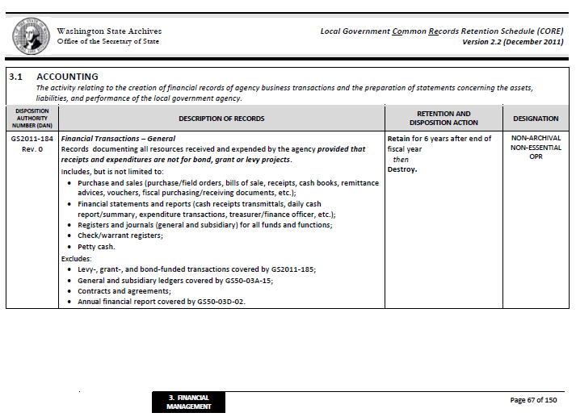
Local Gov’t CORE

Slide 46
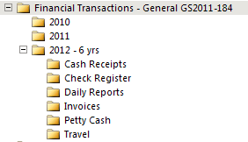
An example
Additional file folders can be created
as necessary under each record series
Additional records series under a category
can be added

Slide 47
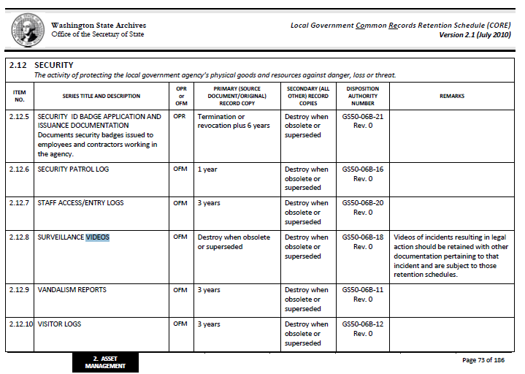
Local Govt CORE

Slide 48
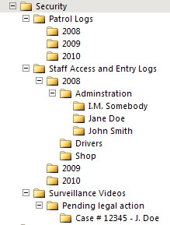
Local Gov’t CORE

Slide 49
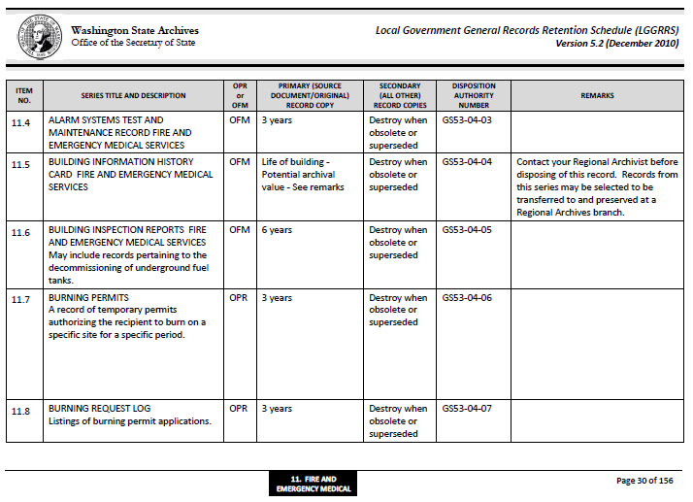
Fire and Emergency

Slide 50
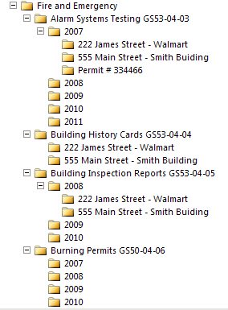
Example file plan

Slide 51
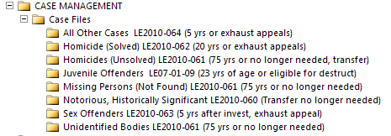
Law Enforcement

Slide 52
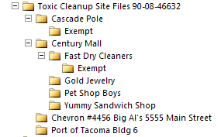
This series is ARCHIVAL - 9 year retention for agency, then transfer to archives
You may create and protect folders as exempt or confidential

Slide 53
What About Text Messages?
Content is key – are you conducting business?
Have policies regarding use of texts
Agency responsibility to capture texts that need retention according to approved schedules
3rd party tools/applications available
Cannot rely on provider to retain!

Slide 54
Helpful hints
Use existing retention schedules!
Consult with users, enlist their input
Work on keeping file names short and simple, yet make sense to users
Keep it under 255 characters & spaces, otherwise may have problems with access and retrieval
Notes:
Can link to existing approved schedules, adapt to agency needs

Slide 55
What About Websites?
Records Retention – 3 areas
  Website Design/Architecture
  Website Content
  Changes to Website Content

Slide 56
Website Design / Architecture
Records documenting the technical design and structure of website
  the look and feel of your website
Includes connection between the website and other databases and applications
Webpage style templates
Notes:
What is a Record Series? KEY = information that’s related (same action or same subject)
This records retention schedule documents the life cycle of a records series. This means:
all books, papers, microforms, computer-readable materials, maps, photographs, film, video and sound recordings, or other documentary materials, regardless of physical form or characteristics, made or received by any agency in connection with the transaction of public business
Records Series can be:
Simple: Birth Certificates; Complex: Case Files and Personnel File
Combined media types: may contain paper, electronic, photographed, imaged.
Example: OFFENSE/INCIDENT REPORTS Investigation reports and notes; witnesses and suspects statements; results of chemical analysis and polygraph tests; crime scene information and photograph, citations.
No matter what media types they must all be disposed of as a unit!

Slide 57
Content
Typically, website content falls into these main categories:
  Secondary Copies of Other Public Records
  Database-Driven Content
  Advice / Information

Slide 58
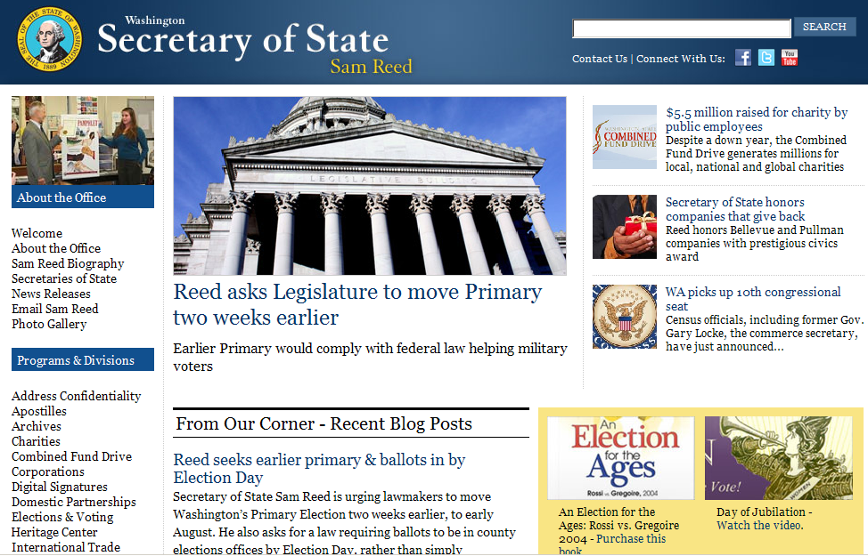
Notes:
An example of our own website, and all the different aspects – we’ve blogs, twitter, facebook. You can purchase a book, watch a video etc. Step back and dissect – what needs to be kept , anything secondary copy, what might be a primary copy?

Slide 59
Secondary Copies - Retention
How to apply retention:
  Manage the agency’s primary copy
  Use appropriate record series based on the function and content of the record
  Treat web version as secondary copy
Notes:
What is a Record Series? KEY = information that’s related (same action or same subject)
This records retention schedule documents the life cycle of a records series. This means:
all books, papers, microforms, computer-readable materials, maps, photographs, film, video and sound recordings, or other documentary materials, regardless of physical form or characteristics, made or received by any agency in connection with the transaction of public business
Records Series can be:
Simple: Birth Certificates; Complex: Case Files and Personnel File
Combined media types: may contain paper, electronic, photographed, imaged.
Example: OFFENSE/INCIDENT REPORTS Investigation reports and notes; witnesses and suspects statements; results of chemical analysis and polygraph tests; crime scene information and photograph, citations.
No matter what media types they must all be disposed of as a unit!

Slide 60
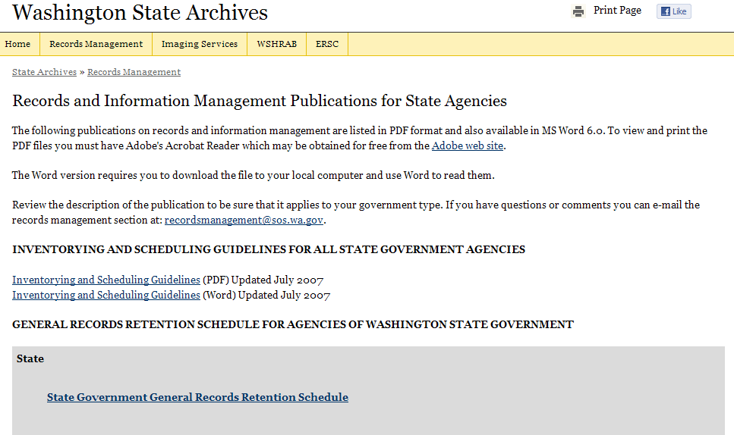
Contains secondary copies of approved retention schedule

Slide 61
Content – Database-Driven
How to apply retention:
  Manage the record within the database as the agency’s primary copy
  Use appropriate record series based on the function and content of the record
  Records documenting the rules governing database / website interaction are covered by website design
Notes:
What is a Record Series? KEY = information that’s related (same action or same subject)
This records retention schedule documents the life cycle of a records series. This means:
all books, papers, microforms, computer-readable materials, maps, photographs, film, video and sound recordings, or other documentary materials, regardless of physical form or characteristics, made or received by any agency in connection with the transaction of public business
Records Series can be:
Simple: Birth Certificates; Complex: Case Files and Personnel File
Combined media types: may contain paper, electronic, photographed, imaged.
Example: OFFENSE/INCIDENT REPORTS Investigation reports and notes; witnesses and suspects statements; results of chemical analysis and polygraph tests; crime scene information and photograph, citations.
No matter what media types they must all be disposed of as a unit!

Slide 62
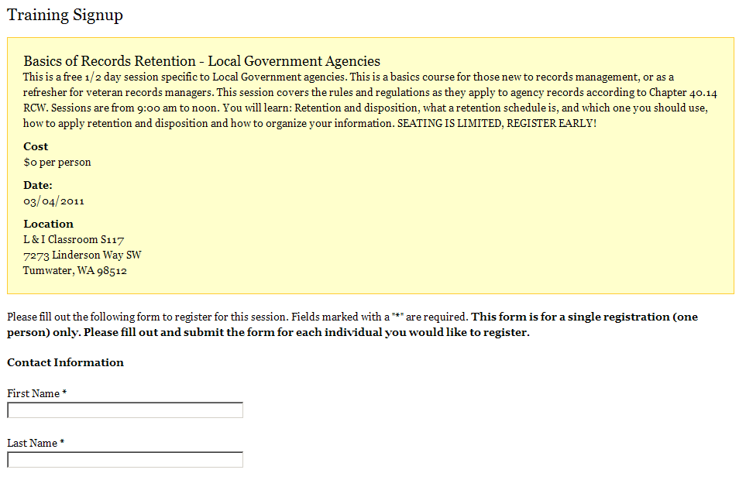
Online registration - database
Conferences and Seminars
GS 22005
3 years after date of event
Information is generated through web form and put into a database
Website is only place this record is generated
Notes:
This is from our very own online registration. Information dumped into an database, information then managed within database. Retention for conferences and seminars GS

Slide 63
Why Document Changes
It is not enough to just know what you said (the content)
Agencies also need records documenting when did we say it and when did we stop saying it (the context to the content)

Slide 64
Capturing websites
It depends on the complexity of website
Options include:
Snapshots
Email confirmations/webmaster
Change logs/audit logs
Maintaining entire site
3rd party software for ECM
  Drupal, ColdFusion, Alfresco

Slide 65
What about databases?
Apply same principles as websites
  Based on content and function of database
  Is it a repository of information held elsewhere?
  Does it contain evidence of business transactions not found in another format?
  Is the database dynamic with continuous changes, updates?

Slide 66
Capturing databases
It depends on the complexity and function of database
Options include:
Change logs/audit logs
Maintaining entire database
3rd party software for ECM

Slide 67








Do you?

Slide 68
Points to ponder
Ask some questions:
Make a business case for use – do you really need to add another “technology du jour”?
Check with legal counsel
Check out terms of service agreements
Notes:
Dade County Florida – Prosecuting attorney recommended county agencies NOT use facebook due to risk and potential pitfalls.

Slide 69
TOS Agreement = Contract
Security, identity “hijacking”
Indemnity issues
Privacy, data ownership
Rights of company to edit/display/advertise
Addressing merger/acquisitions
Will use meet overarching regulations?
  FOIA, ADA, RCW’s, WAC’s
Notes:
Some issues to discuss – you will never be able to rely on cloud providers i.e. social media to manage your information.

Slide 70
Hot off the press
Facebook now has state and local government terms of service agreements
Go to very bottom of first Facebook page– click on Terms
Go to very bottom again – click on Pages Terms
Go to very bottom again – click on Amended Pages Terms for State and Local Governments in the United States

Slide 71
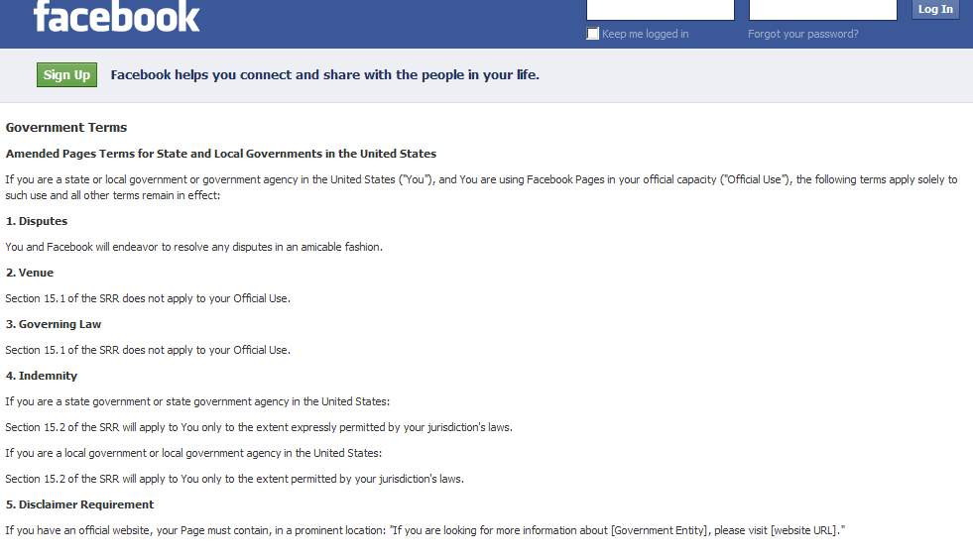

Slide 72
Tips and tools to aid social media retention
  Series of email exchanges on content, when posted, when withdrawn, updates, etc.
  3rd party software or content management systems
      TwInbox
      TweetTake
      SocialSafe

Slide 73
Going to the cloud
Issues to consider:
Custody
Co-mingling of data (will probably not be held separately from others using storage server)
Privacy, security / hijacking of information
Data transmission/flow (Where is the server, exactly?
Disaster preparedness and recovery

Slide 74
Clouding the issue
What about the vendor:
  How stable? What’s their history?
  Do they outsource or sub-contract ?
  How proprietary are their applications?
  Their hiring practices for employment? Are there background checks, etc?
  Their overall audit / security processes?
  Can your rules apply?

Slide 75
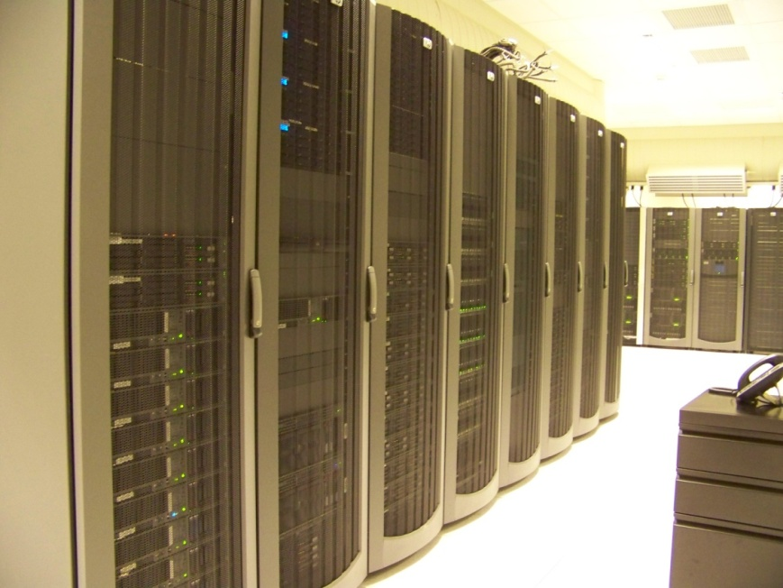
Introduction to the Digital Archives
    Opened in 2004 in Cheney, WA
2005 3.5 million records
2006 6 million records
92 million records
100 million and adding daily!
Notes:
What kinds of records?
Most from local government agencies: County Auditors recordings, Minutes, Ordinances, Resolutions from governing bodies – municipal, county, and special districts. Historical records from the past from our branches: birth, death, census, naturalization.

Slide 76
Digital Archives Value
Access and convenience
Reduce agency workload
Limited business resumption
Digital Archives migration strategy
There is no charge for any of this!
Notes:
Benefits the public

Slide 77
Transferring Your Records
Part 1: Set It Up
  Consultation
    Call your regional consultant
  Forms Generation
    Transfer Agreement and Plan
  Transfer
    Secure SFTP or Hard Drive
  Ingestion
    Security and error checks
Notes:
77

Slide 78

Transferring Your Records
Biggest Challenge
Biggest challenge to the Digital Archives:
Multiple proprietary formats!
When purchasing an electronic records management system, please let your vendor know that the Digital Archives has an acceptable data export format. We will be glad to work with your vendor so that we can preserve your records.
Notes:
78

Slide 79
In conclusion…
Explore available options, and adapt them to best serve agency needs and usage
  Establish policies, procedures, ground rules
  Take time to fully develop file structures and plan, plan, plan for implementation
  Keep it as simple as possible
  Education, training, and more training
  Lots of patience (Chocolate helps!)

Slide 80
Questions?
Records Management Helpdesk
recordsmanagement@sos.wa.gov
Subscribe to listserv for the latest updates
http://www.sos.wa.gov/archives/
RecordsManagement/

Slide 81
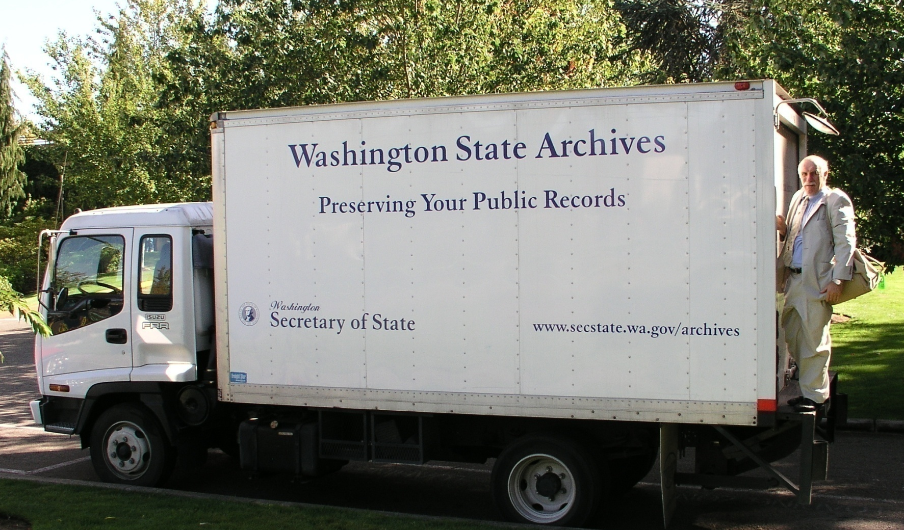
Records Rule!
Thank You!
Washington State Archives:
Partners in preservation and access
www.sos.wa.gov/archives

