Slide 1
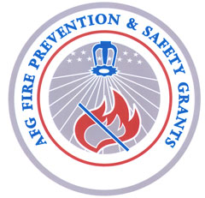
Community Risk Reduction for Fire Department Leaders, Part 1. Introduction

Slide 2
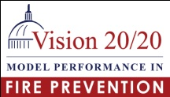
What is Community Risk Reduction?
Definition
An approach for fulfilling the mission of the fire department through strategies designed and implemented at the station level that target and reduce key risks of that particular community.

Slide 3
What is Community Risk Reduction?
Characteristics of CRR
Proactive
Systematic
Prevention-oriented
Community-based (Fire Station-based)
Data-driven
Effective
Responsive to resource constraints (efficient)

Slide 4
What is Community Risk Reduction?
6 Steps
Identify Risks
Prioritize Risks
Develop Strategies & Tactics to Mitigate Risks
Prepare the CRR Plan
Implement the CRR Plan
Monitor, Evaluate, & Modify the Plan as Needed

Slide 5
What is Community Risk Reduction?
Identify Fire and Life Safety Risks
Prioritize the Risks
Choose How to Prevent the Risks or Reduce the Effects of the Risks
Involve Community Partners to Plan and Implement with You

Slide 6
Community Risk Reduction
I. Participant Introductions

Slide 7
Community Risk Reduction
Participant Introductions
Introduce yourself and report 2 items about yourself:
What is your #1 responsibility as a fire officer -- OR –
What is your responsibility in meeting the mission of your organization
- AND -
What is your experience with CRR?
Participant Introductions

Slide 8
Merseyside Fire and Rescue, Video Part 1.

Slide 9
Community Risk Reduction
II. Lesson Goals and Instructional Objectives

Slide 10
Community Risk Reduction
The GOAL for the lesson is to introduce community risk reduction as a strategy for fire departments, introduce preparing a CRR station plan, develop positive attitudes about community risk reduction and provide motivation to learn more about CRR.
The Target Audience for the lesson is fire officers and chief officers in the fire and emergency response community with little or no prerequisite knowledge of community risk management.

Slide 11
Community Risk Reduction
Instructional Objectives
Upon successful completion of the lesson the participant shall be able to:
1. Define community risk reduction, integrated risk management, risk, mitigation, program outcome
2. List the demographics and other factors that influence residential fire risk
3. List the common fire department functions that contribute to delivering community risk reduction

Slide 12
Community Risk Reduction
Instructional Objectives
Upon successful completion of the lesson the participant shall be able to:
4. Describe the five “E” strategies to mitigate community risk & unintentional injuries
5. List four sources of data to assess risk for community risk reduction
6. List four community risk reduction community partners
7. Describe the fire officer's role in community risk reduction

Slide 13
Community Risk Reduction
Instructional Objectives:
8. Summarize community risk reduction as delivered from the fire station for the 1st due response area (list the 6 steps)
9. List three sources for to learn more about community risk reduction
10. Given an CRR case study identify the benefits of the CRR strategy, key steps and people in the implementation, and identify who is responsible for each step of the CRR Planning that guides the project

Slide 14
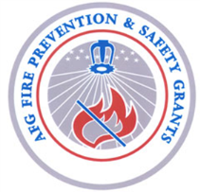
What is a CRR Plan?
The 5 Sections of a CRR Plan:
Section 1: Vision, Mission & More
Section 2: Community/Service Area/Station Demands
Section 3: Identify and Prioritize Risks
Section 4: Determine Strategies & Implementation
Section 5: Monitoring & Evaluation

Slide 15
Community Risk Reduction:
Your Experience
The Lesson Activities
Other Participants
The Instructor
CRR Case Studies
Handouts
Resources
A Station CRR Plan
Vision, Mission & More
Community/Service Area/Station Demands
Identify and Prioritize Risk
Determine Strategies
& Implementation
5. Monitoring & Evaluation

Slide 16
Community Risk Reduction
III. Preparing participants to learn

Slide 17
Community Risk Reduction Vocabulary
Definitions:
Prevention
Risk
Loss
Mitigation

Slide 18
Community Risk Reduction Vocabulary
Prevention
Prevention is a critically acclaimed second studio album by Scottish band De Rosa released March 2, 2009
Prevention is a magazine about health in the United States
Prevent is a former company from Slovenia, and
There is a prevent defense in American football

Slide 19
Community Risk Reduction Vocabulary
Prevention
Prevention is a critically acclaimed second studio album by Scottish band De Rosa released March 2, 2009
Prevention is a magazine about health in the United States
Prevent is a former company from Slovenia, and
There is a prevent defense in American football

Slide 20
Community Risk Reduction Vocabulary
Prevention
Avoid Deter Anticipate Hinder
Impede Thwart Halt
Bring to an end
Keep an event from occurring

Slide 21
Community Risk Reduction Vocabulary
Risk
Danger, hazard, and a popular board game (now a pricey Ap for iPhone and iPad!)
Potential for Loss
The possibility of loss, injury, or other adverse or unwelcome circumstance

Slide 22
Community Risk Reduction Vocabulary
Mitigation
Alleviate Reduce Ease Lessen harm of event
Reduce impact of event
Mitigation is the effort to reduce loss of life and property by lessening the impact of natural and human caused disasters or events
Make less severe, serious, or painful
a mitigated risk is a diminished risk. This means the risk had been reduced.

Slide 23
Community Risk Reduction Vocabulary
Mitigation
The threat of wildland fires for people living near wildland areas or using recreational facilities in wilderness areas is real. Dry conditions at various times of the year and in various parts of the United States greatly increase the potential for wildland fires. To assess the risk consider:
fire resistance of your home
topography of your property
the vegetation close by
(Not prevent the wildfire but reducing the impact)

Slide 24
Community Risk Reduction Vocabulary
Risk
Potential for Loss
Balance: Low probability and enormous loss
High probability and less loss
Consider the Fukushima TEPCO Nuclear Power Reactors
What was the probability? What was the loss?
Consider a 6 year old falling off a bicycle riding without training wheel the first time. What was the probability? What was the loss?

Slide 25
Community Risk Reduction Vocabulary
Risk
Potential for Loss
Balance: Low probability and enormous loss
High probability and less loss
Consider a fire in family home with 4 people asleep. What is the risk. How is the risk mitigated?
Consider a fire in a 7 story hospital with full occupancy. What is the risk. How is the risk mitigated?

Slide 26
Community Risk Reduction Vocabulary
Loss
Deaths Injuries Property
Direct Loss
Indirect Loss
(damage/harm/injury/cost experience)

Slide 27
What is a CRR Plan?
The 5 Sections of a CRR Plan:
Section 1: Vision, Mission & More
Section 2: Community/Service Area/Station Demands
Section 3: Identify and Prioritize Risks
Section 4: Determine Strategies & Implementation
Section 5: Monitoring & Evaluation

Slide 28
Community Risk Reduction-Prevention Strategies
Prevention Strategies
Education
Engineering
Enforcement
Economic Incentive
Emergency Response

Slide 29
Community Risk Reduction-Prevention Strategies
Education
The purpose of prevention education is to raise public awareness, provide information and knowledge, and ultimately produce desired low-risk behavior.
Knowledge, Skills, Attitudes, Behavior Change,
Educational Gain

Slide 30
Community Risk Reduction-Prevention Strategies
Engineering – New Products New Technology
Modifying the product or the environment to prevent or mitigate the injury
CFCI Child Passenger Seats
Cribs Bicycle Helmets
Sprinklers Smoke Alarms
Construction design
Double wall chimney flues

Slide 31
Community Risk Reduction-Prevention Strategies
Enforcement
Adopt codes and ordinances
City building codes
Emergency Exits
Fences around swimming pools
Width of streets for fire apparatus
Federal regulations
Seat belts and air bags in vehicles
Airline passenger rules
Tobacco sales to minors
Fire Sprinklers in Hotels and Motels

Slide 32
Community Risk Reduction-Prevention Strategies
Enforcement
Enforcement attempts to reduce dangerous behaviors through legislation and its enforcement. Legislation can target behaviors by individuals, manufacturers, and local governments.
Examples of state and local injury laws include:
regulating the color and speed capacity of school buses;
mandating that buildings be constructed to meet codes and standards;
requiring people to report child abuse; and
restricting the sale of alcohol to minors.
All these laws would be useless if they were not enforced. In addition, education plays a key role in informing people of their responsibilities under these laws.

Slide 33
Community Risk Reduction-Prevention Strategies
Enforcement
Review of plans
Inspections
Under constructions
Before occupancy
During operation
Penalties for non compliance
Fines for property owner
No license to operate
Penalties for not following the legal requirements are used to influence the actions of individuals, organizations and businesses to reduce risk and injury

Slide 34
Community Risk Reduction-Prevention Strategies
Enforcement, Education and Engineering
Combination of these 3 = Big Success in Injury Prevention
Seat belts
Federal regulation for mfg of all vehicles
Penalties for non use
Public Education

Slide 35
Community Risk Reduction-Prevention Strategies
Economic Incentives
Economic incentives are used as incentives or deterrents to personal or corporate behavior.
The goal is to change behavior and behavioral risk factors

Slide 36
Community Risk Reduction-Prevention Strategies
Emergency Response
Effective emergency response can mitigate the loss of an unintentional injury.
Appropriate Equipment
Trained Responders
Timing

Slide 37
Community Risk Reduction-Prevention Strategies
Enthusiasm of a Few
A small group of thoughtful people could change the world. Indeed, it's the only thing that ever has. Margaret Mead

Slide 38
Community Risk Reduction
Participant Exercise #1
Use one of the Scenarios as an Example before the participants begin.
Read the scenario and lead participants through discussing the E’s strategies to prevent/mitigate the risk/loss in the scenario

Slide 39
Community Risk Reduction
Participant Exercise #1
Each group has 3-5 minutes to read the scenario and to choose how to mitigate loss/risk with at least 2 of the E Prevention Strategies
Prepare a 90 sec report to the class :
The scenario loss/risk
The E’s you chose to mitigate the loss/risk

Slide 40
Community Risk Reduction
Participant Exercise #1
Participants report

Slide 41
Community Risk Reduction How the E’s prevent/mitigate fire loss:
Conclusion Exercise #1
MGM Grand Fire Las Vegas November 1980
85 die 650 injuries
1972 Construction Cost $106 Million
Owners fought the
installation of
sprinklers Cost $192,000
(.1% of the construction $$)

Slide 42
Community Risk Reduction How the E’s prevent/mitigate fire loss:
Conclusion Exercise #1
Station Nightclub Fire, West Warwick, RI
February 2003
100 die 230 injured 132 escaped
No sprinklers
Combustible interior
Fireworks inside without permit
Fire was so fast no time to exit
Exits met the code

Slide 43
Community Risk Reduction How the E’s prevent/mitigate fire loss:
February 24, 2011 Houston
Daycare fire
February 25, 2001 Phoenix
Daycare fire

Slide 44
Community Risk Reduction How the E’s prevent/mitigate fire loss:
February 24, 2011 Houston
Daycare fire: 4 die, 3 injured
February 25, 2001 Phoenix
Daycare fire

Slide 45
Community Risk Reduction How the E’s prevent/mitigate fire loss:
February 24, 2011 Houston
Daycare fire: 4 die, 3 injured
February 25, 2001 Phoenix
Daycare fire: All waited safely at the store next door for firefighters to clean up the water

Slide 46
Community Risk Reduction How the E’s prevent/mitigate fire loss:
February 24, 2011 Houston
VS.
February 25, 2001 Phoenix
The DIFFERENCE was Sprinklers
4 children die 50 children safe

Slide 47
Community Risk Reduction
IV. Community Risk Reduction Terms

Slide 48
Community Risk Reduction
WHAT: … fulfilling the mission of the fire department through strategies designed and implemented at the station level that target and reduce key risks of that particular community.
HOW: Target loss/risk
-at the lowest level in the Fire Department
-at the most basic route/cause of the risk
-with the people who are most effected & have the most to loose

Slide 49
Community Risk Reduction
HOW: Target loss/risk
-at the lowest level in the Fire Department
-at the most basic cause of the risk
-with the people who are most effected
& have the most to loose
REMEMBER: THE Risk varies by location -
Each fire station will have different:
Risk, Effected People and Partners

Slide 50
Community Risk Reduction
“The more we know about which groups are at greatest risk and under what circumstances, the more effective we can be at targeting resources and developing the means to mitigate these risks.”
U.S. Unintentional Fire Death Rates by State John R. Hall, Jr., May 2010.

Slide 51
Community Risk Reduction Vocabulary
Definitions:
Demographics
Socioeconomic
Process Evaluation
Formative Evaluation

Slide 52
Community Risk Reduction Vocabulary
Demographics
Demographics or demographic data are the characteristics of a human population include gender, race, age, income, disabilities, mobility (in terms of travel time to work or number of vehicles available), educational attainment, home ownership, employment status, and even location.

Slide 53
Community Risk Reduction Vocabulary
Socioeconomic

Slide 54
Community Risk Reduction Vocabulary
Process Evaluation
Formative Evaluation

Slide 55
Community Risk Reduction
V. What is CRR and Why is it important

Slide 56
What is Community Risk Reduction and Why Is It Important
Case Study
Britain Experiences 40% Reduction in Fire Loss
Merseyside Fire and Rescue Video 8 minute Movie

Slide 57
Community Risk Reduction
Participant Exercise #2
Britain Case Study
Each group has 10 minutes to read the case study answer the questions assigned
Prepare a 2 minute report to the class:
Read the assigned question
Give your answers

Slide 58
Community Risk Reduction
Participant Exercise #2
Britain Case Study
Participants report

Slide 59
Community Risk Reduction
VI. Model for a CRR Station Plan

Slide 60
What is a CRR Plan?
The 5 Sections of a CRR Plan:
Section 1: Vision, Mission & More
Section 2: Community/Service Area/Station Demands
Section 3: Identify and Prioritize Risks
Section 4: Determine Strategies & Implementation
Section 5: Monitoring & Evaluation

Slide 61
CRR Station Plan
Overarching Principles
The fire station staff know their area
Involve the target audience
Engage partners
early
involve in planning
determining strategies
implementation
Partnerships are a key to reach any audience especially those at highest risk

Slide 62
The slides from Lydia go here in the PowerPoint.
There are some place holders with the 5 Sections that can be eliminated.
Lydia has examples of application of each section – we can decide about expanding them – i.e. the data examples that are in the identify risk section

Slide 63
CRR Station Plan
Section 1: Vision, Mission & More

Slide 64
CRR Station Plan
Section 2: Community/Service Area/Station Demands

Slide 65
CRR Station Plan
Section 3: Identify and Prioritize Risks

Slide 66
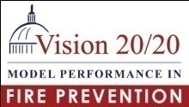
To Identity Risk - Use Data …
Use Data to Identify Risks – current and trends
a. Collect & analyze data:
b. Identify risks –mapped geographically (GIS) is best
Emergency runs Injuries & Deaths Target hazards Demographics | Housing Businesses Crime rates
Cigarette fires False alarms Falls – older adults People with disabilities | Spray booths Poisonings Children playing with fire

Slide 67
Use Data … Philadelphia
Operation Staying Alive!
Each Engine and Ladder company chose one High Risk Area (of 1 block)
Risk was determined by recent fire experience of the company:
A fatal dwelling fire
A recent home fire

Slide 68
Use Data … Wilmington
Residential fires & home fire death 2003-2009 data was highlighted with GIS mapping to show “hot spots”
3 of the 11 fire stations were in the “hot spot” areas and chosen for CRR
These “hot spots” were also in the lower income areas of the community

Slide 69
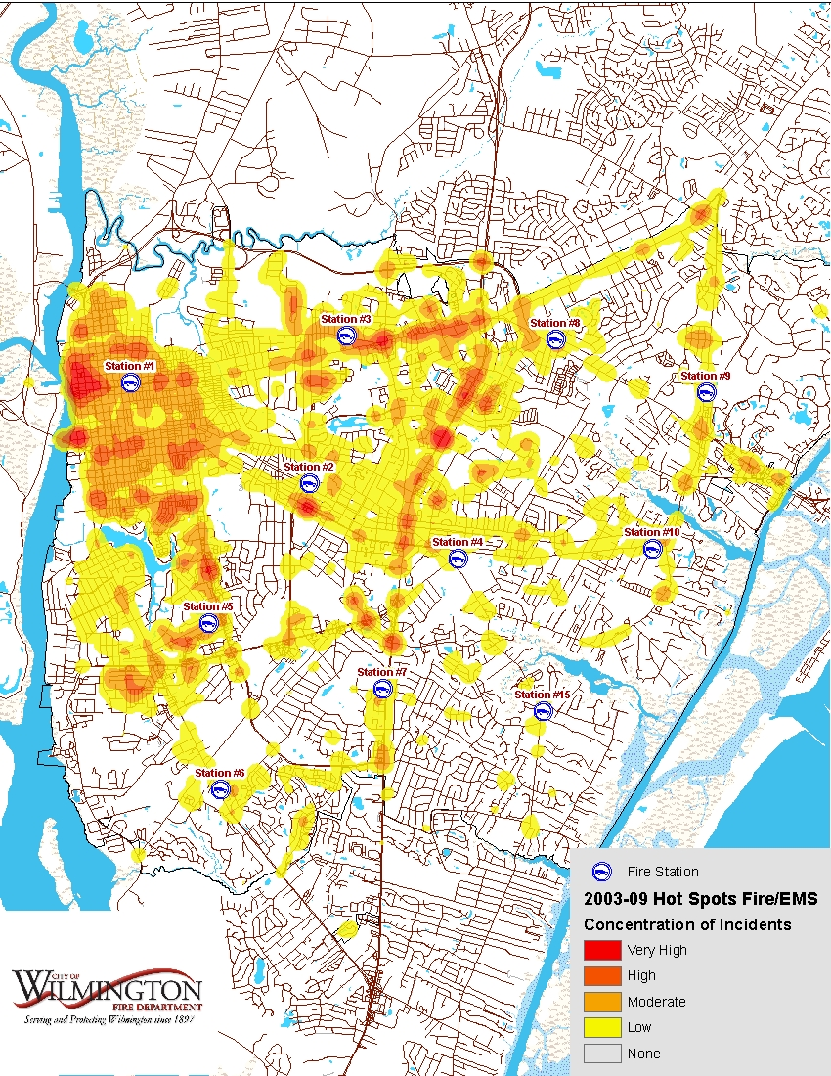
Use Data … Wilmington
11 Fire Stations
Choose 3 for CRR

Slide 70
Use Data … Wilmington
3 Fire Stations
In Higher Risk Areas
#1 #3 #5

Slide 71
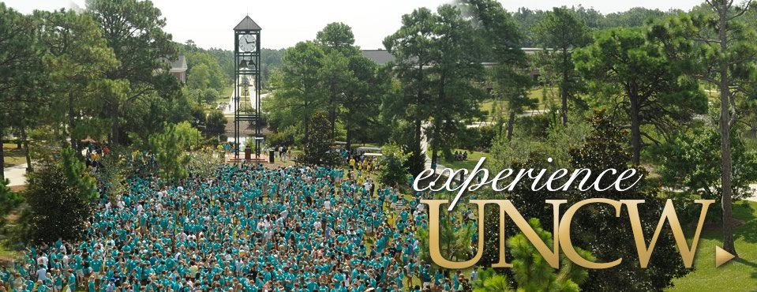
Use Data … Wilmington
What other risk in Wilmington?
Students in off campus rental housing
Station #4 is the UNCW responding station

Slide 72
Use Data … Wilmington
2 Fire Stations serving
UNCW –an area with a High Risk Population
#4 #8

Slide 73
Use Data … Wilmington
What about the other 6 fire stations?
Assess the risk in their area!
Community Involvement
Population Trends
Track Occupancy Changes
Target Business or Manufacturing Risk

Slide 74
Use Data …
1. Use Data to Identify Risks
What are indicators of high home fire risk?
Low Income (poverty)
Low Education (lack of a high school education)
People Who Smoke
Low or High Population Density (rural and very urban)
Young children (4 and under)
Older Adults (65+ risk increases greatly with age)
African American (new)
Native American
People with Disabilities
U.S. Unintentional Fire Death Rates by State, Sept. 2007, National Fire Protection Association
Centers for Disease Control and Prevention

Slide 75
Use Data …
http://www.census.gov/
American FactFinder
Search by City, County, or Zip Code
Get a Fact Sheet for your community
City/town,
County, or zip
State
- - select a state - -
GO
Or select a state using a map

Slide 76
Find Data …
http://www.census.gov/
American FactFinder
Get a Fact Sheet for your
City/town,
County, or zip
Compare Your Local Risk Factors with National Averages
Local USA
Poverty 21.3% 14.3%
HS Education 63% 80%
Disabilities
21 to 64 32% 20%
- - select a state - -
GO
27% less adults with HS
60% more disabilities

Slide 77
Use Data …
Other sources of INFORMATION/DATA:
Community Planning – predictions for population, business, industry, annexation for
growth or decline
Community Development – not for profit or government agencies providing programs & services to assist residents
Other Municipal Sources --

Slide 78
Use Data …
Other sources of INFORMATION/DATA:
Other Municipal Sources – Parks & recreation, law enforcement,
Other Government -- State, county, city heath depts., human services, work force agencies,

Slide 79
Use Data …
Your Station Demand
What other risks are there in your community?
Falls
MVA
drowning
bicycles and skateboards
ATV’s
Insert unintentional injury chart from CDC

Slide 80
The CRR Process …
Identify and Prioritize Risk
Think about the probability of an event occurring and its potential consequence/impact
Solicit input from firefighters, inspectors, investigators, community partners
Consider assigning weights and probabilities to come up with a scoring method for prioritizing risks

Slide 81
CRR Station Plan
Section 4: Determine Strategies & Implementation

Slide 82
CRR Station Plan…
6. Develop Strategies & Tactics to Mitigate Risks
For each risk identified, think about what could be done to prevent or reduce the risk. Use the Five E 's :
Emergency Response: Would changes in our emergency response protocols help?
Engineering: Are there engineering/technology solutions that could help?
Education: Would educating the public help – if so who, what, when, how?
Economic Incentives: Could economic incentives improve compliance and/or raise awareness?
Enforcement: Is stronger enforcement required?

Slide 83
CRR Station Plan
Section 5: Monitoring & Evaluation

Slide 84
Community Risk Reduction
VII. CRR in the USA

Slide 85
The Benefits of Community Risk Reduction
Participant Exercise #3, Part 1.
1.Read the case study
2. Complete the Participant Case Study Worksheet

Slide 86
The Benefits of Community Risk Reduction
Participant Exercise #3, Part 2.
3. Work as a team to “sell” the CRR project(s) in the case study to the person or group identified in your random selection from the BOX
4. Present your persuasive presentation to the class. You have 3 minutes

Slide 87
The Benefits of Community Risk Reduction
Participant Exercise #3, Part 2.
Participants report

Slide 88
Community Risk Reduction
VIII. CRR Solutions to Real Problems
Show Merseyside video Part 3 – emphasizes partners and advocates

Slide 89
Community Risk Reduction
Merseyside
Fire and Rescue Video Part 3

Slide 90
Community Risk Reduction – GO!
Participant Exercise #4
Read the SCENARIO
List information/data needed
Identify community partners
How will you measure outcomes?
CHOOSE an Area
Conduct a “windshield assessment
What do you look for to assess risk
What information does the station have
What is a cost effective Strategy

Slide 91
Community Risk Reduction
An approach for fulfilling the mission of the fire department through strategies designed and implemented at the station level that target and reduce key risks of that particular community.

Slide 92
Community Risk Reduction
Fulfilling the Mission of the Fire Department
Use information to Target Unique Risks of the Community
Manage the Risks with prevention and mitigation Strategies
Projects Designed At the Station Level
Implemented at the Station Level
Involving community partners

Slide 93
Community Risk Reduction
IX. So you want to know more:
Tridata Reports
Vision 20/29 Website with Case Studies
NFA Courses
Other?

Slide 94
Community Risk Reduction
Merseyside Fire Rescue Video Part 4

Slide 95
Community Risk Reduction
Conclusion
“Any person who is at all conversant with fire safety knows that at least eighty-five percent of [fires] could be prevented. It is the duty of the Fire Chief to assume leadership and point out the way for the protection of life and the conservation of property of our citizens.

Slide 96
Community Risk Reduction
If the fire loss of the country is to be reduced, we must get away from the out-of-date methods of the old time red-shirt brigade. They thought the duties of the firemen were to sit around the engine houses waiting for an alarm of fire and then proceed to extinguish it as best they could; but the modern Fire Chief knows that he must be up and doing and prevent fires from starting, if he is to be successful in reducing the loss.”

Slide 97
Community Risk Reduction
Chief W. D. Brosnan of Albany, Georgia, 1928, First Annual Meeting, Southeastern Association of Fire Chiefs

Slide 98
Community Risk Reduction
……but the modern Fire Officer knows that we must be up and doing …. if we are to be successful in reducing the loss…….

Slide 99
Community Risk Reduction
Let each of us be UP and DOING – Community Risk Reduction and preventing loss…

Slide 100
Community Risk Reduction

