Slide 1
Todd Short Ken Carlson Redmond Fire Marshal Bellevue Fire Marshal
The Role of the Fire Marshal

Slide 2
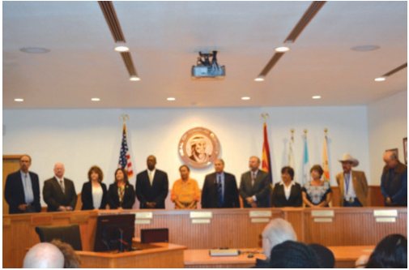
Who’s Job???

Slide 3
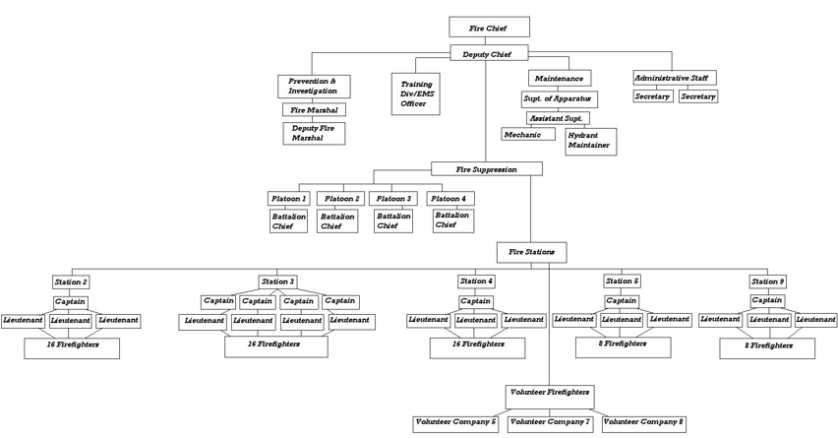
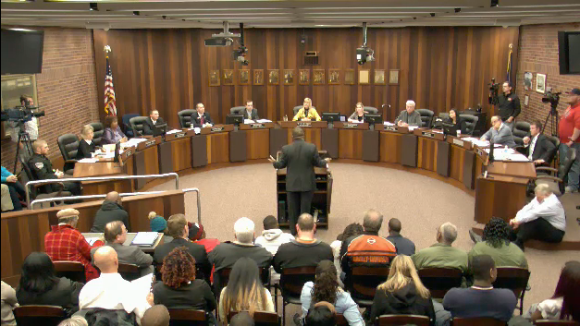
Things that influence the Fire Marshal
Organizational Structure
Size of Organization
Chief
Council and/or Commission
Codes & Standards
Based on our experience…not the only view/perspective

Slide 4
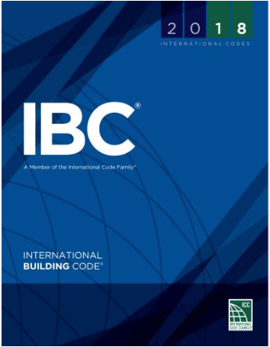
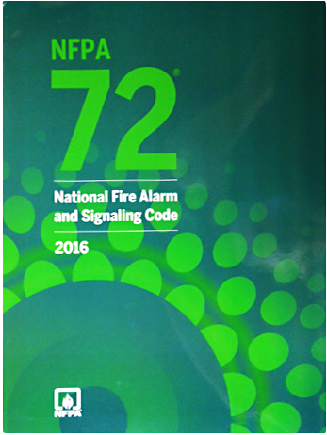
Safety Through Codes
If you aren’t promoting fire and life safety codes who will?
Are you actively involved in code development at the local, state, and national level?
How do you stay in tune with code changes?
Notes:
Inherent with Fire Marshal to advocate for fire and life safety codes.
Explain State of WA code development process.
Inherent with Fire Marshal to advocate for fire and life safety codes.
Explain State of WA code development process.
Identify how you can get involved with WSAFM code development.
Codes are constantly changing and we need to keep up!

Slide 5
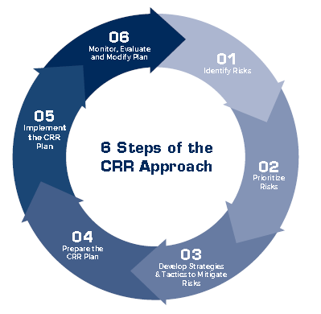
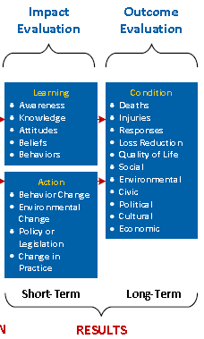
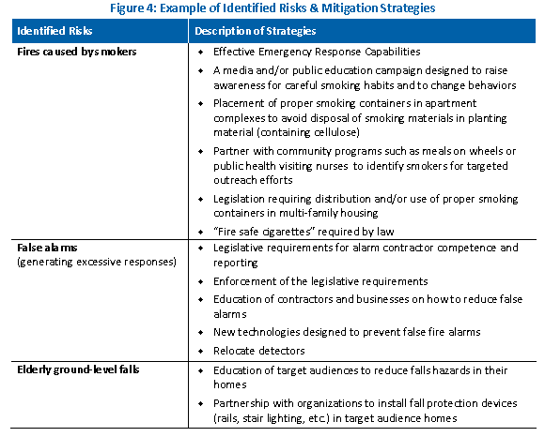
Safety Through Prevention Education
Have you completed your community risk assessment?
How do you measure effectiveness of your programs?
How do you determine your community education needs?
Notes:
Hold up copy of CRR material.
Are you data driven? How do we become data driven? Do you evaluate the programs and report on outcomes?
Examples – food on the stove is most prevalent fire call, what programs are available?

Slide 6
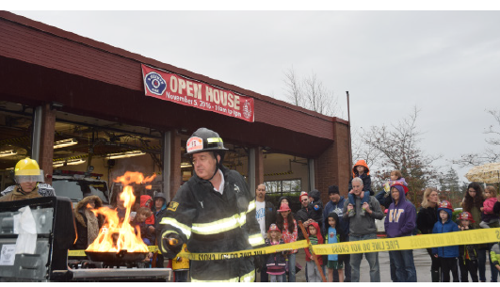
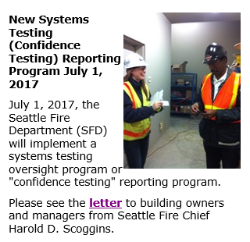
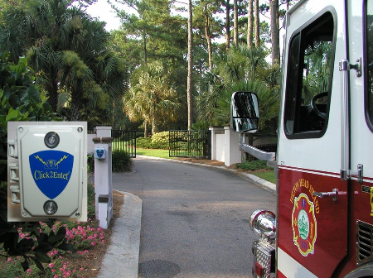
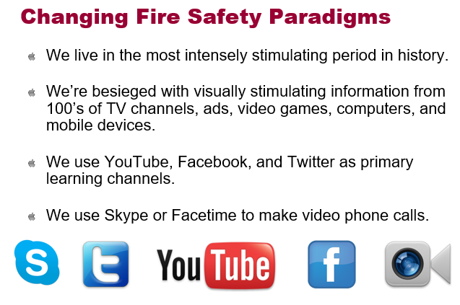
Safety Through Code Compliance
What activities are you promoting to achieve code compliance?
Are you marketing safety or pushing a comply or die message?
Notes:
Examples – The Compliance Engine/Tegris; annual inspections;
Audience- what are you doing to gain code compliance? Anyone using a more customer centric approach?

Slide 7
Consistency
Equal Enforcement
Equal Application of Codes/Standards
Equal Interpretation
Notes:
Do you treat people the same regardless of whether they are a pain or you have a good relationship?

Slide 8
Networking
Association Memberships
Chamber of Commerce
Civic Organizations

Slide 9
Establishing Relationships
Neighboring Fire Marshals
Stakeholders (e.g. schools, Microsoft, Chamber)
FA Advisory Board
Experts
Building Official
Elected Officials
Fire Chief

Slide 10
Ethical
Never Lie (Ever)
Avoid Perception of Impropriety
Trust is earned over years and taken away in seconds

Slide 11
Transparency
Willing to Answer Any Question
Open to Criticism
Open to “Better”

Slide 12
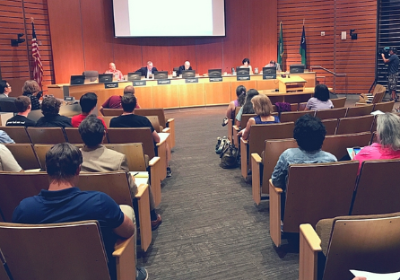
Dealing with the Elected Officials
Know the “rules of engagement” before you engage
Establish Relationships
Meet them outside of critical decision making processes
Connect with key staff serving politicians
Develop trust
Follow through-Always!
Keep them informed about opposing views/risks
Notes:
Examples of

Slide 13
Build Credibility
Do not ever mislead or misrepresent
Don’t ask for things you don’t need
Demonstrate fiscal responsibility
Be prepared with solid facts
Don’t negatively engage with opponents
You are the expert, don’t rely on emotional appeal, stay with facts
Treat everyone with respect, no matter what political level they are at
Notes:
Examples – Master Builders, Fireworks Industry (Jerry Farwell)

Slide 14
Stay Positive and Enthusiastic
Do not engage in tit for tat
Have backup data available to support your stated position
Avoid using humor to press a point

Slide 15
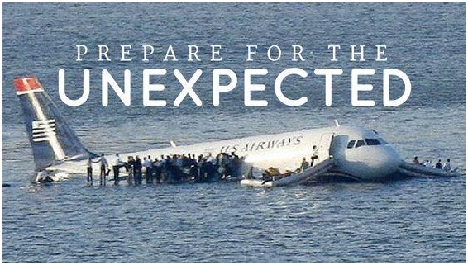
Finally
Capitalize on opportunities
Look for advocates that can support your position
Be prepared for the unexpected, maximize whatever you get

Slide 16
Thank them, when/where appropriate
For their support
For resources
Time
Interest

Slide 17
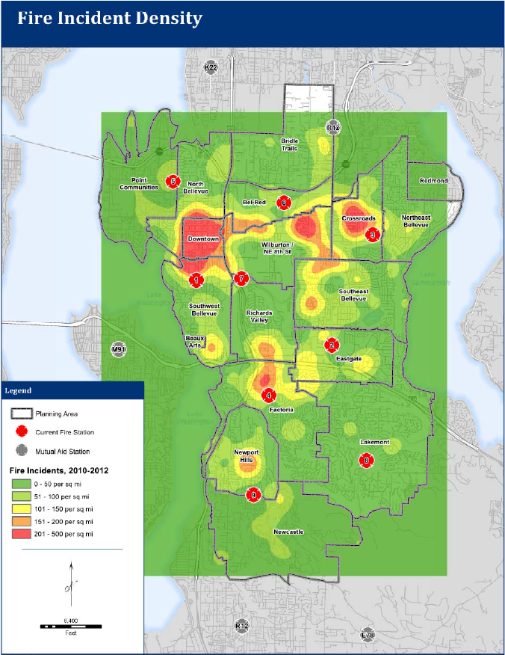
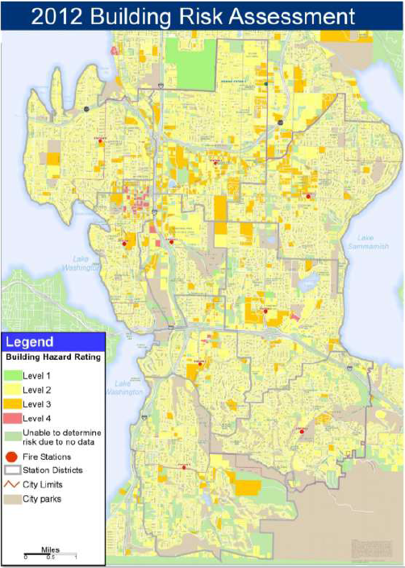
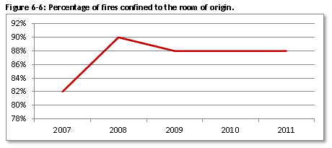
Defining the Problem
First step in process/program improvement is to clearly define the problem.
Data
Evidence
Cost
To the organization
To stakeholders
Of not making the change

Slide 18
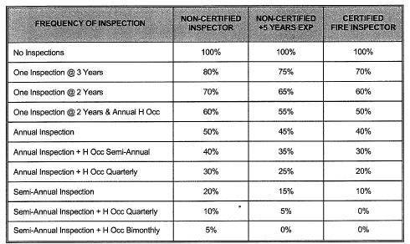
Evaluating Options
What are “others” doing?
Impacts of implementation – positive/negative to organization & stakeholders
Mapping Solutions & Alternatives
Implementation Plan
Notes:
Alignment where possible

Slide 19
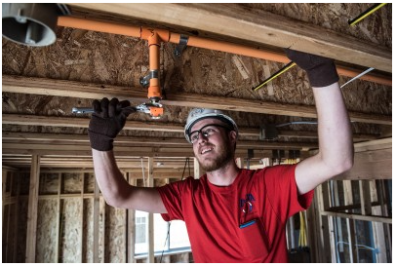
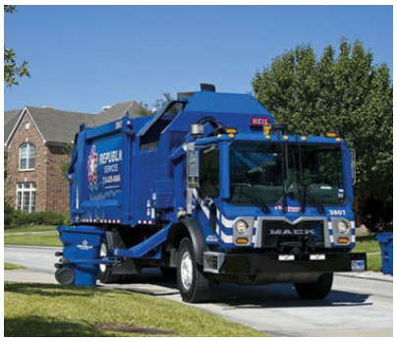
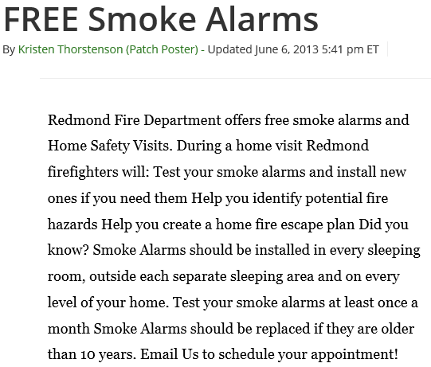
Examples
Successes:
Sprinklers
Large Wood frame buildings under construction
Mandatory Garbage Collection
Failures:
Smoke Alarm Program
Sprinklers

