Slide 1
FIRE DEPARTMENT
COMMUNITY ASSISTANCE, REFERRAL, & EDUCATIONAL SERVICES

Slide 2
What will FDCARES do for your community members?
FDCARES will prevent injuries and illness in your community.
FDCARES will save citizens unnecessary insurance co-pays for both ambulance transports and hospital visits.
FDCARES can save your tax payers millions of dollars.
FDCARES WILL HELP THE MEMBERS OF YOUR COMMUNITY TO LIVE LONGER, HEALTHIER, INDEPENDENT LIFESTYLES!

Slide 3
What effect will FDCARES have for various organization?
FDCARES will reduce ambulance transports of citizens with non-acuity and low acuity needs.
FDCARES will reduce emergency room visits for non-acuity and low acuity needs.
FDCARES will reduce the emergency room beds taken by non-acuity and low acuity needs, reducing the need for hospital diversions.
FDCARES will increase your emergency unit reliability.
FDCARES will improve emergency unit response time.
FDCARES can save your organization upwards of millions of dollars.

Slide 4
FDCARES Is an Injury and Illness prevention program.
The “CARES” program is a way of connecting with your community members through pre-incident patient intervention and after incident patient stabilization. We provide these services through offering community assistance and referrals to various outside agencies and social services as well as educating our aging community about services that are available to them.

Slide 5
We are facing
An increasing population within our communities.
An increasing in the elderly community.
An increase in assisted living facilities.
An increase in recurrent type medical incidents.
An increase in the need for non-emergent EMS assistance.
When we as a fire service faced a similar problem before with an increase in fire incidents we developed fire prevention, education, and evacuation drills.
C.A.R.E.S. IS THE FUTURE OF THE FIRE SERVICE

Slide 6
HOW FDCARES WAS CREATED
Our department had two programs operating independently. They were:
A Fall Prevention Program (If you have a fall prevention program you will already be offsetting your expenses.)
An informal Recurrent 911 User program
Both programs dealt with members of the community that regularly utilized the 911 system for low acuity or non-acute type incidents.

Slide 7
Scope of the Recurring Patient
3420 Incidents During the 2009 Year of recurrent nature.
1290 of which occurred within care facilities.
Roughly 2100 Incidents called into 911 in the year 2009 were referred to the nurse line (TRP) In all of King County. Approximately only 200 within the KFD response area.
OVER 3600 RECURRENT NATURED AND/OR LOW ACUITY INCIDENTS ANNUALLY THAT C.A.R.E.S. COULD ADDRESS.

Slide 8
WHAT TYPE OF CITIZENS ISSUES ARE WE TALKING ABOUT?
Fallen but uninjured.
Fallen and injured.
Mental health related issues.
Dementia related responses.
Alcohol related issues.
Lack of a sufficient amount human interaction.
In home assisted living facilities that lack the resources to handle every type of patient they may house.
Elderly who’s family will lose their property to the state if they are moved from their home to an assisted living facility.
System abusers. (These are exceptions rather than the rule.)

Slide 9
Anatomy of a Recurrent Customer
This resident is a 64 Y.O. patient with a report of a language barrier, lives alone in a Senior Apartment Complex - an independent, multifamily dwelling.
This patient has a history of:
Non-insulin dependant diabetes and is unable to check their blood sugar.
Can’t afford and has not taken her medications for a couple of months.
High blood pressure, CHF, and CVA.
Frequently calling 9-1-1 for related issues.
Reports being fearful of losing her independence.
According to our reports, her calls to 9-1-1 begin on April 14th, continuing for 5 months through September 4th, 2009 for a total of 18 calls for assistance.
12 out of the 18 times she is transported to Valley Medical Center by
ambulance.

Slide 10
Continued:
April 14th – Weakness, unk. Blood Sugar level – transport for hypertension.
April 16th – Weakness, dizziness – transport for hypertension.
May 30th – Possible CVA – transport for suspected CVA.
June 4th – Stroke – transport for suspected CVA.
June 13th – Thinks possibly has had stroke – transport for suspected CVA.
June 28th – Feels SOB, also chest pressure – transport for shortness of breath.
June 29th – Saying had a CVA while sleeping – transport for suspected CVA.
July 6th – C/O SOB, thinks BS high – out of testing supplies, no transport.
July 8th – Felt pain in back of head, slurring speech – transport Other neurologic. (FIRE CREWS REALIZED AT THIS POINT THIS WAS A RECURRENT PT.)
July 20th – C/O left sided weakness, thinks cardiac related – transport for “other illness”.
July 21st – Abdominal pain, left sided weakness – transport for suspected CVA.
July 29th – Abdominal pain, chills clammy, unk BLS – no strips, no transport.
August 1st – Thinks had another stroke last night – no transport.
August 1st – Reports of another stroke last night – transport for suspected CVA.
August 9th – Feeling disoriented, several mini strokes – No transport.
August 26th – Thinks they had another stroke, head feels strange. No transport.
17. Sept. 2nd – Dizziness – no transport pt refused.
18. Sept. 4th – RHR, dizzy all day yesterday, feels near syncope – transported.
12 out of the 18 times this patient is transported!

Slide 11
What finally stopped this persons need for the 911 system?
She was given information educating her on various symptoms related to her illnesses and when to be concerned.
She was set up with a low cost medication program
She received blood sugar test strips and was educated on how to use them and how to read the results of her blood sugar tests.
Unfortunately for her it took several months of self research and self initiative to locate her needed resources and to obtain her medications.

Slide 12
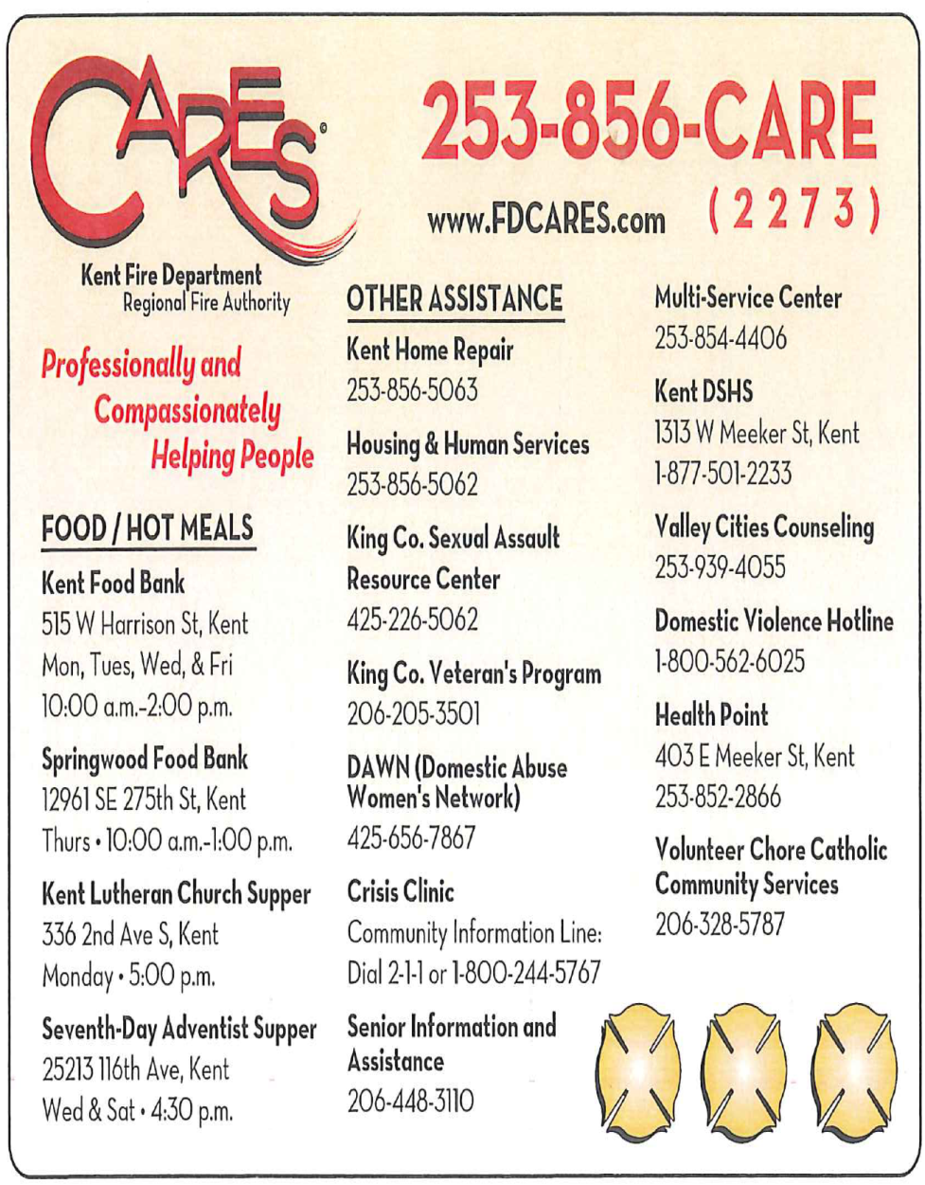
PATIENT REFERRAL PROGRAM

Slide 13
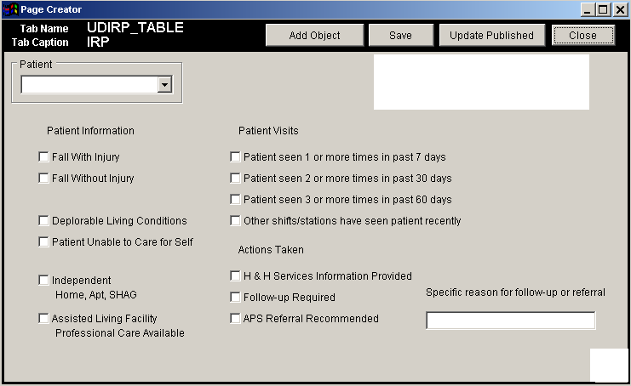
INCIDENT REPORTING SYSTEM

Slide 14
Sample Report

Slide 15
Anatomy of an FDCARES Customer
FD responded to 2 911 incidents of a 76 Y.O. diabetic patient. Firefighters entered pt. into the FDCARES system and our IPC made contact. After pt. evaluation a GRAT referral was made and Evergreen mental Health made contact. An APS referral was also made with a Medicaid application & COPES (Community Options Program Entry System) assistance requested. Since the initial FDCARES visit the pt. receives:
1. Home health services with a case manager
2. Visiting nurse and mental health clinician
3. Is eligible to receive free meals, specific with diabetic diet
4. Assistance with bath aid
5. Through COPES, a personal care attendant will be assigned to:
Provide housekeeping assistance
Provide shopping assistance
Provide Assistance with meal preparation
Provide assistance with medication management
Increased this patients socialization
This patient HAS NOT NEEDED the 911 system since FDCARES interaction.

Slide 16
OBJECTIVES & GOALS
Prevent injury and illness and provide for a healthier community.
Ensure early identification of low acuity & non-acute users of 911.
Capture 100% of citizens that would benefit from fall prevention devices.
Provide direct contact with fall patients.
Provide after incident follow-up to citizens with non acute and low acuity, repetitive type 911 incidents.
Develop a community connection for citizens, to social services.
Provide an alternative resources to the 911 system.
Slow the rate of increase of non acute and low acuity incidents.
Improve emergency apparatus reliability through incident reduction.
Improve response times for emergency apparatus.

Slide 17
ARE WE MAKING A DIFFERENCE?
Some areas of assistance are difficult to measure:
1. How many debilitating injuries and early death related injuries were prevented?
Some assistance can be measured in appreciation and possibly by vote of the citizens on ballot issues:
2 Many of the citizens that we assist through the CARES program send in cards, thank you letters and donations to help to continue the program.
Some areas are measured with statistics:
3. The reduction in low acuity / non acute type incidents from year to year compared to population growth?

Slide 18
SPONSORS
We have a number of sponsors within our community:
Tri-Med Ambulance
Valley Medical Center
Covington Medical Center
Franciscan Health System
King County Emergency Medical Services
ENDORSEMENTS
"The Kent Fire Department C.A.R.E.S. program is a wonderful program and will set a standard for other cities throughout the region. This program helps people and that's what it's all about!“
Dr. Mickey Eisenberg, KCEMS

Slide 19
IT’S NOT JUST A PROGRAM… IT’S OUR MISSION
Professionally and compassionately helping people.

Slide 20
QUESTIONS?
THE END!

