Slide 1
Fire Safety Materials Generator
incl. new tools for rental properties!
Notes:
Vision 20/20’s Fire Safety Materials Generator is a free online resource funded by Fire Prevention and Safety Grants from the U.S. Department of Homeland Security/FEMA. It allows fire departments and their partners to create and customize educational tools for their communities.

Slide 2
100+ million smoke alarms needed in U.S. for basic protection levels.
(source: TriData for Vision 20/20)
Notes:
A major focus of Vision 20/20’s work is to raise the number of working smoke alarms in the U.S. through proven Community Risk Reduction strategies. The problem of missing and/or non-working smoke alarms remains a huge challenge in our country. Based on informal research by TriData, Vision 20/20 estimates a need to install more than 100 million alarms to bring homes in the U.S. up to minimum levels of protection.

Slide 3
Fire Safety Materials Generator Background
What is the Fire Safety Materials Generator
A new tool, to generate customized door hangers, flyers and activity guides using proven fire safety messages, with your logo and information, that you can then download and print out.
Goals:
Increase number of working smoke alarms in the U.S.
Focus on #1 cause of home fires = cooking
Allow FDs to customize based on local risks and demographics
Notes:
NFPA estimates that almost five million households in our country do not have any smoke alarms, and many more don’t have enough of them.
Extrapolating from Vision 20/20 field data, TriData estimates a need for between 100 and 150 million smoke alarms in the U.S., excluding multi-family occupancies, to bring homes closer to current code (NFPA 72) requirements. That number is based on informal risk assessments and is most likely underestimated.

Slide 4
Research Timeline
January-February 2016
Materials Generator beta test
Survey
July 2011
Branding –
“Fire is Everyone’s Fight”
Interviews
Focus Groups
Bulletin Boards
Surveys
April-June 2013
In-home smoke alarm formative and concept testing
Door-to-Door Interviews
January -July 2017
Development of New Landlord/Renter Materials
November 2013
Fire department creative interest and perspectives
Survey
July- October 2016
Landlord & Renter Research
Focus Groups and IDIs
August 2012
Message concept testing – smoke alarms and kitchen safety
Focus Groups
July 2015
Materials Generator usability
User Experience Interviews
October 2013
Smoke alarm creative testing
Door-to-Door Interviews
Notes:
The Fire Safety Materials Generator is based on years of research and testing by the award-winning social change marketing firm Marketing for Challenge (previously called Salter Mitchell). Early testing in 2011 led to the creation of a national slogan to unite the U.S. fire service around the common theme “Fire is Everyone’s Fight.” This campaign is now under the leadership of the U.S. Fire Administration. Further testing with high-risk focus group representatives helped Vision 20/20 craft and confirm simple messages on the topics of smoke alarms and cooking safety that would be included in the Materials Generator. In 2016, based on requests from the field, we began a new round of research and development on components for both landlords and residents that would address the fire safety education needs of people living in rental properties. The new tools were released in July of 2017.

Slide 5
Effective Smoke Alarm Messaging
People generally know they should have a smoke alarm
They perceive that home fires are rare
We often asking people to do multiple things – install an alarm, test it, replace the batteries, and so on.
As a result, our target behavior becomes muddled
Suffers from a lack of immediate rewards and new information
Notes:
One of the great strengths of the Materials Generator is that every aspect is research-driven and based on expert guidance on what makes a message compelling enough to actually change behavior.

Slide 6
Effective Smoke Alarm Messaging
By limiting the number of takeaways, and following the below framework and effective hooks for audiences, we have better formula for effective messaging.
EFFECTIVE MESSAGING FORMULA
FRAMEWORK
Combine Immediate Reward (showing you care) with New Information (how-to and believable) to create effective messaging
ELEMENTS
Emotion (humanize and re-frame)
Control (role of protector)
“How-to” (rational balance)
Actions (clear guidance)
Vividness (clear and memorable)
Notes:
The experts at Marketing for Change shared their formula for effective educational messages. One big revelation was that traditional messages about smoke alarms focused on the future benefits of having a working smoke alarm…IF there is a fire (sometime in the future), the smoke alarm will sound and you can get out….This approach is not likely to inspire people to take immediate action – especially when they lead busy lives and are already juggling many things on life’s To Do list. A more effective approach is to use emotion to appeal to their basic desire to protect the people and things they love. The idea is to communicate that installing and maintaining smoke alarms TODAY is a way to show their love.

Slide 7
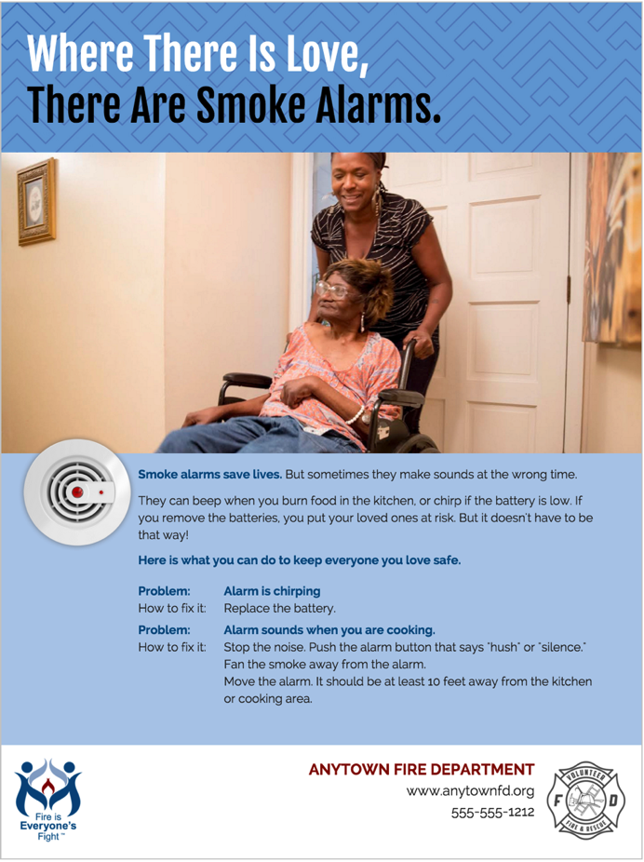
Sample Flyer
Notes:
We created a new theme using this emotional approach: Where There is Love, There Are Smoke Alarms. The Materials Generator provides specific smoke alarm and cooking safety messages, along with many diverse images of people of different ages and ethnicities who appear to love and care for each other. Studies have shown people tend to respond more to images of other people, especially those who resemble them.

Slide 8
Thanks to Beta Testers
SHCNC – Sacramento, CA
UC Davis Health System Fire Prevention - Sacramento, CA
Roanoke Fire-EMS - Roanoke, VA
Tucson Fire Department – Tucson, AZ
Delaware State Fire School – Dover, DE
Mississippi testers
Downers Grove Fire Department - Downers Grove IL
Arvada Fire Protection District – Arvada, CO
CAL FIRE - San Bernardino Unit - San Bernardino, CA
Jackson Hole Fire/EMS – Jackson, WY
Cleveland Fire Department – Cleveland, OH
Sacramento Metropolitain Fire District – Sacramento, CA
Morgan Hill FD, South Santa Clara County FPD, CAL FIRE SCU - Morgan Hill, CA
Notes:
Before we launched the Materials Generator, we tested all the materials in communities across the U.S. thanks to generous Vision 20/20 supporters.

Slide 9
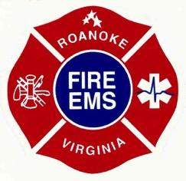
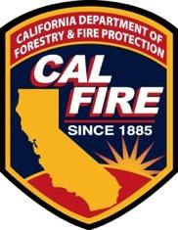
Materials Generator Samples From Community Campaigns

Slide 10
Key Beta Test Findings
Feedback for the Materials Generator was overwhelmingly positive, with 11 out of 13 respondents reporting that they “loved it” or “liked it”
Why the positive reactions?
“We love that we can produce quality material with consistent messages.”
“Variety of standard images that represented many different races, genders, and ages.”
“The ability to adapt the materials to the needs of the audience we were trying to reach.”
12 out of 13 respondents reporting that they were “very interested” in using it for future campaigns and that it served the needs of their department’s outreach communication staff “very well” or “somewhat well.”
Notes:
Feedback was very positive.

Slide 11
Reaction to Messages
Respondents highlighted the positive reactions from younger and older audiences:
“The overall response was very favorable. The children were able to follow along with the message being presented and the vivid colors of the materials caught their eye as well as the parents, as I was able to see for myself and it was also expressed to me from several teachers.”
“The materials were well-received at the senior centers. We also distributed to the local newspaper press to engage a larger scale audience.”

Slide 12
What Did Users Like Best about the
Fire Safety Materials Generator?
Very easy to use
The value of market research based messaging
Customizable for local needs – includes room for partner logos
Messages tested for literacy appropriateness
Notes:
Here are some of the things our users said they liked about the Fire Safety Materials Generator.

Slide 13
How to Use the Fire Safety Materials Generator Video
Access at: www.strategicfire.org/MaterialsGenerator
Notes:
When you go to the landing page of the Materials Generator you can click on a 90-second video that will give you a quick orientation.

Slide 14
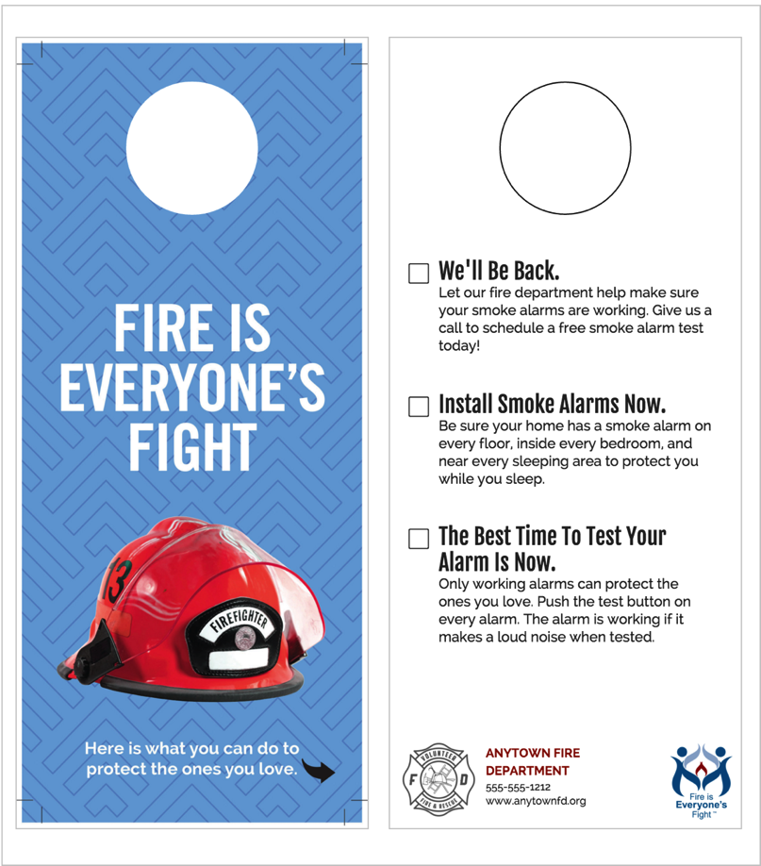
Sample Door Hanger
Notes:
Let’s take a closer look at some of the materials you can create using the Materials Generator. This flyer is designed for fire departments that are conducting home safety visits to install smoke alarms and educate residents about how to maintain and respond to their alarms. International research has shown that this is perhaps the MOST effective thing a fire department can do to reduce community risk. Fire departments that are not installing alarms in high risk homes are missing out on a strategy that has proven effective in the United States and in many countries throughout the world. Notice there is room for only 3 brief messages. Again, based on research, we know that many people either cannot or will not read something that is too wordy. The Materials Generator allows you to choose the messages you want to include from within a set of audience-tested options, but you are limited to only 3 at a time.

Slide 15
Customized Image Flyer
Notes:
This wonderful example of a customized flyer comes from Deanna Harrington in Arvada, CO. As she prepared to make a fire safety presentation to a community of older adults, Deanna visited the facility a week ahead to take a photo of a very popular couple who lived there. Deanna uploaded this photo to illustrate the flyer she distributed during her presentation. The residents were thrilled to see someone they knew and liked…and were therefore interested to read what it said. This ability to customize images is one of the strongest featrues of the Materials Generator.

Slide 16
Notes:
Here is another great example from the Alaska State Fire Marshal’s Office. With permission from their caregivers, this image of beautiful Alaska native children was used to illustrate a Facebook promotion to increase the use of working smoke alarms across the state.

Slide 17
Notes:
Here is a very innovative use of the Materials Generator from Kathy Clay, Battalion Chief for the Jackson Hole, WY, Fire Department. Kathy was launching a CRR program to reach high-risk homes in the community, but was not getting much buy-in from her firefighters….until she began featuring them on the flyers being distributed throughout the community. Residents began to recognize the members of the department. This led to fun conversations and a stronger connection between the department and the community.

Slide 18
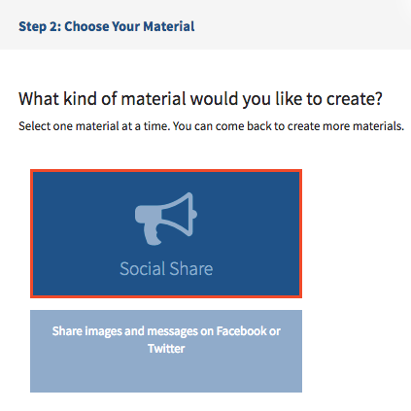
New Updates
Social Media content:
Design and develop social media post graphics with the Materials Generator on the topics of smoke alarm maintenance and kitchen safety.
This will allow users to easily spread safety messages through digital channels like Facebook & Twitter
Notes:
Social Media content: Users loved being able to create flyers and door hangers and children’s activity sheets (one on smoke alarms, and one on escape planning). But many fire departments are increasing their use of social media to reach their communities. As a result of this feedback, we designed social media post graphics for the Materials Generator on the topics of smoke alarm maintenance and kitchen safety.

Slide 19
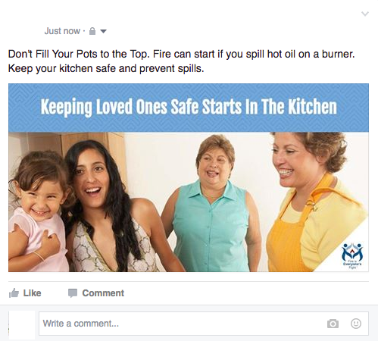
Social Media Examples:
Notes:
Here are a couple of examples.

Slide 20
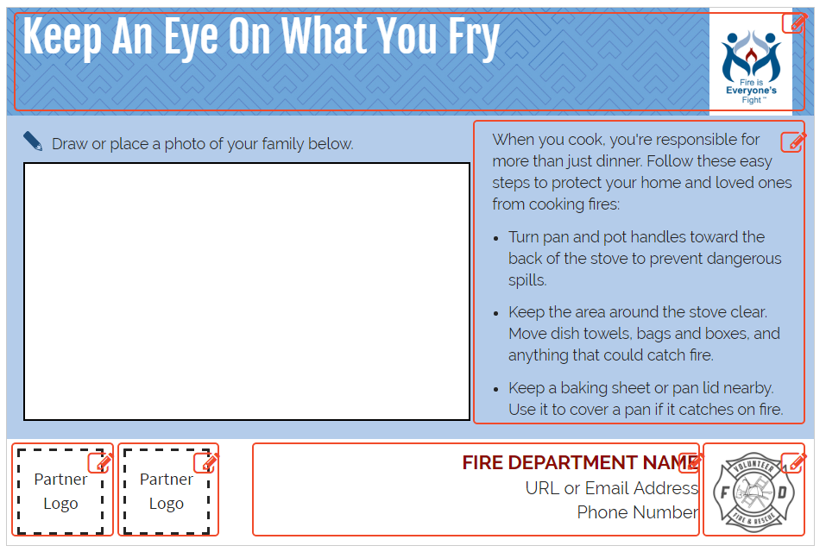
New Updates
Re-designed format to allow for 2 additional logos on flyers, activity guides and refrigerator cards.
Notes:
When the Materials Generator was first released, there was only room for one logo – usually the fire department’s. Users correctly pointed out the importance of partnerships in Community Risk Reduction and asked if we could redesign the Materials Generator to allow for additional partner logos. Again, our friends at Marketing for Change made this happen and there is now room for a main logo and contact information on the right and for 2 more logos to the left.

Slide 21
Rental SME Task Group
Brian Andersen – Fire Marshal, Minot (ND) Fire Dept
Dave Cherrone – Fire Marshal, Clay Fire Territory, South Bend, IN
Gregg Cleveland – Chief, LaCrosse (WI) Fire Dept
Joanne Hatch – Public Education Chief Officer, Tualatin Valley (OR) Fire & Rescue
Notes:
We also got feedback on the difficulty of reaching high-risk residents living in rental properties. The first thing we did was to establish a task group of experienced practitioners from across the U.S. to get their guidance about what tools would be needed to tackle this problem.

Slide 22
Rental SME Task Group (cont.)
Tim Heath – Chief, West Lafayette (IN) Fire Dept
Lela Hinds-Peterson – Fire and Life Safety Education Specialist, Mesa (AZ) Fire Dept
David Klein – Deputy Fire Marshal, Las Vegas (NV) Fire Dept
Hallie McCurdy – Ass’t Chief, West Pierce (WA) Fire & Rescue
Notes:
You will note as I scroll through these slides that our Subject Matter Experts come from large, medium-sized and small departments and represent diverse regions and communities.

Slide 23
Rental SME Task Group (cont.)
Tim Nelson – Chief, Amherst (MA) Fire Dept
Kevin Partridge – Chief, Easton (MA) Fire Dept
Mark Sauls – Ass’t Director, FL Division of State Fire Marshal
Kim Scott – Life Safety Educator, Boulder (CO) Fire Dept
Barry Simays – Battalion Chief/Fire Marshal, Burlington (VT) Fire Dept
Notes:
After surveying our Subject Matter Experts, Marketing for Change spent months interviewing both landlords and property managers as well as residents, and learned some key findings.

Slide 24
Resident Research Results
Landlords and residents rarely discuss fire safety or smoke alarms
Variety of communication channels
Where does legal responsibility lie?
Residents put safety first, but don’t perceive landlords as sharing that value
Smoke alarm maintenance should be a joint effort
Notes:
Almost all the focus group respondents admitted that they had never talked about the smoke alarms in their units when they moved into the apartment or home. No one confirmed whose responsibility it would be to test and maintain the alarms. No one explained to those unfamiliar with the devices, such as new immigrants from other countries, what a smoke alarm was, the different sounds it makes (chirp and beep) and WHAT TO DO when it made those sounds.

Slide 25
Landlord Research Results
Smoke alarm maintenance not top of mind
Fire safety rarely discussed between landlords and residents
Landlords DID want to hear about maintenance needs
Landlords couldn’t confirm if residents were changing batteries or testing alarms
Notes:
These insights help us prioritize development of some new tools for the Materials Generator.

Slide 26
Material Development Goals
Establish communication
Establish responsibility
Leverage other monthly & seasonal behaviors
Continue messaging about protecting loved ones
Encourage a joint approach
Remind landlords of smoke alarm maintenance
Notes:
We set out to create new options that would help prompt this important ongoing conversation between landlords and residents. We designed these tools to fit the unique needs and existing communications channels of renters, such as email reminders about routine maintenance.

Slide 27
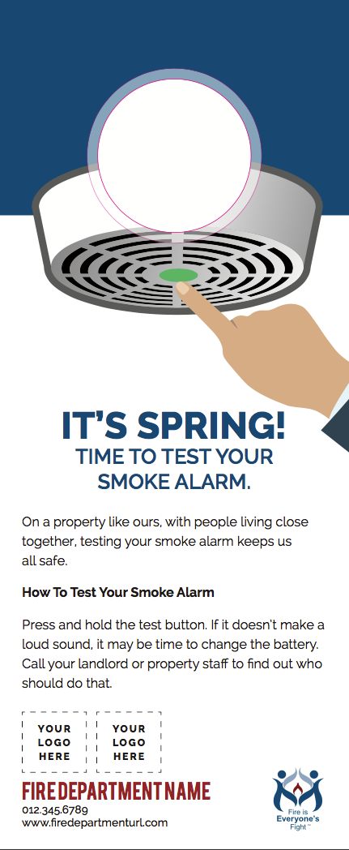
Seasonal Door Hangers
4 New Seasonal Door Hanger Fronts
New Seasonal Door Hanger Back
Notes:
This is an example of a door hanger that would be used in the spring to remind residents to test their smoke alarms as part of their spring cleaning chores.

Slide 28
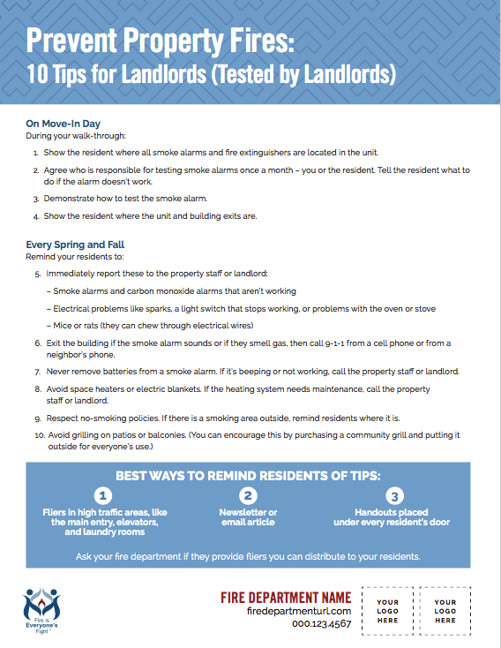
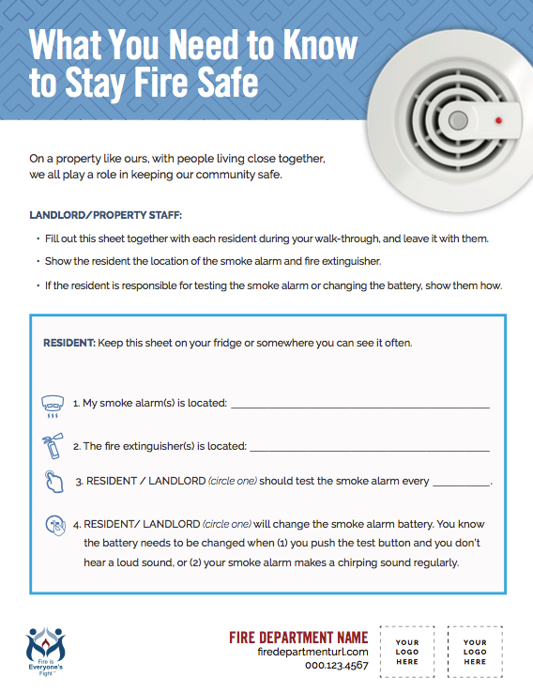
Tip Sheet & Checklist
Notes:
We created a tip sheet and checklist for property owners/managers to go through when a new resident moves in. This is often a very confusing time for the resident, so having the landlord walk them through the “whys and wherefores” of smoke alarms is an important way to enhance everyone’s safety, whether they are moving into a single family home or a multi-family property.

Slide 29
Refrigerator Magnet
Notes:
The refrigerator magnet can be used in any community outreach campaign where people live close to each other.

Slide 30
To sign up for Vision 20/20 alerts
Text STRATEGICFIRE to 22828
You will receive an immediate reply asking for your email.
Notes:
We invite each and every one of you to become active in Vision 20/20. In 2018 Vision 20/20’s fifth national symposium on Model Performance in Community Risk Reduction. We will be putting out a call for abstracts later this year to identify programs that are modeling best practices in CRR and have the evaluation results to prove it. The best way to stay connected and learn about the Symposium and all of Vision 20/20’s latest news is sign up for our alerts by texting STRATEGICFIRE to 22828.

Slide 31
We want to hear from YOU!
What great ideas do you have to make the Materials Generator even better?
What new topics do you think we should add?
Meri-K Appy
Vision 20/20 Executive Committee
meri-k@appyandassociates.com
202-412-5387
Notes:
Vision 20/20 has no sustained funding – we have benefited from year-to-year grants and some additional donations – so we can’t promise we’ll be in a position to respond immediately to your ideas and requests. But as you can see from all the changes I’ve pointed out today, we try our best to be responsive to the needs of the field. And we love to see examples of how you are using and customizing the Materials Generator. Feel free to get in touch with me if you have any questions or suggestions and I’ll do everything I can to help.

Slide 32
www.strategicfire.org/materialsgenerator
Thank You!

