Slide 1
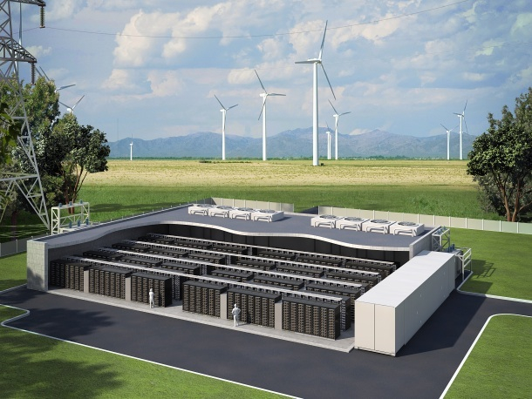
Energy Storage Systems UL Listings and the NEC Kelly Nicolello Senior Regulatory Engineer
Source: Stanford Energy Club
Notes:
Energy storage technologies may include pumped hydro, compressed air energy storage, various types of batteries, flywheels, electrochemical capacitors, etc., provide for
multiple applications: energy management, backup power, load leveling, frequency regulation, voltage support, and grid stabilization.

Slide 2
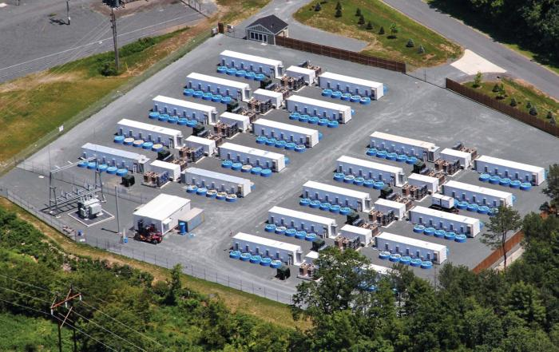
Why Energy Storage?
Recently, enormous focus has been placed on expanding the energy storage infrastructure.
The benefits of energy storage are driven by several dynamic factors.
Source: Energy Storage Solutions
Notes:
In February 2013, the California Public Utilities Commission (CPUC) determined that Southern California Edison must procure 50 MW of energy storage capacity by 2021 in Los Angeles area. Other States are looking to the example that California is setting, and Congress has introduced two bills that establish incentives for storage deployment.
The bills before congress are S. 1030 (STORAGE Act ) and S. 795 (MLP Parity Act). Details on the California bill (AB 2514) can be found on the CPUC website: http://www.cpuc.ca.gov/PUC/energy/electric/storage.htm

Slide 3
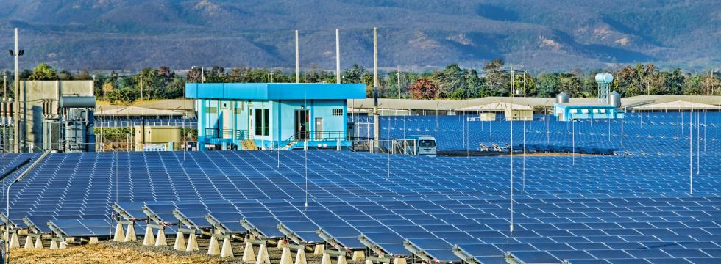
Grid Balancing & Load Leveling
Source: Energy Transition
EDF Renewable Energy
Notes:
Energy storage can play a significant role in improving the operating capabilities of the grid, lowering cost and ensuring high reliability, as well as deferring and reducing infrastructure investments. It can also be instrumental for emergency preparedness because of its ability to provide backup power as well as grid stabilization.

Slide 4
Reliability & Resiliency
Source: L.A. Times
Notes:
The expansion of the electrical system can be accelerated by the widespread deployment of energy storage, since storage can be a critical component of grid stability and
resiliency.

Slide 5
Infrastructure Benefits of Energy Storage
Adding Energy Storage:
Reduces the need for new grid construction and system upgrades
Augments the performance of aging transmission and distribution assets:
DOE Estimates:
70% of transmission lines are more than 25 years old
70% of transformers are more than 25 yeas old
60% of circuit-breakers are more than 30 years old
Improves grid security, reliability and resiliency
Reduces peak demand stress on transmission and distribution lines
Notes:
Information obtained from Fitch Ratings, “Frayed Wires: US Transmission System Shows Its Age,” 2006.
Energy storage can reduce the need for new transmission grid construction upgrades as well as augment the performance of existing transmission and distribution assets. DOE estimates that 70% of transmission lines are 25 years or older, 70% of power transformers are 25 years or older, and 60% of circuit breakers are more than 30 years old.
Extending the capability of the transmission grid by positioning energy storage on the load side of transmission constraint points makes the grid more secure, reliable, and responsive.
Additionally, energy storage can reduce line-congestion and line-loss during peak times. By reducing peak loading (and overloading) of transmission and distribution lines, energy storage can extend the life of existing infrastructure.

Slide 6
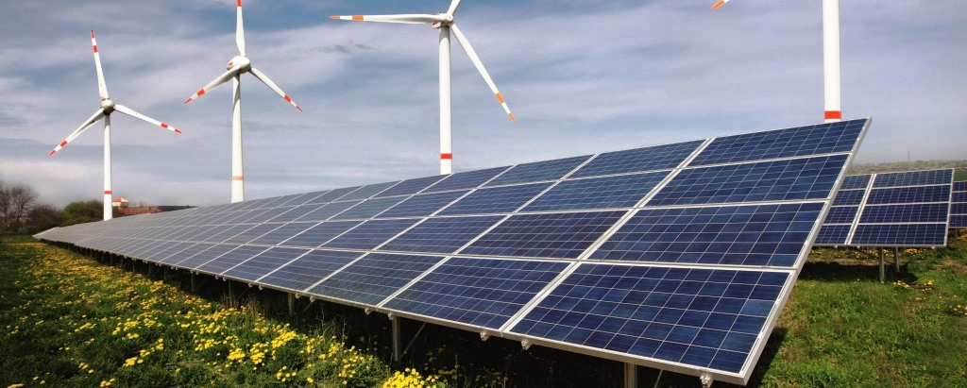
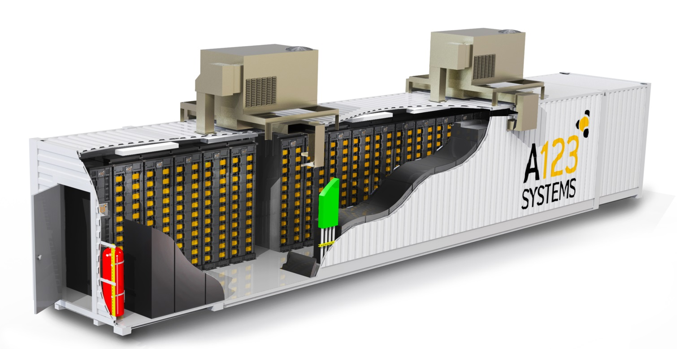
Supporting Renewables by Mitigating Intermittency
Notes:
An intermittent energy source, such as wind and PV power generation, that is not continuously available due to some factor outside direct control. Effective use of intermittent sources in an electric power grid usually relies on using the intermittent sources to displace fuel that would otherwise be consumed by non-renewable power stations, or by storing energy in the form of renewable energy storage systems.

Slide 7
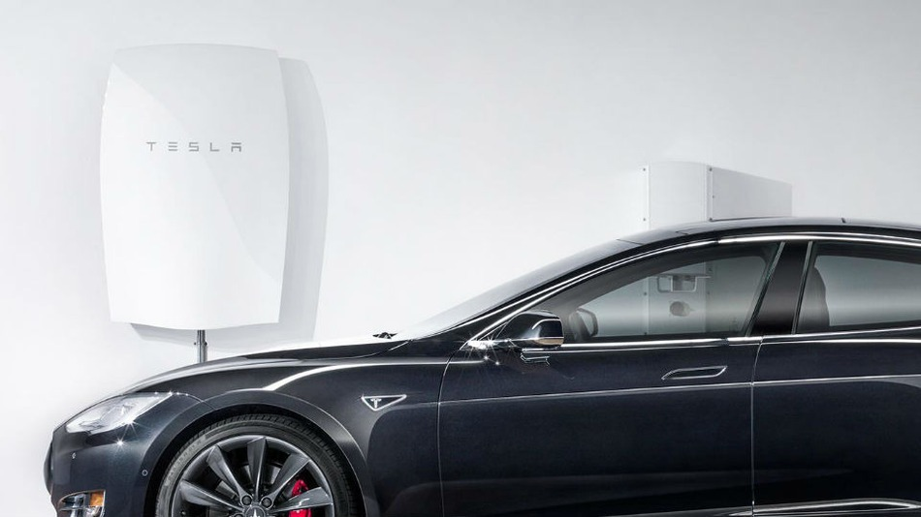
Customer Side of the Meter Storage
ESS Technology is changing consumer needs and requirements
The “Smart grid” enables consumers to enhance their electric utilization with consumer storage systems
The “Smart grid” contributes to improved grid reliability and performance
New increased role of consumer storage in grid functionality
Notes:
The deployment of EV’s is another form of customer storage of electricity, this is permitted where installed to comply with NEC Section 625.48.
Increasingly, deployment of new ESS technologies on the customer side of the meter is changing the electrical nature of customer requirements. The evolution of the “smart grid” is enabling customers to shape their requirements to improve their own utilization of electricity, while also contributing to improved grid reliability and performance. These developments create an opportunity for customer storage to play an increasing role in grid services.
ESS’s should not be confused with UPS systems. A UPS is used to provide alternating-current power to a load for some period of time in the event of a utility power failure. In addition, it may provide a more constant voltage and frequency supply to the load, reducing the effects of utility voltage and frequency variations. In the development of UL 1778, it was not anticipated to be for continuous use in the applications where an energy storage systems are intended to be used.

Slide 8
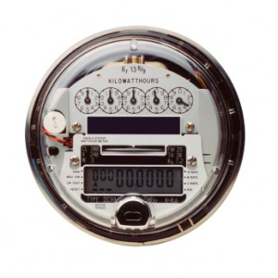
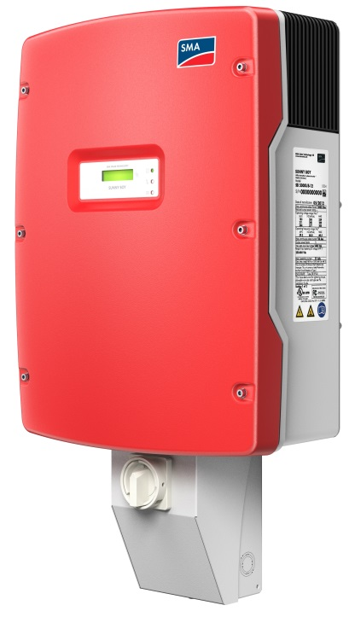
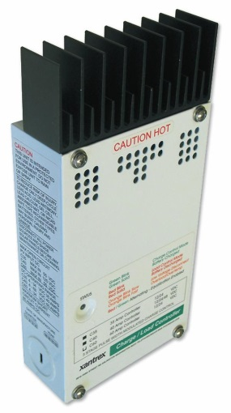
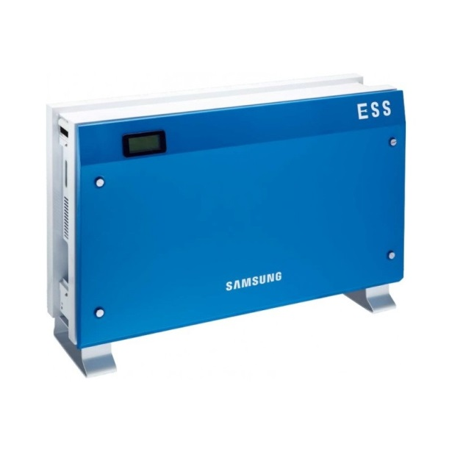
PV System
Utility Meter
DC/AC Inverter
Utility Grid
Charge Controller
Your House
Energy Storage System
Notes:
Recently, customer systems combining PV and energy storage have increased because of their ability to improve customer energy economics. As PV systems drop in price, customers will increasingly opt to deploy PV-storage systems.

Slide 9
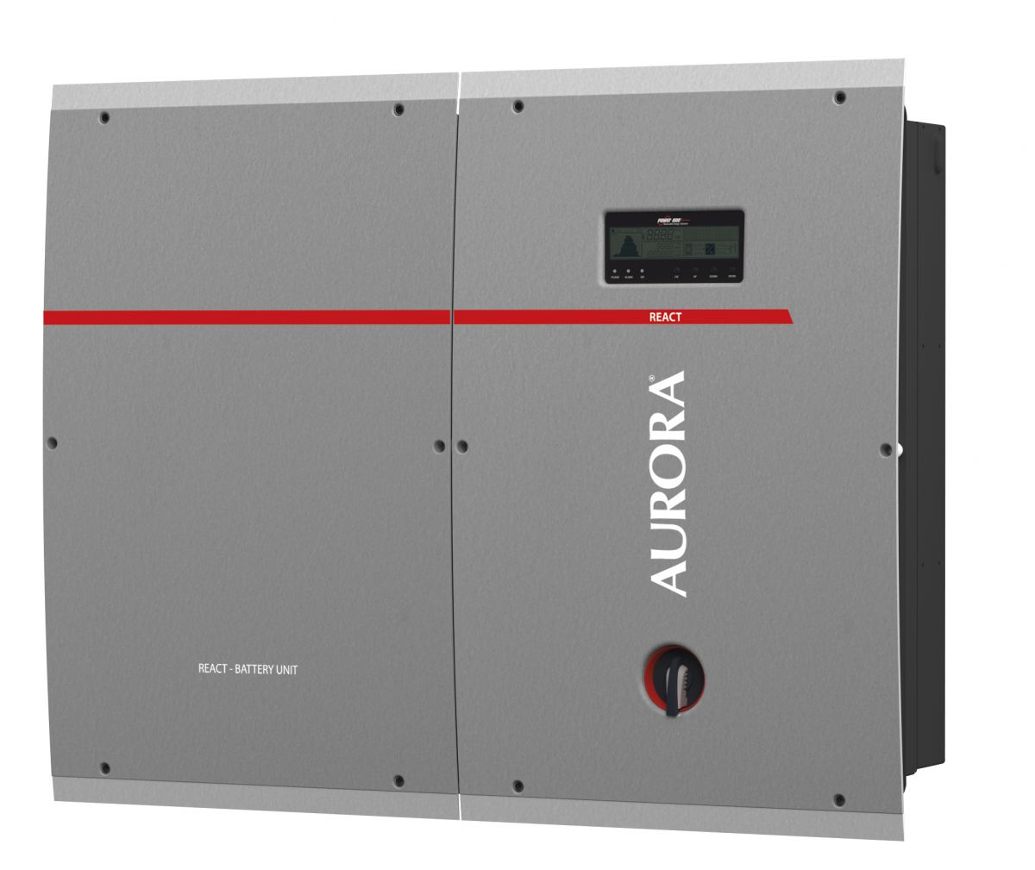
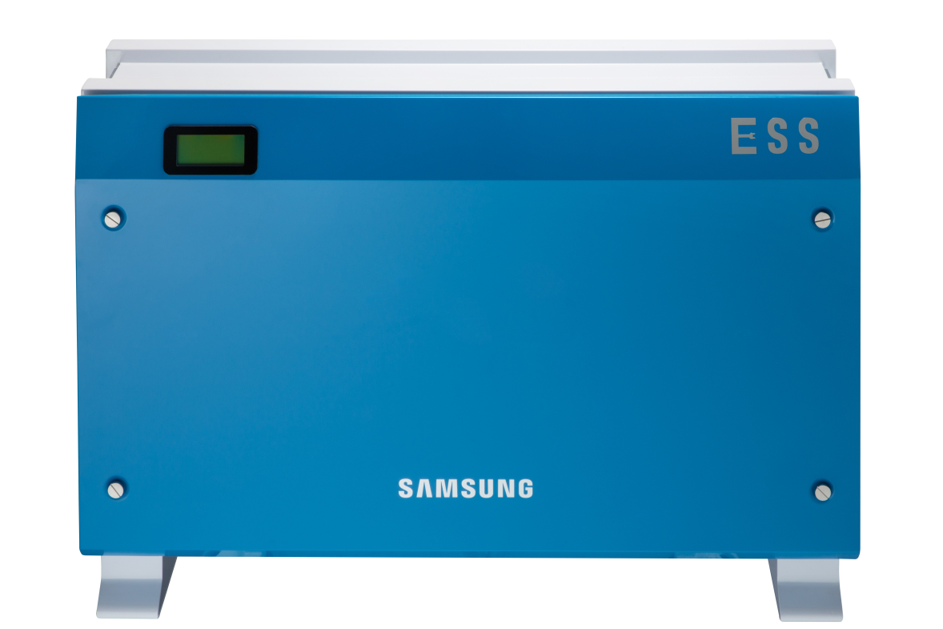
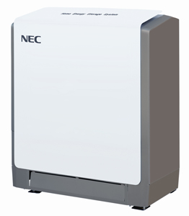
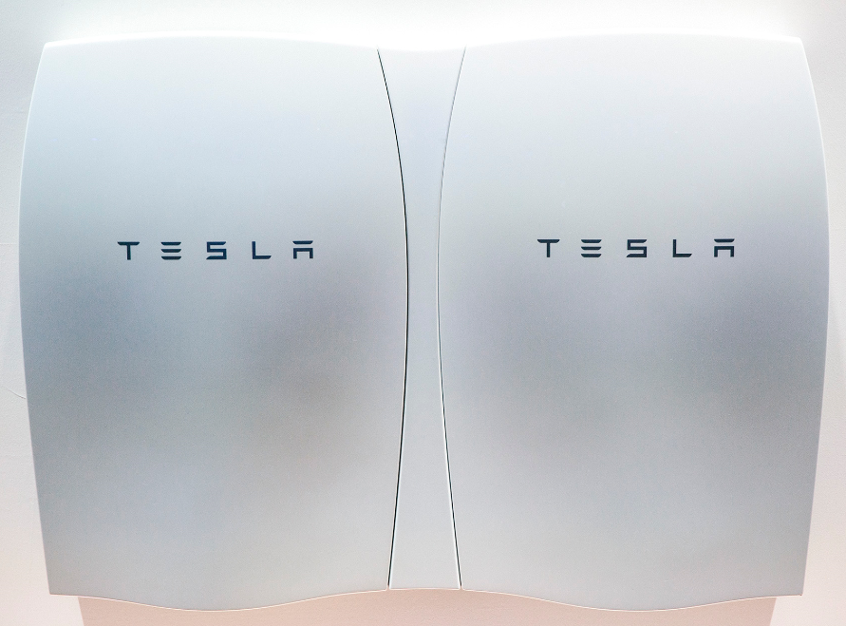
Notes:
Examples of ESS’s designed for residential use.
The Aurora unit consists of a 4.6kW single-phase grid connected inverter and a lithium-ion battery, providing 2kWh of usable capacity.
The Samsung unit consists of single-phase grid connected inverter and a lithium-ion battery, providing either 3.6 or 5.5kWh of usable capacity.
The NEC unit consists of lithium-ion battery, providing either 5.5 or 57.8kWh of usable capacity.
The Tesla unit consists of lithium-ion battery, providing 10 kWh weekly cycle and 7 kWh daily cycle models. Multiple batteries may be installed together for homes with greater energy need, up to 90 kWh total for the 10 kWh battery and 63 kWh total for the 7 kWh battery.

Slide 10
Energy Storage Technologies
Various energy storage technologies are being used or explored across the different applications, including:
Electrochemical – such as batteries and electrochemical capacitors
Chemical – such as hydrogen supplied equipment combined with a fuel cell power system
Mechanical - such as compressed air, pumped water or fly wheel technologies
Thermal – such as a system that uses heated fluids
Currently, the primary focus of the expansion and deployment is battery-based energy storage systems, and the primary technology for these systems is Lithium ion
Notes:
ELECTROCHEMICAL ENERGY STORAGE SYSTEM - Consists of a secondary battery, electrochemical capacitor, flow battery or hybrid battery-capacitor system that stores energy and any associated controls or devices that can provide electric energy upon demand.
CHEMICAL ENERGY STORAGE SYSTEM - Consists of hydrogen supply equipment or other fuel supply equipment combined with a fuel cell power system or generator to convert the fuel to electrical energy.
MECHANICAL ENERGY STORAGE SYSTEM - Consists of a mechanical means to store energy such as through compressed air, pumped water or fly wheel technologies and associated controls and systems, which can be used to run an electric generator to provide electric energy upon demand.
THERMAL ENERGY STORAGE SYSTEM - Consists of an system that uses heated fluids such as air as a means to store energy along with associated controls and systems, which can be used to run an electric generator to provide electrical energy upon demand.

Slide 11
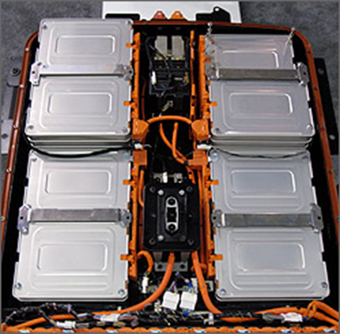
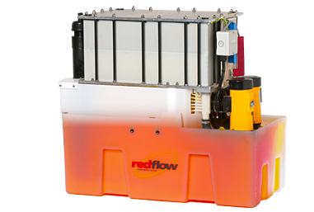
Energy Storage Technologies
Various energy storage technologies are being explored:
Lithium ion; and
Redox flow
Source: US DOE
Source: Redflow Ltd
Notes:
Redox flow battery (after reduction–oxidation), is a type of rechargeable battery where rechargeability is provided by two chemical components dissolved in liquids contained within the system and separated by a membrane. Ion exchange (providing flow of electrical current) occurs through the membrane while both liquids circulate in their own respective space.

Slide 12
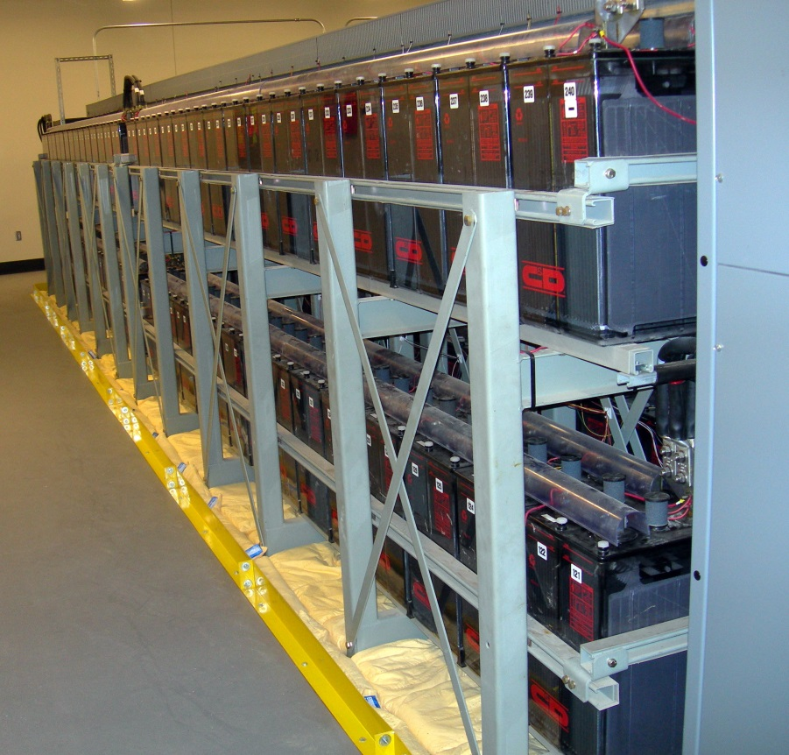
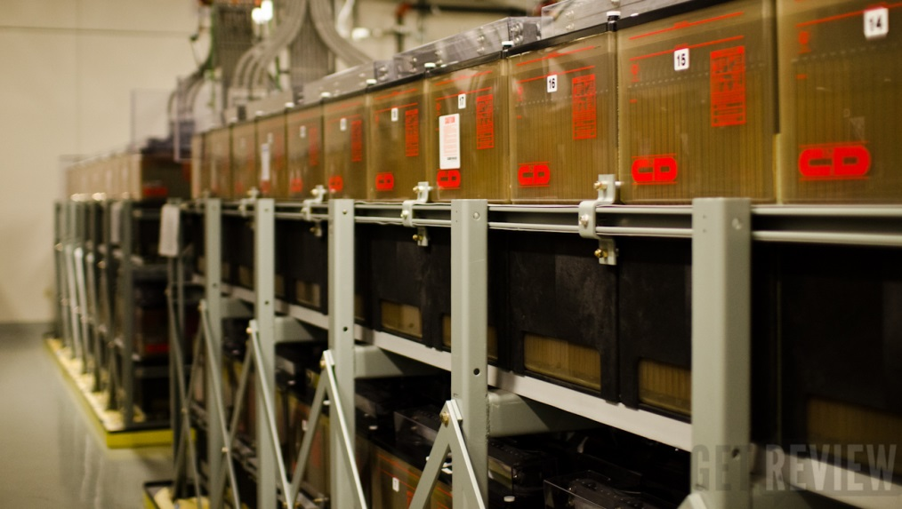
Current Technologies for Energy Storage Systems
Electrochemical Systems
Battery systems:
Lead acid
Nickel cadmium or Nickel metal hydride
Lithium ion
Sodium Sulfur or Sodium Nickel Chloride
Vanadium Redox Flow Batteries
Zinc Bromine Flow Batteries
Ultracapacitor or battery/ultracapacitor hybrid systems

Slide 13
Potential Hazards Associated with Energy Storage Systems
Energy
Fire
Explosion
Mechanical
Pressure
Noise
Chemical
Toxic or hazardous substance exposure/ concentrations
Moving parts
Burns
Sharp edges
Electrical burns
Arc Flash
Electric shock
Electrical

Slide 14
Standards activities
In order to address key safety issues for energy storage systems, UL has undertaken a number of key activities:
Published UL 9540 [Energy Storage Systems and Equipment] for energy storage system safety;
Published UL 9741 [Bidirectional Electric Vehicle (EV) Charging System Equipment] to address V2X technology;
Developing UL 1974 [Repurposed and Refurbished Batteries for Use in Stationary and Other Applications] to address repurposed vehicle batteries
Notes:
“V2X” used to collectively address:
EV – to - Load (V2L)
EV – to - Home (V2H)
EV – to - Grid (V2G)

Slide 15
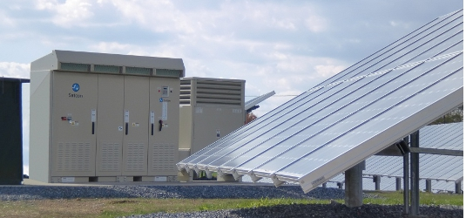
UL 9540 - Scope
These requirements cover ESS’s that are intended to store energy from power or other sources and provide electrical or other types of energy to loads or power conversion equipment such as;
A standalone system to provide energy for local loads
In parallel with an electric power system
Electric utility grid
For use in utility-interactive applications in compliance with IEEE 1547 and IEEE 1547.1
ESS’s are to be installed in accordance with the national and local electrical
codes as well as other
applicable codes
Notes:
IEEE 1547 Standard for Interconnecting Distributed Resources with Electric Power Systems
IEEE 1547.1 Standard for Conformance Test Procedures for Equipment Interconnecting Distributed Resources with Electric Power Systems

Slide 16
UL 9540 - Requirements
UL 9540 will address key issues associated with energy storage systems, including:
Battery system safety
Functional safety
Grid connectivity
Interconnection with premises wiring systems
Environmental performance
Containment
Fire detection and suppression

Slide 17
UL 9540 - Overview
Utility Grid Interaction Requirements
Operate safely through grid conditions
Referenced requirements of IEEE 1547 and IEEE 1547.1
Provisions for special purpose utility interactive features
Tests
Tests of UL 1741/UL 62109-1
Special purpose utility interactive tests (per document referenced)
Abnormal per Section 47 of UL 1741
Compliance to UL 1741/UL 62109-1 and
UL 1741 - Standard for Safety for Inverters, Converters, Controllers and Interconnection System Equipment for Use With Distributed Energy Resources (US Standard ONLY)
UL 62109-1 - Standard for Safety for Safety of power converters for use in photovoltaic power systems - Part 1: General requirements (Harmonized International Standard with National differences)

Slide 18
UL 9540 - Overview
Enclosures & Guarding
Walk in systems
Markings, signage and instructions
Electrical
Fluid handling & containment
Fire containment & suppression

Slide 19
UL 9540 Overview – Performance Testing
Electric
Normal operations
Dielectric voltage withstand
Grounding and bonding
Insulation resistance
Mechanical
Over speed test
Faulted securement test
Fluid containment
Leakage
Strength
Environmental
Broken part

Slide 20
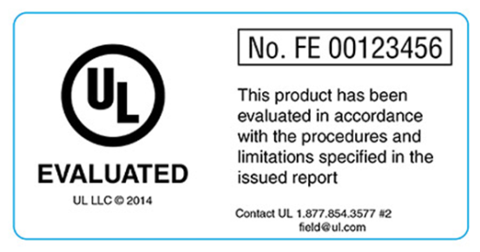
Overview of Certification Options
Why Certification?
Ease of acceptance & installation
Required by model Codes and/or the AHJ
What Does Certification Entail?
Certification Process
Compliance to UL 9540 (Energy Storage Systems and Equipment)
Covered by UL Product Category FTBW (Energy Storage Systems and Equipment)
Ongoing production inspection
Field Evaluation
Performed on installed products in cooperation with the AHJ
Non-destructive evaluation
No production inspections
Field label marking
UL Certified mark
Due diligence
Notes:
Mention NFPA 790 and 791 as reference documents for AHJ’s when accepting FE’s.

Slide 21
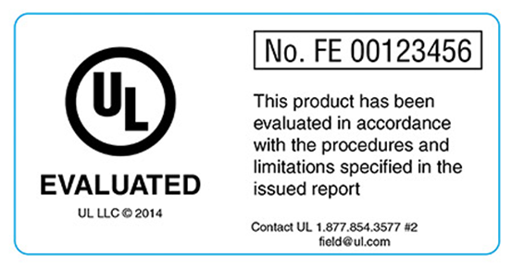
Certified vs Field Evaluation
Certified
Field Evaluated
Certified
Self contained, factory packaged ES systems
Modules or ES subassemblies
Serve as building blocks for other systems
Field Evaluation
Engineered and field constructed ES system
Limited production

Slide 22
Field Evaluation
Discussion with AHJ
Review of Product Documentation
Determination of Applicable Local Code Criteria and Applicable Standards
Determination of Non-destructive Test Program or Pre-testing of Systems or Components
On-site Review of Installation and System
On-site Conduction of Non-destructive Testing
Completion of Report and Affix label
Notes:
Emphasize On-site unless pre-arranged with AHJ permission prior to the FE. Both the IBC and IFC permits alternative materials, design and methods of construction and equipment provided that any such alternative has been approved. This is where the building official has the authority to require tests, such as a field evaluation, as evidence of compliance at no expense to the jurisdiction.

Slide 23
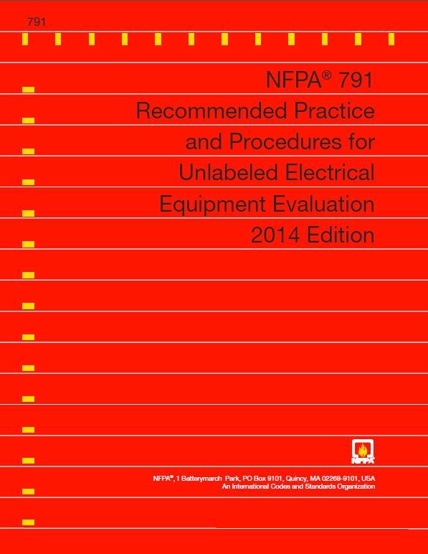
Field Evaluation – NFPA 791-2014
The Field Evaluation Body (FEB) is to use the
appropriate standards based on the design and
application of the equipment under evaluation.
The primary standard is to be a nationally
recognized product safety standard written and
maintained by a Standards Development
Organization (SDO) that issues product safety
standards, such as UL.
If no single standard applies to the equipment,
applicable portions of related standards for
subassemblies and supplementary standards
are to be applied.
The actual requirements to be used for the construction inspection should come from the applicable primary product safety standard and the electrical installation codes.
Notes:
Again Reference NFPA 790 for competency requirements, NFPA 791 defines an FE as the process used to determine conformance with requirements for one-of-a-kind, limited production, used, or modified products that are not listed or field labeled under a certification program.

Slide 24
Extending the Technology
UL continues to work with key stakeholders to address ESS deployment issues, including:
Work with first responders to support the necessary tactics and equipment to deal with more and larger distributed energy storage systems
Work with DOE and national model code agencies to update codes to address new ESS technologies
Addressing standardized performance assessments for ESS
Safety of repurposed EV batteries which still have a useful life in stationary applications such as ESS
“V2X” technologies allowing energy in EV batteries
Notes:
UL PDEs, Research Staff and CAAS working with:
DOE – Codes and Standards Working Group
IFC – Fire Code Action Committee for updated requirements in 2018 (IFC)
NFPA – NEC Article 706 in draft
NFPA – NFPA 1/Fire Code Technical Committee - for updated 2018 NFPA 1
“V2X” used to collectively address:
EV – to - Load (V2L)
EV – to - Home (V2H)
EV – to - Grid (V2G)

Slide 25
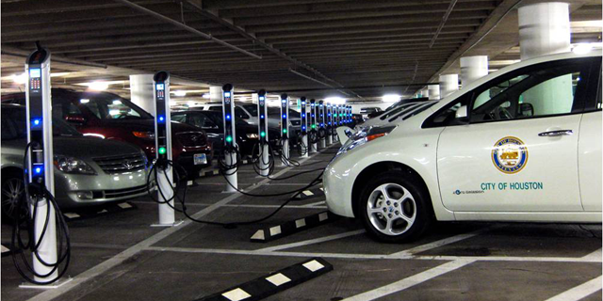
V2X
“V2X” used to collectively address:
EV – to - Load (V2L)
EV – to - Home (V2H)
EV – to - Grid (V2G)
V2L and V2G technology
allow energy from the EV
battery to be exported to the home and grid as needed
Addressed by the new UL 9741 (Bidirectional EV Charging System Equipment) and NEC Section 625.48, with residential and fleet/commercial systems being developed right now for deployment
Source: City of Houston
Notes:
625.48 - Electric vehicle supply equipment and other parts of a system, either on board or off board the vehicle, that are intended to be interconnected to a vehicle and also serve as an optional standby system or an electric power production source or provide for bi-directional power feed shall be listed and marked as suitable for that purpose. When used as an optional standby system, the requirements of Article 702 shall apply, and when used as an electric power production source, the requirements of Article 705 shall apply.

Slide 26
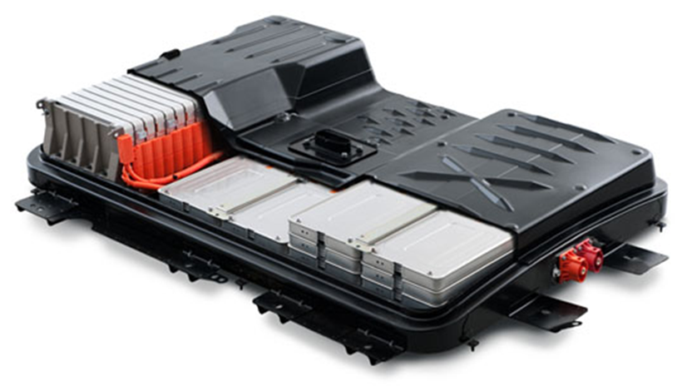
Repurposing
Electric vehicle and other batteries have a defined useful life, based on:
Driving demand
and conditions; and
Charging history
However, these batteries may still have a useful life in stationary applications such as ESS, with derived environmental benefits for extending battery life
Standardizing methods to assess and quantify module and/or cell safety is the focus on UL 1974

Slide 27
Code requirements
NEC Article 480 addresses Storage Batteries, but would benefit from updates as it relates to new technologies and systems
UL proposal in last Code cycle
will be revisited
Evolve from lead acid to Li
Evolve from special commercial
facility use to broad ESS use
Consider Article 705, Interconnected Electric Power Production Sources
Building and Fire Codes may also require updates

Slide 28
Code requirements
At the 2014 UL Electrical Council meeting the need for new ESS requirements was discussed.
Great news! New NEC Article 706 is proposed to address safe ESS installation and use, including listing.
There is a need to take another look at Article 480 proposals on storage batteries to address new technologies and systems, and reflect learnings from the field.
Notes:
Building and Fire Codes may also require updates

Slide 29
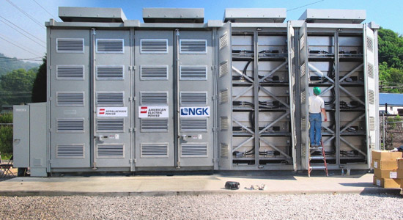
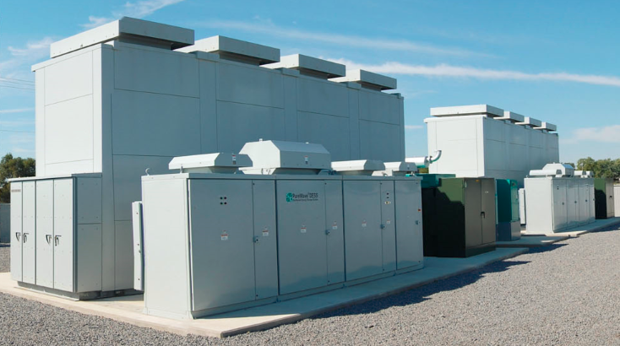
2017 First Revision Article 706
Part I. General
706.1 Scope.
This article applies to all permanently installed energy storage systems (ESS) that may be stand-alone
or interactive with other electric power production sources.

Slide 30
2017 First Revision Article 706
Part I. General
706.2 Definitions (in part)
Container
Electrochemical Battery
Energy Storage System (ESS)
Energy Storage System, Self-contained
Energy Storage System, Pre-engineered of Matched Components
Energy Storage System, Other
Flow Battery
Notes:
Terms new to the NEC and specific to ESS’s

Slide 31
2017 First Revision Article 706
Part I. General
706.4 System Classification.
706.5 Equipment.
Permits either listed parts intended for the application as a part of an energy storage system or prepackaged self-contained systems listed for the intended application
706.7 Disconnecting Means.
Shall be provided for all ungrounded conductors, shall be readily accessible and located within sight of the ESS
706.8 Connection to Other Energy Sources.
706.10 Energy Storage System Locations.
706.11 Directory.

Slide 32
2017 First Revision Article 706
Part II. Circuit Requirements
706.20 Circuit Sizing and Current.
Identifies how the maximum current shall be calculated
706.21 Overcurrent Protection.
Requires that OCPD in dc circuits shall be listed and shall have the appropriate voltage, current, and interrupting ratings and that a listed, current-limiting, OCPD shall be installed in each dc output circuit adjacent to the ESS.
706.23 Charge Control.

Slide 33
2017 First Revision Article 706
Part III. Electrochemical Energy Storage Systems
Applies to ESSs that are comprised of sealed and non-sealed cells or batteries or system modules that are comprised of multiple sealed cells or batteries.
706.30 Installation of Batteries.
706.31 Battery and Cell Terminations.
706.32 Battery Interconnections.
Permits limited use of flexible cables as identified in Article 400 in sizes 2/0 AWG and larger. Such cables shall be listed and identified as moisture resistant.
706.33 Accessibility.
The terminals shall be readily accessible for readings, inspection, and
cleaning where required by the equipment design.
706.34 Battery Locations.

Slide 34
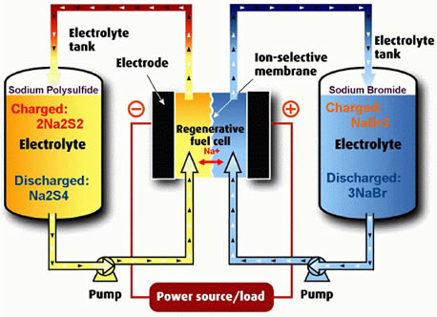
2017 First Revision Article 706
Part IV. Flow Battery Energy Storage Systems
706.41 Electrolyte Classification.
Requires that the type of electrolyte(s) acceptable for use with the ESS shall be identified by name and chemical composition. The identification shall be provided by readily discernable signage adjacent to every location in the system where the electrolyte can be added or removed.
706.42 Electrolyte Containment.
Requires that flow battery systems
shall be provided with a means for
electrolyte containment and an alarm
system to signal an electrolyte leaks.
Notes:
Flow batteries were invented by US utilities specifically to provide MW-scale storage capacity beyond the geographic constraints of hydroelectric facilities. Significant US industry and DOE investment over the past 40 years has led to a mature understanding of the advantages and limitations of available chemistries, as well as more recent breakthroughs in performance and thermal tolerance. With the recent advances in these areas, flow batteries may be commercially deployable in the US within the next few years.

Slide 35
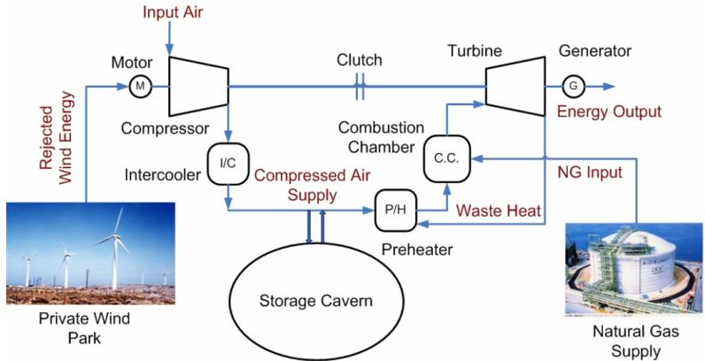
2017 First Revision Article 706
Part V. Other Energy Storage Technologies
706.50 General.
Notes:
Compressed Air Energy Storage (CAES) involves compressing air in an underground cavern or other chamber during the evening – when electricity demand is lower – and releasing it during the day, when the need for electricity is greater.

Slide 36
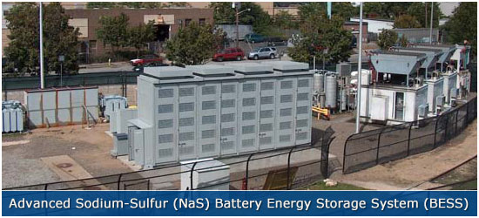
Future battery technologies
While Lithium-ion is the primary driver for today’s battery technology, new battery innovations continue:
Lithium polymer batteries continue to be deployed
Molten salt (e.g. NaS)
and flow battery
technologies will continue
to be used in more large
scale applications
Metal-air technology is being worked toward commercialization; still managing safety risks
Argonne National Lab is working on the “Manhattan Project” for reinventing battery technology
UL’s technical team is extremely active in leading battery safety science.
Notes:
Lithium polymer batteries have the lithium-salt electrolyte not held in an organic solvent but in a solid polymer composite such as polyethylene oxide or polyacrylonitrile; they offer different shapes and packaging options like pouch cells, but has some challenges in degradation rates compared to lithium ion.
Sodium sulfur used in about 200 sites, in Japan, Germany, France, US for peak shaving. Operates at about 300C, efficient
Flow batteries use external tanks of electrolytes pumped through the cell
Metal-air batteries use a connection to ambient air as a cathode, using the oxygen; reactivity of the lithium anode with air and humidity is an issue.

Slide 37
Proposed Fire Code Changes – 2018 IFC and in 2018 NFPA 1
Active ICC Fire-Code Action Committee on Battery/ESS drafting proposed update to Section 608 Stationary Battery Storage Systems:
Adding requirements for new chemistries/technologies
Requirements for permits and inspection – reference to NEC
Addressing requirements for hazard mitigation analysis
Requirements on locations within buildings
Requirements for structural and seismic protection
Requirements for listing and labeling
Requirements for safety signage
Requirements for fire detection and suppression
Requirements for ventilation and thermal runaway protection

Slide 38
Summary
Energy storage systems will continue to be deployed into the infrastructure (Utility and Consumer) at increasing rates
Battery technology continues to evolve, but in the near term lithium-ion products will be most prevalent
The technical and Code community must continue to work together to proactively address these issues
UL will continue its efforts in safety science to enable a safe and sustainable energy storage infrastructure

Slide 39
THANK YOU.

