Slide 1
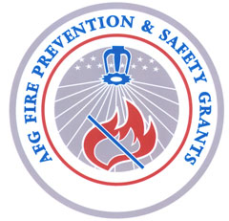
Community Risk Reduction (CRR) for Fire Department Leaders

Slide 2
Community Risk Reduction
Part I: Introduction

Slide 3
CRR - Introduction
Definition – Community Risk Reduction (CRR)
An approach for fulfilling the mission of the fire department through strategies designed and implemented at the community level that target and reduce key risks of that particular community.

Slide 4
CRR - Introduction
Characteristics of CRR
Proactive
Systematic
Prevention-oriented
Community-based (ideally fire station-based)
Data-driven
Effective
Responsive to resource constraints (efficient)

Slide 5
CRR - Introduction
6 Steps of the CRR Approach
Identify Risks
Prioritize Risks
Develop Strategies & Tactics to Mitigate Risks
Prepare the CRR Plan
Implement the CRR Plan
Monitor, Evaluate, & Modify Plan as Needed

Slide 6
CRR - Introduction
ACTIVITY 1: Participant Introductions
Introduce yourself & report 2 items about yourself:
1. What is your #1 responsibility as a fire officer? OR:
What is your responsibility in meeting the mission
of your organization?
2. What is your experience with CRR?

Slide 7
CRR -Introduction
History of CRR:
CRR is not a new concept
Implemented in UK, AU, & NZ for several years now with much success
Also been done in the US – although sporadically and on a much smaller scale.

Slide 8
CRR - Introduction
Great Example of CRR at work: Merseyside Fire & Rescue, UK
Merseyside has been doing CRR for X years now (called IRM there)
Nationally mandated for the last X years
Strategy includes home visits and referrals to other health and social services.
Experiencing 40% reduction in fire loss???

Slide 9
CRR – Introduction
ACTIVITY 2:
Merseyside Fire and Rescue, Video

Slide 10
Community Risk Reduction
Participant Exercise Instructions #
Britain Case Study
Split into groups
Take 10 minutes to read the case study and answer the questions assigned
Report back to class by reading your assigned question and briefly providing your answer.

Slide 11
Community Risk Reduction
II. CRR Lesson Goals & Objectives

Slide 12
CRR – Lesson Goals & Objectives
Lesson GOALs:
introduce CRR as a strategy for fire departments
introduce how to prepare a CRR station plan
develop positive attitudes about CRR
motivate audience to learn more about CRR
Target Audience:
Fire officers and chief officers in the fire and emergency response community with little or no knowledge of community risk management.

Slide 13
CRR – Lesson Goals & Objectives
10 Objectives
Upon completion of lesson, you will be able to:
1. Define community risk reduction
2. List the factors that influence residential fire risk
3. Identify common fire department functions that contribute to reducing community risk
4. Describe the 5 types of strategies for reducing /mitigating community risk

Slide 14
CRR – Lesson Goals & Objectives
Instructional Objectives Con’t.
5. List 4 sources of data to assess risk for community risk reduction
6. List 4 potential community risk reduction partners
7. Describe the fire officer's role in community risk reduction

Slide 15
CRR – Lesson Goals & Objectives
Instructional Objectives Con’t:
8. Identify the 6 steps of CRR
9. List 3 sources for learning more about community risk reduction
10. Given a CRR case study, identify the:
benefits of the CRR strategy
key steps of the strategy
people involved in implementing the strategy
who is responsible for each step

Slide 16
Community Risk Reduction
III. CRR Terminology

Slide 17
CRR – Terminology
Key Terms:
Prevention
Risk
Loss
Mitigation

Slide 18
CRR - Terminology
“Prevention”
Definition
Bring to an end
Keep an event from occurring
Synonyms:
Avoid, Deter Anticipate Hinder
Impede Thwart Halt

Slide 19
CRR - Terminology
“Risk”
Definition
Danger, hazard, and a popular board game (now a pricey Ap for iPhone and iPad!)

Slide 20
CRR - Terminology
“Loss”
Defintion
Death, injury, property damage, or other adverse or unwelcome circumstances.

Slide 21
CRR -Terminology
“Mitigation”
Definition:
Reduce impact of event
The effort to reduce loss of life & property by lessening the impact of natural & human caused disasters/events
Make less severe, serious, or painful
Synonyms:
Alleviate Reduce Ease Lessen harm of event
A mitigated risk is a diminished risk. This means the risk has been reduced.

Slide 22
CRR Terminology - Mitigation
Example
Residents living in an area with many wildfires are advised to:
make their home’s fire resistance
consider the topography of their property
eliminate or reduce vegetation close by the home
These actions won’t prevent a wildfire but they will reduce the impact

Slide 23
Community Risk Reduction
IV. Identifying and Prioritizing Risks

Slide 24
CRR – Identifying & Prioritizing Risk
Each community faces a variety of risks:
Some Examples
Residential Fires Wildland fires Arson Falls Motor Vehicle/traffic accidents Inadequately managed social and health conditions | Drownings Pedestrian accidents Bicycle & skateboard accidents Firearms Suffocation Poisoning Struck by or against

Slide 25
CRR – Identifying & Prioritizing Risk
What are the risks in your particular area?
Using data from your fire/EMS calls and incident reports – as well as experience - what seem to be the major risks experienced in your area?

Slide 26
CRR – Identifying & Prioritizing Risk
Example – Wilmington NC
Data of residential fires & home fire deaths 2003-2009 data were highlighted with GIS mapping to show “hot spots”

Slide 27
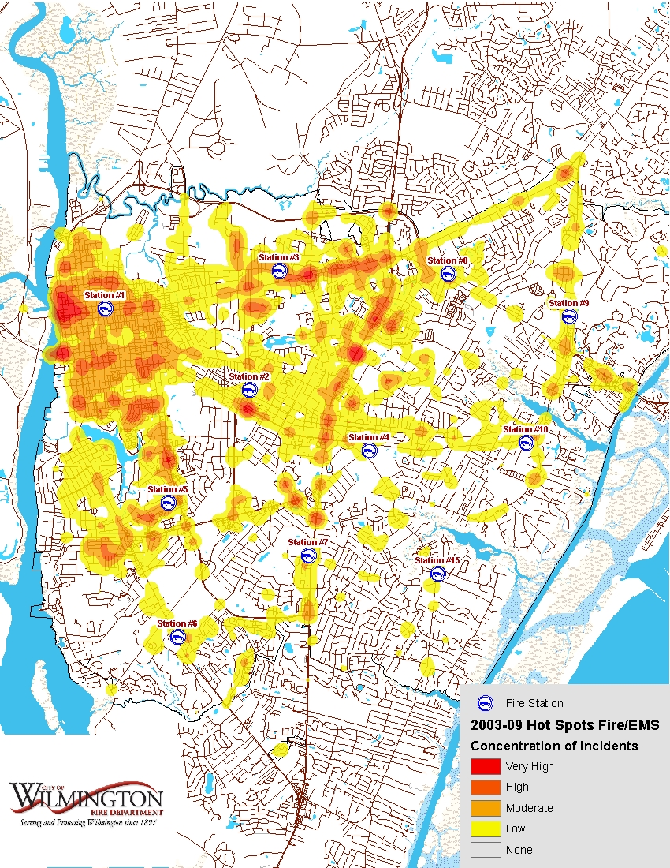
CRR Risk… Wilmington
Question:
Which Stations are in higher risk areas?

Slide 28
CRR Risk… Wilmington
Answer:
Stations #1, #3, #4, #5, & #8
You can tell by the concentration of reds/oranges.

Slide 29
CRR - Risk
Identified 5 stations with higher fire/EMS risk. Now need to find out:
the type of risk
what causes it
who’s affected
which can vary by station.
Even stations nearest each other can face very different community risks.

Slide 30
CRR – Identifying and Prioritizing Risks
Demographic characteristics of those at increased risk:
Low Income (poverty)
Low Education (lack of a high school education)
People Who Smoke
Low or High Population Density (rural and very urban)
Young children (4 and under)
Older Adults (65+ risk increases greatly with age)
African American, Native American (and other minorities ?)
People with Disabilities
U.S. Unintentional Fire Death Rates by State, Sept. 2007, National Fire Protection Association
Centers for Disease Control and Prevention

Slide 31
CRR – Identifying and Prioritizing Risks
So…Some Needed Demographic Data:
% at or below Federal Poverty Level
% with High School Education
% Children < 5
% Adults > 64
% Nonwhite
% African American
% Native American
% Hispanic
% Disabled

Slide 32
CRR – Identifying and Prioritizing Risks
To get demographic data:
Determine the zip codes for each station
Go to American FactFinder at http://www.census.gov/
Plug in each zip code into FactFinder and record data for each desired indicator
Add percents across all zip codes within station’s jurisdiction and divide by number of zip codes in that jurisdiction to come up with average percents.

Slide 33
CRR – Identifying and Prioritizing Risks
http://www.census.gov/
American FactFinder
Search by City, County, or Zip Code
City/town,
County, or zip
State
- - select a state - -
GO
Or select a state using a map

Slide 34
CRR- Identifying Risks
More poverty
American FactFinder
Get a Fact Sheet for your
City/town,
County, or zip
Compare Your Station’s Risk Factors with Dept./City Averages
Station City
Poverty 21.3% 14.3%
HS Education 63% 80%
Disabilities 32% 20%
- - select a state - -
GO
Fewer adults with HS Educ
more disabilities

Slide 35
CRR – Identifying Risks
Other sources of Info/Data:
Community Planning – predictions for population, business, industry, annexation for growth or decline
Community Development – not for profit or government agencies providing programs & services to assist residents
Other Municipal Sources – Housing office/bureau, public health, social services, neighborhood centers, parks and recreation depts,

Slide 36
CRR – Identifying & Prioritizing Risks
Prioritizing Risk
Think about the probability of an event occurring and its potential consequence/impact
Solicit input from firefighters, inspectors, investigators, community partners
Consider assigning weights and probabilities to come up with a scoring method for prioritizing risks

Slide 37
CRR - Risks
“The more we know about which groups are at greatest risk and under what circumstances, the more effective we can be at targeting resources and developing the means to mitigate these risks.”
U.S. Unintentional Fire Death Rates by State John R. Hall, Jr., May 2010.

Slide 38
Community Risk Reduction
IV. Prevention/Mitigation
Strategies

Slide 39
CRR- Strategies
5 Types of Prevention Strategies (“the 5 E’s”)
Education
Engineering
Enforcement
Economic Incentive
Emergency Response

Slide 40
CRR – Strategies
Education
Education raises awareness and knowledge of fire safety, and is the first step of producing desired low-risk behavior.

Slide 41
CRR- Strategies
Engineering – New products/technology
Modifying the product or the environment to prevent or mitigate injury.
Examples:
- CFCI ??? - Child Passenger Seats
- Cribs - Bicycle Helmets
- Sprinklers - Smoke Alarms
- Construction design
- Double wall chimney flues

Slide 42
CRR - Strategies
Enforcement
Reduce dangerous behaviors through legislation and its enforcement. Legislation can target behaviors by individuals, businesses, and local governments. Typically done through inspections with penalties for non compliance.
Examples:
Selling tobacco or alcohol to minors
Fire Sprinklers in hotels and motels
Smoke alarms in new construction
Emergency Exit signs in places where people assemble

Slide 43
CRR - Strategies
Economic Incentives
Economic incentives, usually involve money, are offered to encourage people to make certain choices or behave in a certain way.
Examples: Taxes, fines, fees, vouchers, discounts

Slide 44
CRR - Strategies
Emergency Response
Effective emergency response can mitigate the loss of an unintentional injury.
Examples:
Appropriate Equipment
Trained Responders
Timing of Response
Type of Response

Slide 45
CRR – Strategies
Some Strategies Fit Multiple E’s
Example: Seat belts
Education: Campaigns to educate the public on how use can save lives
Engineering: Technology of lap and cross chest seat belts
Enforcement – Manufacturers required to include in all automobiles, Penalties for non use

Slide 46
CRR- Strategies
ACTIVITY 3:
Participant Exercise – Using Scenarios to enhance understanding of the 5 types of Strategies

Slide 47
CRR- Strategies
Instructor Example???:
MGM Grand fire, Las Vegas, Nov 1980
Losses:
85 deaths
650 injuries
$106M in property
Proposed prevention/mitigation strategies:
Engineering - installation of sprinklers
Enforcement - mandating sprinkler installation in large new construction projects.

Slide 48
CRR –Strategies
Another Instructor Example
Daycare Fire, Houston – 2/24/11
Losses: 4 deaths, 3 injuries
Strategies: None
Daycare Fire – Phoenix – 2/25/01
Losses: 0 deaths, 0 injuries
Strategies:
Engineering – had sprinklers
Education: Knew what to do in event of emergency. Waited safely at store next door for firefighters to clean up water

Slide 49
CRR – Strategies
Participant Exercise Instructions:
Take 3-5 minutes to read scenario
Discuss how to mitigate risk using at least 2 E strategies
Report back to class the risk/loss scenario, the Es using, and the particular strategy chosen

Slide 50
CRR – Strategies
A best practice CRR strategy:
Home Visits– targeting hard to reach households.
Opportunity to:
Educate resident about fire safety, smoke alarm testing & maintenance, and escape planning & practicing
Test existing alarms and install new ones as needed
Enhance the positive relationship between residents and the fire service

Slide 51
Community Risk Reduction
VI. Developing a CRR Plan

Slide 52
CRR - Plan
Purpose of a CRR Plan:
Systematically walks you through the CRR process which enhances your ability to manage risk
Empowers and engages staff
Serves as a vision and a guide for action for at least one year
Documents risk findings and selected strategies and how/why they were selected

Slide 53
CRR - Plan
Who prepares the plan?
Varies by department/locale. May involve Central Department , Station- level, community partner(s), and/or other agencies’ staff.
Examples:
Vancouver WA: Station-level staff with data analysis by Central Department staff
Tucson AZ: Community Partner
Dallas TX: Central Prevention Office staff with data analysis by the Injury Prevention Center

Slide 54
CRR - Plan
What’s ideally in a CRR Plan?
An outline of vision, mission, values and priorities
A description of the community/service area
A discussion of the risks & ranking of their priority
An assessment of proposed strategies
A basic plan for implementing those strategies
Ideas for monitoring & evaluating activities

Slide 55
CRR - Plan
Key aspects
Takes into account local (neighborhood-level) variation
Fits into Department’s longer-term Strategic Planning
Enhances staff focus on prevention

Slide 56
CRR - Plan
The 5 Sections of the Model CRR Plan
Section 1: Vision, Mission & More
Section 2: Community/Service Area
Section 3: Risks
Section 4: Strategies
Section 5: Implementation
Section 6: Monitoring & Evaluation

Slide 57
CRR - Plan
Section 1: Vision, Mission & More
What’s in the section:
An outline of the Department’s vision, mission, & values as well as the station’s priorities.
Purpose of section:
Provides the context /foundation for risk identification and strategy development.
Helps identify where changes may be needed to create or maintain alignment.

Slide 58
CRR – Plan
Section 2: Community/Service Area
At a minimum this section:
Provides a description based on driving through the community and taking a “windshield” approach to identifying what seem to be high risk areas
Identifies areas likely to be high risk using a proxy for high risk areas based on % of children in Free and Reduced School Lunch Programs or high crime areas.

Slide 59
CRR - Plan
Community Con’t.
Ideally this section:
Provides a description of the station’s jurisdiction in terms of it’s:
People – who live and work there
Infrastructure - the buildings/homes, parks/open spaces etc
History of Fire and EMS incidence/Calls
Organizations present - Business, Associations, Community- based , Faith-based, local government clinics/centers, schools, hospitals etc

Slide 60
CRR - Plan
Community Con’t.
When possible:
Report data at the station- level
Partner with a local college/university for data collection, analysis and reporting assistance.
Use GIS technology - much easier to “see” risks.
Use data from reputable sources that is accurate, valid, reliable and complete.

Slide 61
CRR - Plan?
Community Con’t.
Purpose of section:
Facilitates learning about your community
Sets the foundation for the data-driven CRR process
Documents the critical information necessary for risk and strategy selection
Provides ideas for potential community partners

Slide 62
CRR - Plan
Section 3. Risks
What’s in this section:
Risks identified based on the community data and experiential input
Prioritization of those risks based on as assessment of probability and impact.

Slide 63
CRR - Plan
Risks Con’t.
Purpose of this section:
Walks you through the process of identifying and prioritizing risks
Documents the risks selected and why those risks were selected.
Makes it easy to share results and process with other interested parties

Slide 64
CRR - Plan
Risks Con’t.
Tips
Be inclusive about who looks at the data.
Solicit feedback/input and encourage discussion on what the risks are and their priority
If identify many risks, consider using a model or method for prioritization

Slide 65
CRR - Plan
Risks Con’t.
An easy method for prioritizing risks
Assess each risk’s probability of occurring (eg. High, Medium, Low)
Assess the seriousness of the risks impact if occurs (High Medium, Low)
Develop a grid and place each risk in the appropriate cell.
Focus first on risks that fall in the High/High cell, then second on …
Probability of Occurring | Seriousness of Impact
 |  | Low | Medium | High
 | Low | Fifth | Fourth | Fourth
 | Medium | Forth | Third | Second
 | High | Fourth | Second | First

Slide 66
CRR – Plan
Section 4. Prevention/Mitigation Strategies
What’s in this section:
At a minimum:
A list and brief description of the strategies to implement
Ideally:
Identification of possible strategies
Method of assessing strategies
Results of assessments
List and brief description of selected strategies

Slide 67
CRR - Plan
Strategies Con’t.
Purpose of this section:
Walks you through the process of brainstorming and prioritizing strategies
Documents the strategies selected and makes the case for why you chose those particular strategies.
Makes it easy to share results and process with other interested parties

Slide 68
CRR – Plan
Strategies Con’t.
Steps of the Ideal Process:
Include station-level staff, community partner(s) and other agency staff in this process
Flesh out more about each prioritized risks
Use the 5 E’s framework to brainstorm strategies
Assess strategies
Prioritize and select strategies to implement

Slide 69
CRR - Plan
Strategies Con’t.
Ideal Step 1: Involves a mix of station, department and community organization staff.
Solicit feedback/input and encourage discussion on possible strategies and the pros and cons of each
Make it clear that this work requires balancing complex demands and making hard choices about strategies to pursue

Slide 70
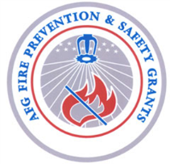
CRR – Plan
Strategies Con’t.
Ideal Step 2: For each prioritized risk, ask:
Why is it occurring?
Who is it affecting?
When is it occurring
Where is it occurring?
Answering these questions will help you brainstorm strategies to reduce that particular risk.

Slide 71
What is a CRR Plan?
Strategies Con’t.
Ideal Step 3: Use the five E’s Framework to brainstorm strategies. Ask: Could something be done in terms of E______ to help reduce the risk?
Emergency Response
Engineering
Education
Economic Incentives
Enforcement

Slide 72
What is a CRR Plan?
Strategies Con’t.
Ideal Step 4: Assess key brainstormed strategies:
Identify pros and cons for each option or identify and use assessment criteria.
Consider feasibility (financial, political, logistical, organizational, and cultural)
Assign a weight or think about the degree of importance of each key point.

Slide 73
CRR - Plan
Strategies Con’t.
Ideal Steps 5 & 6: Prioritize & Select Strategies:
Assign a weight or think about the degree of importance of each key point.
Rank Strategies
Select top strategies or ones on list have the most agreement/enthusiasm on to pursue

Slide 74
CRR – Plan
Section 5: Implementation
What’s in this section:
At a minimum
Brief identification of resources likely to be required – FTEs, Supplies, Materials
Ideally
Resource needs (detailed staff, supplies, equipment)
Timeline of tasks, who is involved, and who’s responsible, start and end dates.
Timeline includes development of training, communication materials, and data collection, storage & reporting

Slide 75
CRR - Plan
Implementation Con’t
Purpose of this section
Makes you think through and plan how to best implement the strategies
Lets you know what needs to be done by when so you can keep on task and be successful
Enables you to think more about the resources /costs required

Slide 76
CRR - Plan
Section 6: Monitoring & Evaluation
Ideally:
Define what success would look like
Identify key process/output measures that can be readily collected and used to track progress
Identify key outcome measures
Minimally:
Think about how you can track and record activity
Think about what you would expect if this effort were successful

Slide 77
CRR - Plan
Monitoring & Evaluation Con’t.
ALL: Commit to:
Incorporate lessons learned into the next activity cycle
Share successes with staff and community at large
Build on, expand, and/or try to sustain what works

Slide 78
CRR – Plan
Monitoring and Evaluation Con’t.
Purpose of this section:
Enable you to improve your service through timely problem identification and adjustment
Help you develop useful data collection tools, processes & systems
Allow you to determine if are really achieving what you set out to achieve
Document what you accomplished/show your value/success

Slide 79
CRR – Plan
Monitoring & Evaluation Con’t.
Ideal Step 1: Define Success – Some Examples:
For a Home Visit Program:
More high risk households would have smoke alarm protection which would reduce their risk of fire-related injuries, death and loss. They would also know more about preventing fire and what to do in the event of a fire.
For a Social and Health Referral System:
More high risk residents would be hooked up with needed social and health services so they would be less dependent on the FD for acute care and would turn to more appropriate providers for service.

Slide 80
CRR - Plan
Monitoring & Evaluation Con’t.
Ideal Step 2: Identify Outcome Measures:
Definition: Measures that let you know if you achieved your goal. Often long-term, may take years to see true impact.
Examples:
Reduction in residential fires per 1000 citizens
Reduction in fire fatalities per 1000 citizens
Reduction in estimated property loss per 1000 citizens

Slide 81
CRR – Plan
Monitoring & Evaluation Con’t.
Ideal Step 3: Process measures
Definition: Measure performance of the process on the assumption that if the process goes well the desired outcomes will be achieved. Measures may be milestones/steps to the goal or tracking activity,
Examples
Number of Homes visited
Number of Alarms Installed
Identification of Target area
Preparation of flyer in 3 languages

Slide 82
CRR - Plan
Summary of CRR Plans
What’s the same across all CRR planning:
Focuses locally – at the neighborhood level
Determines what is going to be done and why
Seeks to reduce fire and EMS risk
What varies across CRR planning:
Content –ability to include all model sections
Level of sophistication reg. steps in each section
Who’s involved in the planning

Slide 83
Community Risk Reduction
VI. Implementation

Slide 84
CRR -Implementation
Key Elements of Implemention:
Identify & allocate/purchase necessary resources
Identify, develop & arrange for any necessary training
Identify, develop & arrange for the distribution of communication materials
Keep on schedule
Remember to revise plan as needed – be open to continuous improvement

Slide 85
Community Risk Reduction
Activities 4 & 5: Participant Exercises – Putting it all together

Slide 86
The Benefits of Community Risk Reduction
Exercise #4 Instructions:
1. Break up into groups
2. Read the case study
3. Complete the Participant Case Study Worksheet
4. Work as a team to “sell” the CRR strategies to the person/group randomly selected.
5. Present your persuasive presentation to the class. You have 3 minutes.

Slide 87
Community Risk Reduction – GO!
Exercise #5 Instructions
Stay in the same group
Read the SCENARIO
List information/data needed
Identify (potential?) community partners
How would you measure outcomes?

Slide 88
Community Risk Reduction
IX. So you want to know more?

Slide 89
CRR - Resources
Resources to turn to
Tridata Reports
Vision 20/29 Website with Case Studies
NFA Courses
Other?

Slide 90
CRR - Resources
US Fire Departments already doing some CRR:
Chicago, IL - ???
Dallas, TX – partnership with Injury Prevention Center
Madison, WI –??
Oklahoma City, OK
Philidelphia, PA - ??
Tualapin?? Valley, OR -??
Tucson, AZ – community partner CRR program
Vancouver, WA – station based CRR
Wilmington, NC – pilot station based CRR

Slide 91
Community Risk Reduction
Conclusion
“Any person who is at all conversant with fire safety knows that at least 85% of [fires] could be prevented. It is the duty of the Fire Chief to assume leadership… he must be up and doing and prevent fires from starting, if he is to be successful in reducing the loss.”
Chief W. D. Brosnan of Albany, Georgia,
First Annual Meeting, Southeastern Association of Fire Chiefs
1928

Slide 92
Community Risk Reduction
Let each of us be UP and DOING – Community Risk Reduction and preventing loss…

Slide 93
Community Risk Reduction
The End

